Slide 1
CompTIA Sec +

Slide 2
Domain 03: Security Architecture

Slide 3

Compare and contrast security implications of different
architecture models to evaluate their effectiveness in various
scenarios
Apply security principles to secure enterprise infrastructure by
implementing best practices and methodologies
Compare and contrast concepts and strategies to protect data,
ensuring optimal safeguarding of sensitive information
Understand the importance of resilience and recovery in security
architecture to maintain operational stability and business
continuity
Notes:
Trainer Notes:
Summarize the points given on the slide and set an expectation about learning these pointers in this lesson.

Slide 4
Security Implications of Different Architecture Models

Slide 5

What Is Security Architecture?
Security architecture is a critical component of an organization's information security strategy. It serves as a blueprint to safeguard data, applications, and systems from cyber threats.
Core aspects:
Principles and processes: Outlining the fundamental methods and procedures that form the foundation of security operations
Technologies: Describing the tools and technologies that protect against cyberattacks, ensuring data and application safety
Protection mechanisms: Focusing on the specific controls that preserve the integrity of an organization’s systems
Notes:
Explain What is Security Architecture and why it is important
Security architecture is like a blueprint for an organization’s information security strategy. It defines the principles, processes, and technologies that protect the organization's data, applications, and systems from cyberattacks.
Security architecture focuses on designing a comprehensive security system that aligns with your organization's needs and risk profile. It considers your business goals, the type of data you handle, and the potential threats you face.

Slide 6
Securing the Network
Network security is essential for safeguarding an organization's data and resources. A comprehensive, multi-layered strategy is implemented to ensure robust protection, incorporating the following key technologies:
Firewalls
Monitor and filter network traffic, acting as barriers based on predefined rules
Access
control lists
Specify which users or system processes are granted access to certain resources
Intrusion
detection systems
Detect and report potential threats in real time
Intrusion prevention systems
Block and prevent identified threats
Security information and event management
Collects and analyzes data from various sources to identify and correlate security events, providing real-time alerts
Notes:
Trainer Notes:
Explain why the security of the network is important.
Network security is vital for protecting data and resources within an organization.
Networks often hold sensitive information, like financial records, personal documents, and login credentials. Strong network security safeguards this data from unauthorized access, theft, or leakage.
It involves using a firewall, IPS/IDS, end point security, VPN, and access control and monitoring tool

Slide 7

Securing the Servers
Securing servers is crucial for protecting sensitive data and maintaining overall system health. Implement these key practices to ensure robust server security:
Access controls and host firewalls: Protect servers using strict access controls, host-based firewalls, and consistent hardening procedures
Regular patching: Maintain security and functionality through regular software and system patching
Frequent backups and monitoring: Ensure data integrity with regular backups and implement thorough logging and monitoring mechanisms
Employee education: Enhance security by educating employees on best practices, including password hygiene and phishing awareness
Notes:
Trainer Notes:
Explain Why the Security of the Server is important
Server security is vital for several reasons
Servers store critical information, like financial records, customer data, and intellectual property.
Businesses rely on servers to run essential services like email and websites.
Server security protects data accuracy and completeness. It prevents unauthorized modifications or tampering that could lead to incorrect information and poor decision-making.
Data breaches and security incidents can severely damage a company's reputation. Robust server security minimizes these risks and builds trust with clients by demonstrating a commitment to data protection.
Servers can be protected using access controls, implementing host firewalls, regular hardening, patching and backup.
Also educate employees at regular interval

Slide 8

Securing the Hosts
Securing individual devices, also known as hosts, on your network is a critical layer of defense in an overall network security strategy. To protect these devices effectively:
Endpoint security solutions
Use antivirus software, endpoint detection and response tools, and mobile device management systems to guard against malware and unauthorized access.
Multifactor authentication
Enhance security with multiple forms of verification to protect against unauthorized entry
Notes:
Trainer Notes:
Explain the importance of Securing the hosts
Securing individual devices, also known as hosts, on your network is a critical layer of defense in an overall network security strategy
Servers can be protected by updating and patching regularly.
Apply Strong password Policies
Implement Multifactor Authentication
Follow the principle of least privilege.
Install and maintain reputable antivirus and anti-malware software on all hosts

Slide 9
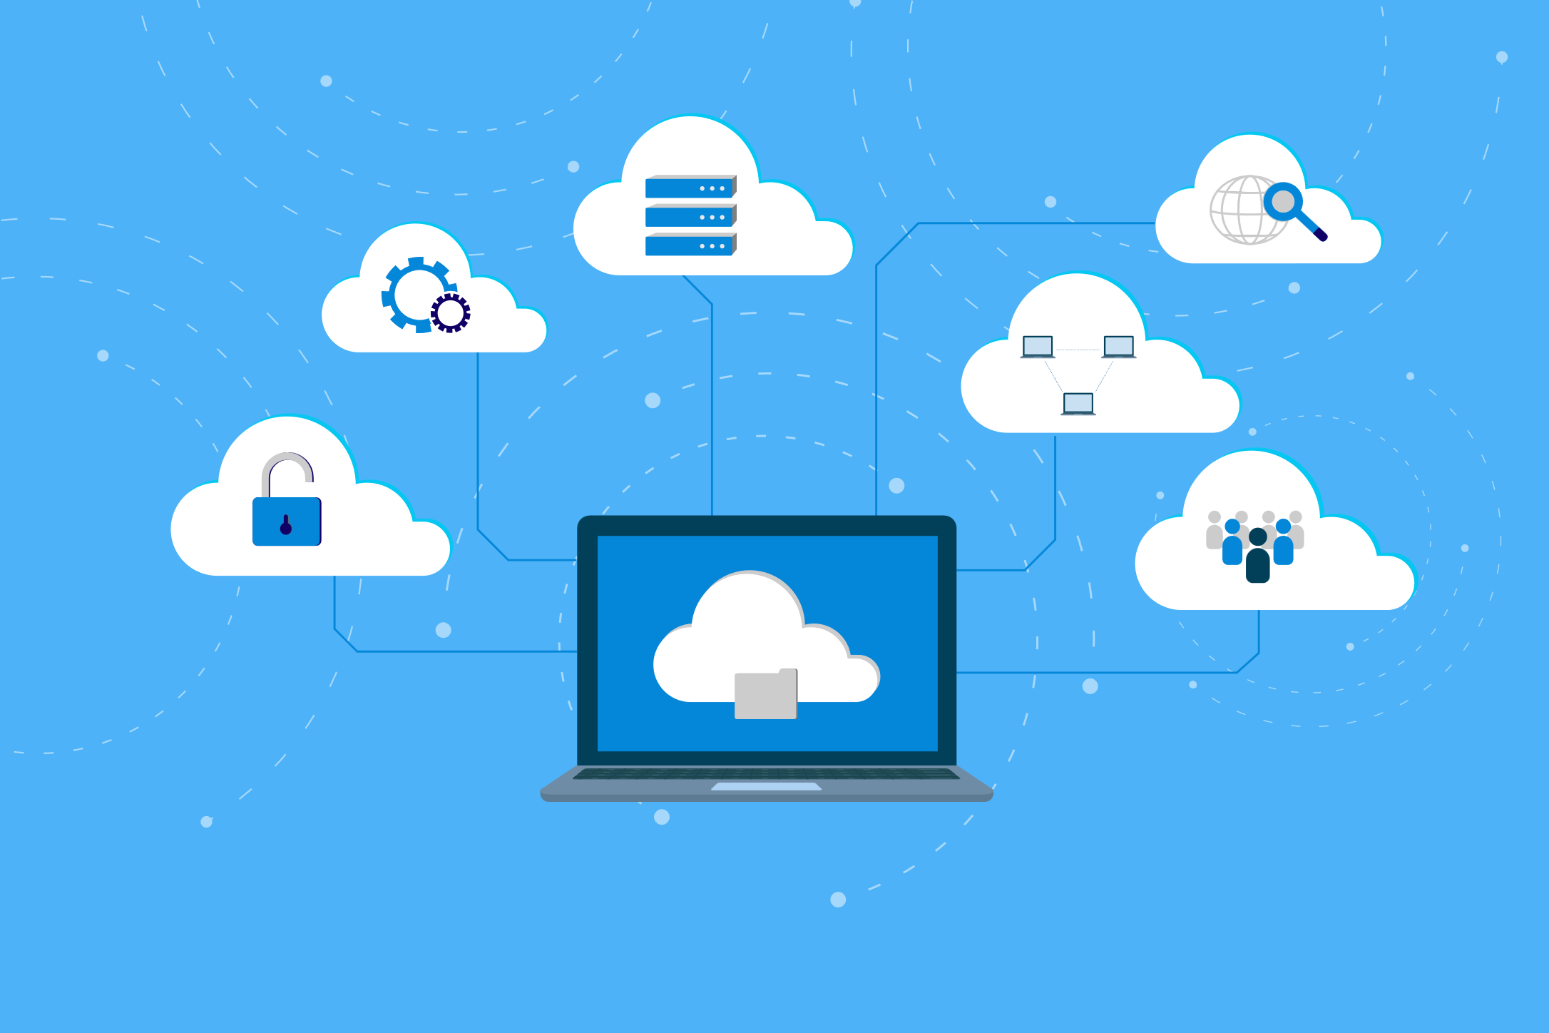
Cloud Computing
Cloud computing leverages the internet to share and utilize computing resources remotely. This approach includes:
Resource sharing
Utilizes the internet to distribute computing resources efficiently
Remote servers
Employ servers on the internet to store, manage, and process data, eliminating the need for local servers or personal computers
Notes:
Trainer Notes:
Explain what is Cloud Computing
Cloud computing is the on-demand delivery of computing resources over the internet. Instead of managing your own physical servers and data centres, you can access a variety of IT services – like storage, computing power, databases, and software – from a cloud provider like Amazon Web Services (AWS), Microsoft Azure, or Google Cloud Platform
Cloud computing is a type of computing that depends on sharing computing resources over the internet.
It uses remote servers on the internet to store, manage, and process your data rather than your local server or computer.

Slide 10
Cloud Computing Models
NIST 800-145 outlines six essential characteristics of cloud computing:
Broad network
access
Rapid elasticity
Measured service
On-demand
self-service
Resource pooling
Multitenancy
Public
Private
Hybrid
Community
Notes:
Trainer Notes:
Explain cloud computing models.
The above model is NIST 800-145
Below is the definition of Cloud as per NIST 800-145
Cloud Computing Definition: It defines cloud computing as a service model for enabling on-demand network access to a shared pool of configurable computing resources (servers, storage, networks, applications, and services) that can be rapidly provisioned and released with minimal management effort or service provider interaction.
Essential Characteristics: NIST 800-145 outlines five essential characteristics of cloud computing:
On-demand self-service: Users can unilaterally provision and configure computing resources without needing to interact with the service provider.
Broad network access: Cloud resources are accessible over the network from various devices and locations.
Resource pooling: The provider's computing resources are pooled to serve multiple consumers with dynamic allocation based on demand.
Rapid elasticity: Cloud resources can be rapidly provisioned and released, enabling users to scale up or down quickly.
Measured service: Cloud systems automatically control and optimize resource use with metering at some level of abstraction (e.g., storage, processing, bandwidth, network traffic).

Slide 11
Cloud Computing: Characteristics
Cloud computing offers several key characteristics that enhance its functionality and efficiency.
On-demand
access
The provider abstracts resources and collects them in a pool, portions of which can be allocated to different consumers based on policies. Key benefits include: Optimized resource usage
Flexibility in resource allocation
Cost savings through shared resources
Resource pooling
Multitenancy
Measured services
Rapid elasticity
Broad network access
Notes:
Trainer Notes:
Explain Resource Pooling
In cloud computing, resource pooling refers to combining a large pool of computing resources (like processing power, storage, memory, and network bandwidth) from multiple physical servers. These resources are not dedicated to any single user but instead dynamically allocated to various users based on their needs.
Think of it like a Utility Grid:
Imagine a power grid supplying electricity to a city. Residents don't have their own personal generators; they all tap into the shared grid. Similarly, cloud providers create a "grid" of resources, and users access what they need when they need it.

Slide 12
Cloud Computing: Characteristics
Rapid elasticity refers to the ability of a cloud service to scale resources quickly and easily to meet fluctuating demands.
On-demand
access
Key benefits:
Scalability: Scale resources up or down as needed
Efficiency: Optimize resource utilization
Automation: Automate provisioning and de-provisioning
Cost-effectiveness: Minimize costs by using resources only when needed
Performance: Ensure consistent performance with dynamic adjustments
Resource pooling
Multitenancy
Measured services
Rapid elasticity
Broad network access
Notes:
Trainer Notes:
Explain Rapid Elasticity
In cloud computing, rapid elasticity refers to the ability of a cloud service to scale resources up or down quickly and easily to meet fluctuating demands. It's one of the key characteristics of cloud computing that differentiates it from traditional IT infrastructure.
Imagine you run an e-commerce website. During peak sales seasons, you experience a surge in traffic, requiring more processing power and storage to handle the increased load. With rapid elasticity, your cloud resources can automatically scale up to meet this demand. Conversely, during slower periods, you can scale down resources to avoid paying for unused capacity. This on-demand provisioning allows for optimal resource utilization and cost efficiency.

Slide 13
Cloud Computing: Characteristics
In broad network access, all resources are available over a network, without any need for direct physical access.
On-demand
access
Key benefits:
Accessibility: Access resources from anywhere
Compatibility: Use various devices to connect
Convenience: No physical proximity needed
Scalability: Connect more users and devices easily
Efficiency: Improve productivity with remote access
Resource pooling
Multitenancy
Measured services
Rapid elasticity
Broad network access
Notes:
Trainer Notes:
Explain Broad Network Access
In cloud computing, broad network access refers to accessing cloud resources from various devices and locations over a network, typically the Internet. This characteristic is essential for the flexibility and convenience that cloud computing offers.
Cloud computing liberates you from physical constraints. You can access resources like storage, applications, and services from virtually anywhere with an internet connection, eliminating the need to be physically present in an office or tethered to a specific device.
Cloud services can be accessed from various devices, including laptops, desktops, tablets, smartphones, and even thin clients

Slide 14
Cloud Computing: Characteristics
In measured services, customers are charged for the actual volume of cloud resources they have consumed.
On-demand
access
Key benefits:
Transparency: Clear understanding of usage
Cost control: Payment only for used resources
Efficiency: Optimized resource allocation
Monitoring: Real-time usage tracking
Budgeting: Prediction and management of costs
Resource pooling
Multitenancy
Measured services
Rapid elasticity
Broad network access
Notes:
Trainer Notes:
Explain Measured Service
In cloud computing, measured services refer to the practice of meticulously monitoring and billing users based on their actual usage of cloud resources. It's a pay-as-you-go model that contrasts with traditional fixed-cost IT infrastructure
Imagine paying for electricity only for the amount you consume, not a flat monthly rate regardless of usage. Measured services in the cloud function similarly. Cloud providers employ metering tools to constantly track your consumption of various resources like storage space, processing power, network bandwidth, and even active user accounts in SaaS (Software as a Service).

Slide 15
Cloud Computing: Characteristics
Multitenancy is an architectural approach where a single physical infrastructure or software application serves multiple customers
On-demand
access
Key benefits:
Resource sharing: Efficient use of resources because of multiple tenants
Cost savings: Reduced cost through shared infrastructure
Isolation: Secure separation of data and applications for each tenant
Scalability: Scaling to accommodate more tenants
Maintenance: Simplified management and updates
Resource pooling
Multitenancy
Measured services
Rapid elasticity
Broad network access
Notes:
Trainer Notes:
Explain Multitenancy
multitenancy is an architectural approach where a single physical infrastructure or software application serves multiple customers (tenants). These tenants share the underlying resources but are logically isolated from each other. This model allows cloud providers to offer cost-effective and scalable services to a large user base.
Imagine a large apartment building. The building's infrastructure (foundation, plumbing, electricity) is shared by all residents (tenants). However, each apartment unit is self-contained, with private walls, doors, and utilities. Similarly, in multitenant cloud computing, the core infrastructure is shared, but each tenant's data and applications are secured and isolated from others.

Slide 16
Cloud Computing: Characteristics
On-demand access allows consumers to access computing resources over the internet as and when needed.
On-demand
access
Key benefits:
Self-service: Consumer-managed resources
Independence: No need for a human administrator
Speed: Instant provisioning of resources
Flexibility: Resources adjusted based on current needs
Control: Full control over resource management
Resource pooling
Multitenancy
Measured services
Rapid elasticity
Broad network access
Notes:
Trainer Notes:
Explain On demand Access
In cloud computing, on-demand access refers to the ability to access computing resources like storage, processing power, servers, databases, and applications as you need them, over the internet. This eliminates the need for you to manage your own physical infrastructure or pre-purchase resources. Here's a breakdown of on-demand access in cloud computing:
Think of it like Utility Services:
Imagine utilities like electricity or water. You don't need to generate your own power or have a personal water well. Instead, you access these resources on-demand through a provider, paying only for what you use. Cloud computing functions similarly. You access resources from a vast pool maintained by the cloud provider, and you only pay for what you consume.

Slide 17

Cloud Computing Deployment Models
The four main types of cloud deployment models:
Public
Private
Hybrid
Community
Notes:
Service Models: NIST 800-145 defines three basic cloud service models:
SaaS (Software as a Service): Customers access and use software applications over the internet, eliminating the need to install and maintain the software on their own devices.
PaaS (Platform as a Service): Provides a platform for developing, deploying, and managing applications without needing to manage the underlying infrastructure (servers, storage, operating systems).
IaaS (Infrastructure as a Service): Offers on-demand access to fundamental computing resources like servers, storage, and networks. Users have control over the operating system and deployed applications.
Deployment Models: NIST 800-145 also identifies four deployment models for cloud services:
Public Cloud: The cloud infrastructure is owned and operated by a cloud service provider and available to any subscribing customer.
Private Cloud: The cloud infrastructure is operated for the exclusive use of a single organization.
Community Cloud: Shared by several organizations with common interests (e.g., security, compliance, regulatory requirements)
Hybrid Cloud: Combines elements of two or more of the other deployment models (public, private, and community).

Slide 18

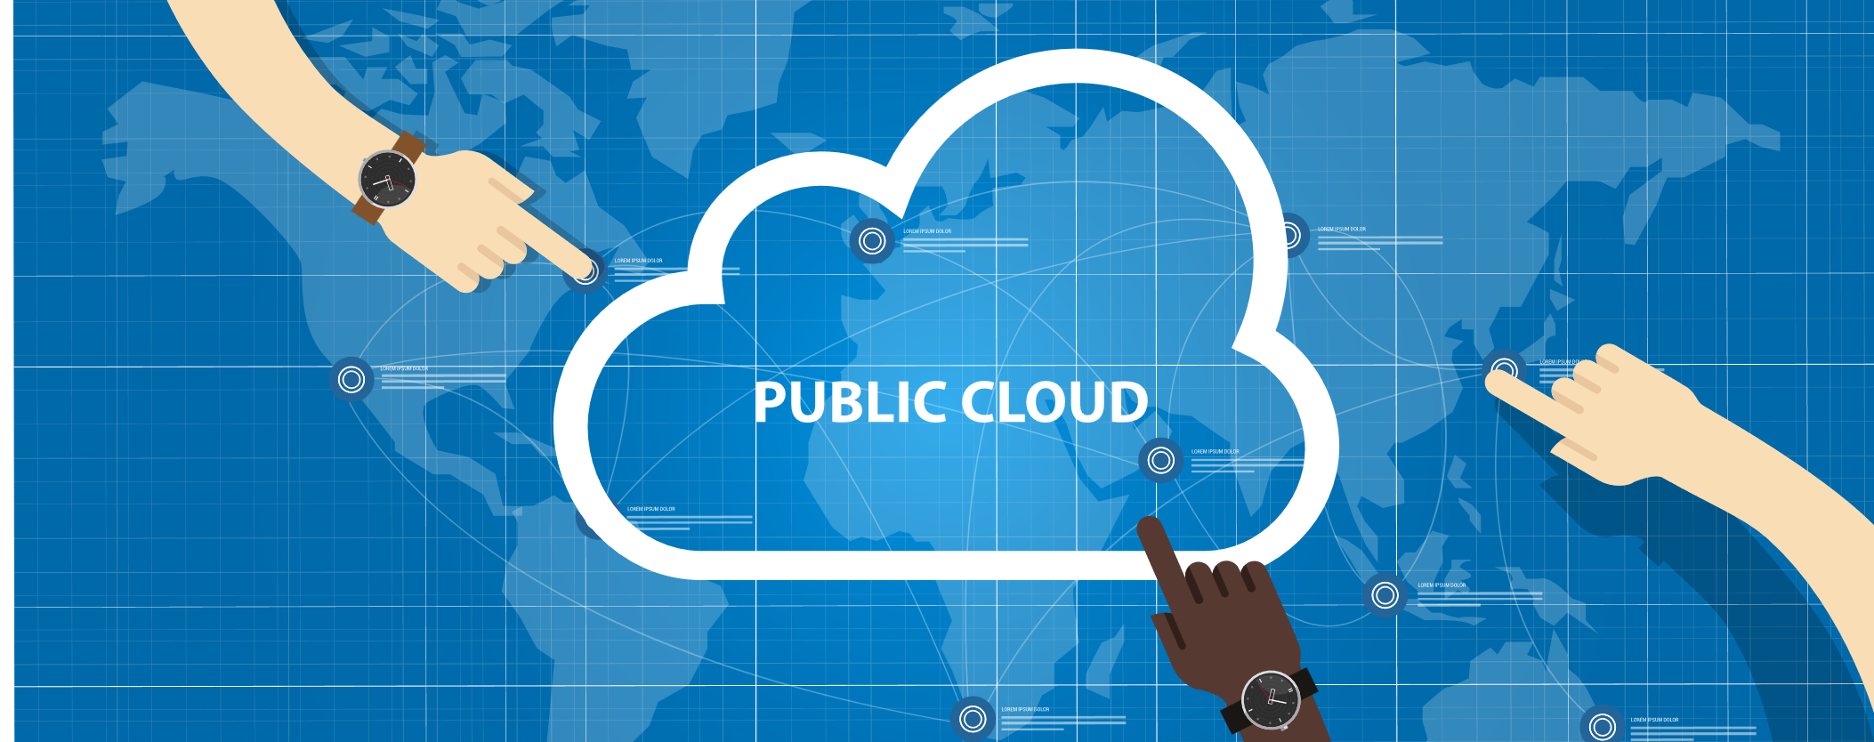
Cloud Deployment Models
Cloud deployment models define how cloud services are made available to users. One standard model is the public cloud.
Public cloud
The cloud infrastructure is made available to the public or a large industry group and is owned by an organization selling cloud services.
Notes:
Trainer Notes:
Explain Public Cloud
A public cloud is a type of cloud computing environment where the cloud resources like servers, storage, databases, and applications are owned and operated by a third-party cloud service provider (CSP) and delivered over the public internet.
Public clouds are a good option for businesses and individuals who need:
Cost-effective IT solutions
Scalable resources to meet changing demands
Rapid deployment of applications
Access to a wide range of cloud services

Slide 19
Cloud Deployment Models
Cloud deployment models define how cloud services are made available to users. One standard model is the private cloud.
Private cloud
The cloud infrastructure is operated solely for a single organization. The organization or a third-party can manage it, and it may be located on-premises or off-premises. This model offers enhanced security and control, which is ideal for businesses with strict regulatory requirements.
Notes:
Trainer Notes:
Explain what is Private Cloud
A private cloud is a cloud computing environment designed for the exclusive use of a single organization. In contrast to a public cloud, where resources are shared among multiple users over the internet, a private cloud offers a dedicated infrastructure for your organization's specific needs. Here's a deeper dive into private clouds
Private clouds are a good fit for organizations that:
Handle sensitive data and require the highest levels of security and privacy.
Have strict regulatory compliance requirements.
Have predictable workloads that don't require significant scaling up or down.
Have the financial resources and IT expertise to manage a private cloud infrastructure.

Slide 20
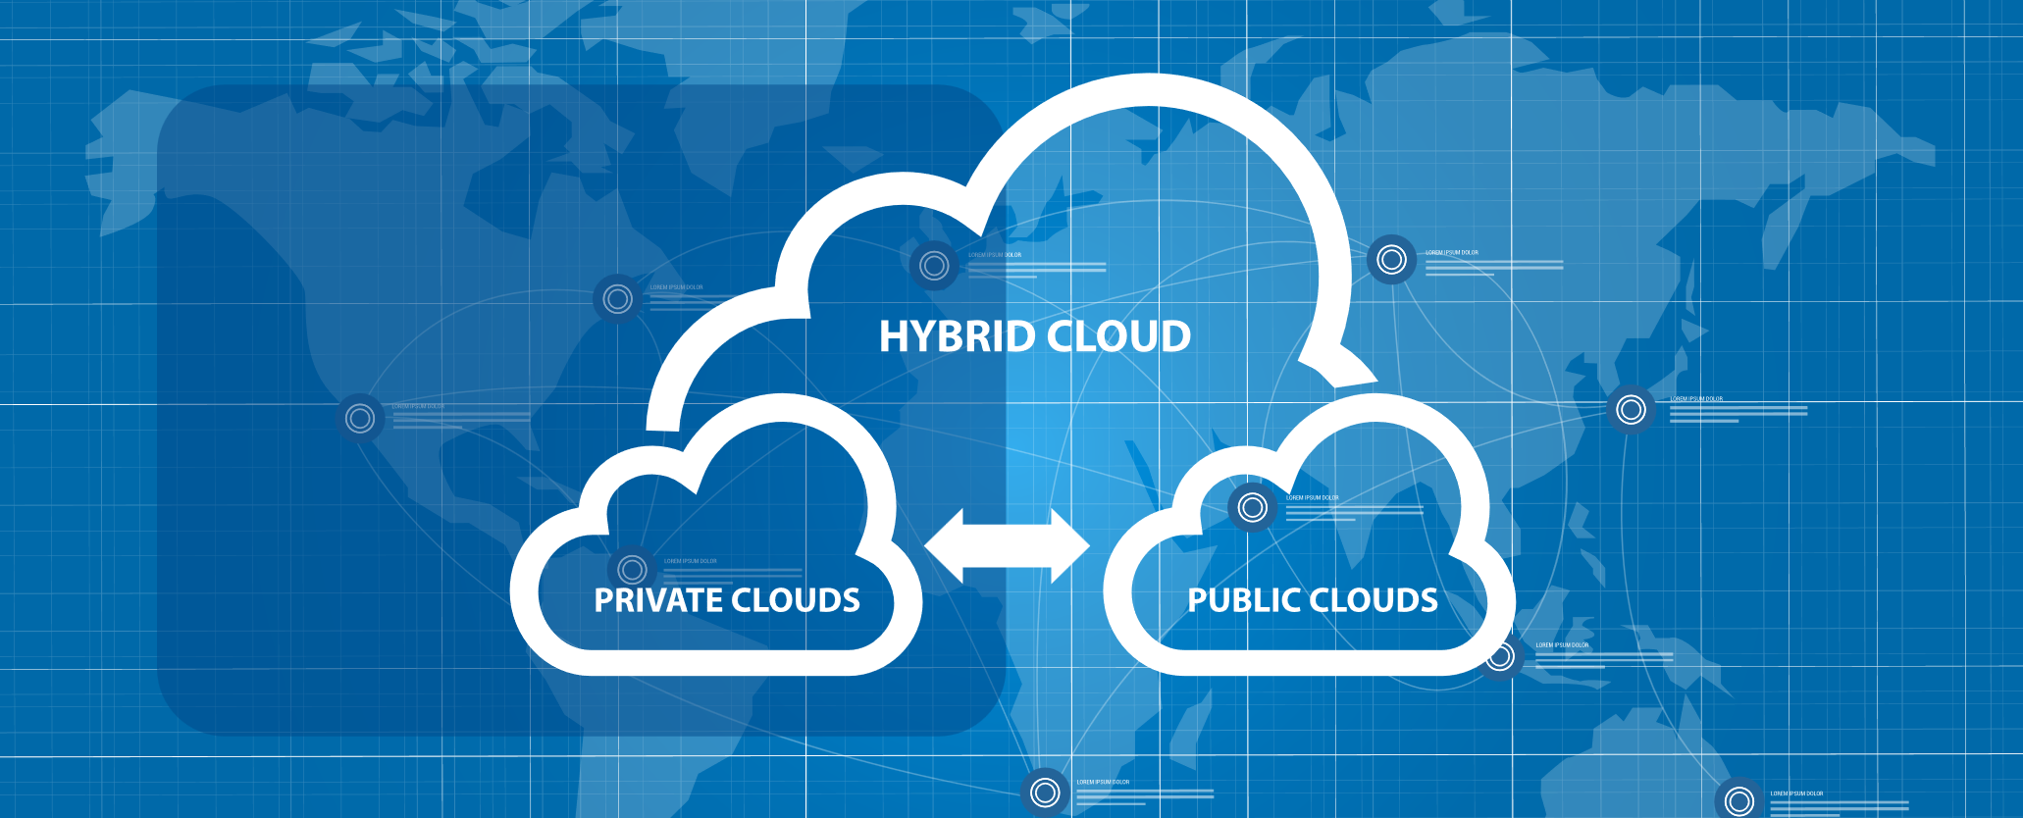
Cloud Deployment Models
Cloud deployment models define how cloud services are made available to users. A flexible model is the hybrid cloud.
Hybrid cloud
Cloud infrastructure is a composition of two or more clouds (private, community, or public) that remain unique entities.
Notes:
Trainer Notes:
Explain Hybrid Cloud
A hybrid cloud combines two or more distinct cloud computing environments (public, private, and community) into a single, flexible IT infrastructure. This integrated approach allows organizations to leverage the strengths of each cloud model to best suit their diverse workload requirements.
Suitable Use Cases for Hybrid Clouds:
Organizations with a mix of sensitive data requiring high security (private cloud) and public-facing applications benefiting from scalability and cost-efficiency (public cloud).
Businesses experiencing fluctuating workloads that can be partially shifted to the public cloud during peak periods for better scalability.
Organizations with disaster recovery plans aiming to leverage the redundancy and failover capabilities offered by a hybrid cloud architecture.
Examples of Hybrid Cloud Deployments:
A retail company might store customer data in a private cloud for security purposes, while running its e-commerce platform on a public cloud for scalability during peak sales seasons.
A healthcare organization may use a private cloud to manage patient records and a public cloud for administrative tasks and data analytics.

Slide 21
Cloud Deployment Models
Cloud deployment models define how cloud services are made available to users. Another model is the community cloud.
Community cloud
Several organizations share cloud infrastructure and support a specific community that has shared concerns (for example, mission, security requirements, policy, or compliance considerations). The infrastructure might be managed by the organizations or by a third party and can be located on-premises or off-premises.
Notes:
Trainer Notes:
Community Cloud
A community cloud is a type of cloud computing environment that shares resources among several organizations from a specific community with common interests. It sits between a public cloud, open to everyone, and a private cloud, dedicated to a single organization.
Community clouds are a good option for organizations that:
Share common interests and security requirements with other potential members.
Seek cost-effective cloud solutions with a balance between security and scalability needs.
Are open to collaboration opportunities with other organizations within the community.
Examples of Community Clouds:
A group of universities sharing a cloud infrastructure for research computing.
Healthcare providers in a region collaborating on a cloud-based patient data management system.
Government agencies within a specific country using a community cloud for secure communication and data storage.

Slide 22
Cloud Computing Service Models
Below are the three core service models that define the scope of services provided in cloud computing:
Software as a Service
(SaaS)
Platform as a Service
(Paas)
Infrastructure as a service
(IaaS)
Public
Private
Hybrid
Community
Notes:
Service Models: NIST 800-145 defines three basic cloud service models:
SaaS (Software as a Service): Customers access and use software applications over the internet, eliminating the need to install and maintain the software on their own devices.
PaaS (Platform as a Service): Provides a platform for developing, deploying, and managing applications without needing to manage the underlying infrastructure (servers, storage, operating systems).
IaaS (Infrastructure as a Service): Offers on-demand access to fundamental computing resources like servers, storage, and networks. Users have control over the operating system and deployed applications.
Deployment Models: NIST 800-145 also identifies four deployment models for cloud services:
Public Cloud: The cloud infrastructure is owned and operated by a cloud service provider and available to any subscribing customer.
Private Cloud: The cloud infrastructure is operated for the exclusive use of a single organization.
Community Cloud: Shared by several organizations with common interests (e.g., security, compliance, regulatory requirements)
Hybrid Cloud: Combines elements of two or more of the other deployment models (public, private, and community).

Slide 23
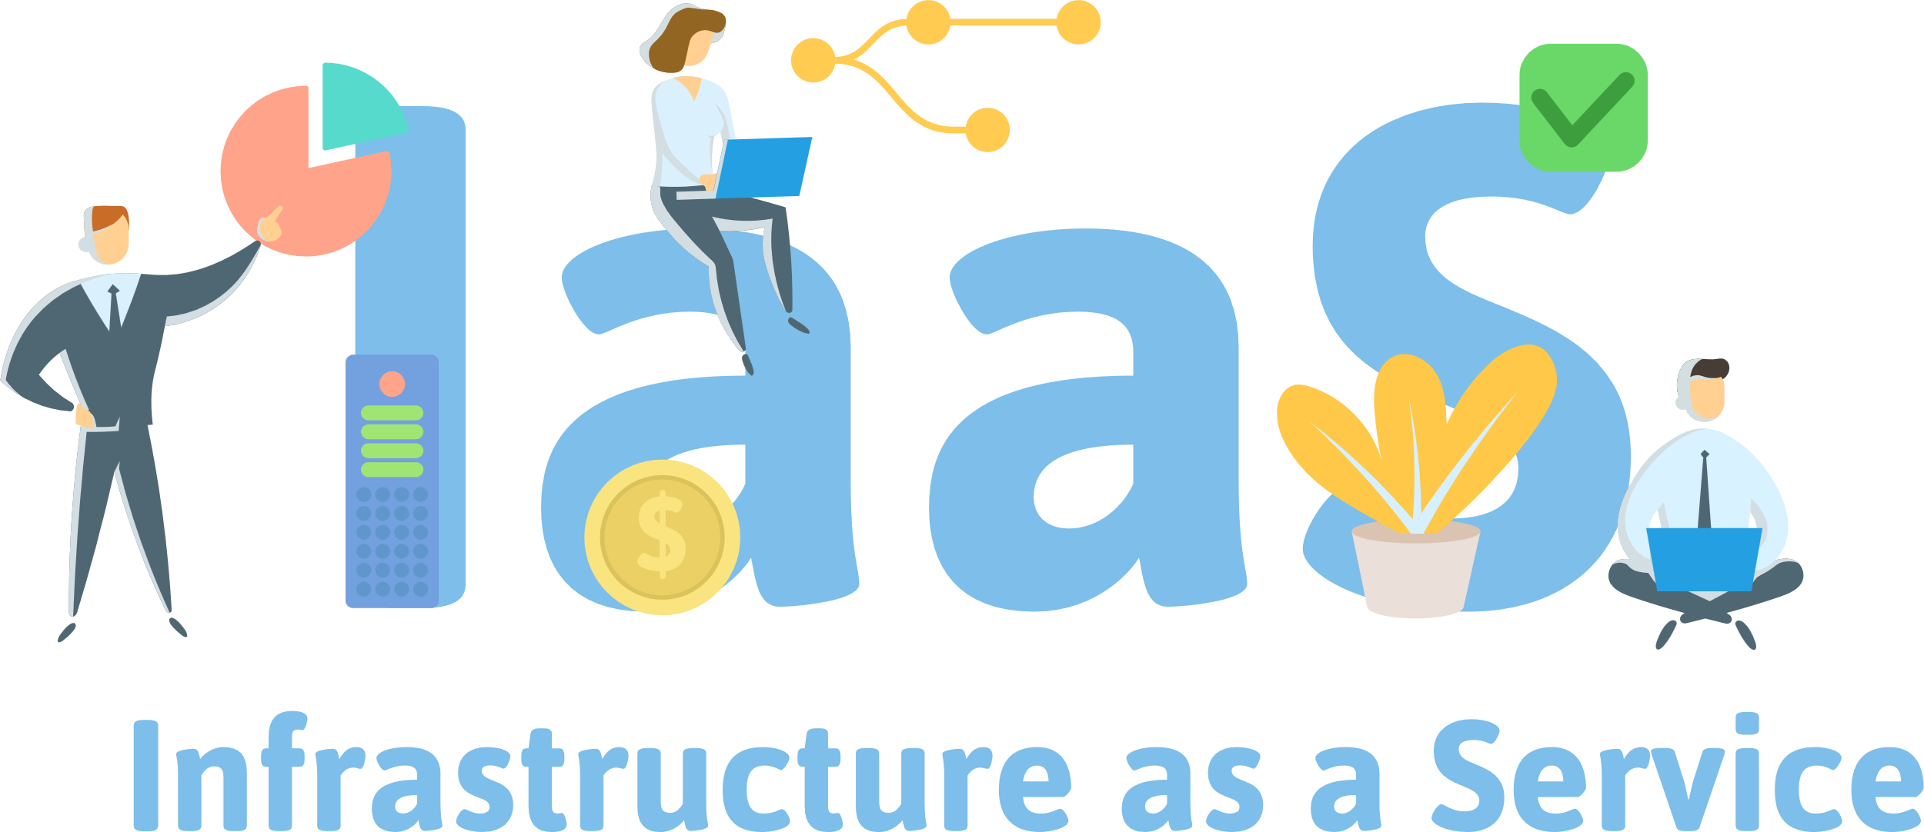
Categorization of Cloud: Service Models
Infrastructure as a Service (IaaS) provides access to a resource pool of fundamental computing infrastructures. Key features include:
Resource pool: Access to fundamental computing infrastructures such as computing, network, or storage.
SPI tiers: These are also called the SPI tiers.
Examples: Amazon EC2, Google Compute Engine, and HP Cloud.
Notes:
Trainer Notes:
Infrastructure as a Service (IaaS)
IaaS stands for Infrastructure as a Service. It's a type of cloud computing service that provides on-demand access to fundamental computing resources like servers, storage, networking, and virtualization. Essentially, it allows you to rent the infrastructure you need to run applications and store data, without having to manage your own physical hardware.
Examples of IaaS Providers:
Amazon Web Services (AWS)
Microsoft Azure
Google Cloud Platform (GCP)
DigitalOcean
IaaS is a fundamental building block of cloud computing. It empowers businesses and individuals to access the IT infrastructure they need without the burden of managing physical hardware. By understanding its characteristics and benefits, you can determine if IaaS is the right solution for your cloud computing requirements.

Slide 24
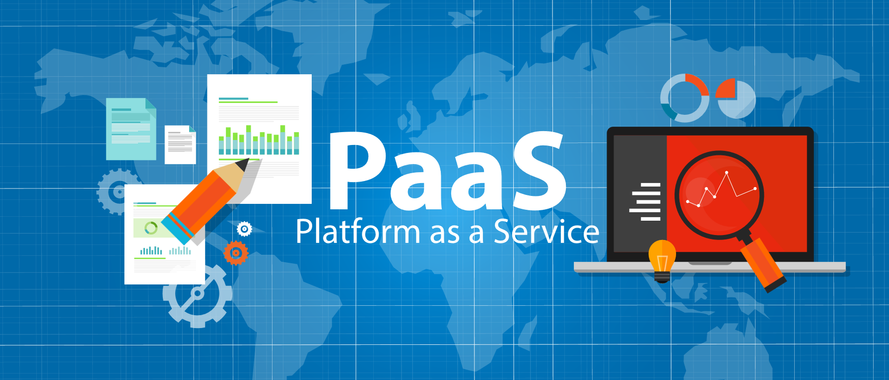
Categorization of Cloud: Service Models
Platform as a Service (PaaS) is a category of cloud computing services that provides a platform allowing customers to develop, run, and manage applications. Key features include:
Simplified infrastructure: It doesn’t have the complexity of building and maintaining the infrastructure typically associated with developing and launching an app.
Examples: Google App Engine, Windows Azure Cloud Services.
Notes:
Trainer Notes:
Explain PAAS
PAAS stands for Platform as a Service. It's a cloud computing model that offers a complete development and deployment environment in the cloud. Unlike IaaS (Infrastructure as a Service) which focuses on providing raw infrastructure, PaaS provides a platform pre-loaded with tools and resources that streamline the development, testing, deployment, and management of applications
Common Use Cases for PaaS:
Developing web applications: PaaS is a popular choice for building and deploying web applications of all sizes and complexities.
Mobile application development: Some PaaS providers offer tools and frameworks specifically designed for mobile app development.
Building APIs: PaaS can be used to develop and deploy APIs that expose data and functionality to other applications.
Creating cloud-native applications: PaaS platforms are ideal for developing and deploying applications designed to run specifically in the cloud.
Examples of PaaS Providers:
Amazon Web Services (AWS) Elastic Beanstalk
Microsoft Azure App Service
Google Cloud Platform (GCP) App Engine
Heroku

Slide 25

Categorization of Cloud: Service Models
Software as a Service (SaaS) is a full application managed and hosted by the provider. Key features include:
Provider management: The provider manages and hosts a complete application.
Consumer access: Consumers access it with a web browser, mobile app, or a lightweight client app.
Examples: Google Apps, Microsoft Office 365.
Notes:
Trainer Notes:
Software as a Service (SaaS)
SaaS, which stands for Software as a Service, is a cloud computing delivery model where users access software applications over the internet on a subscription basis. Think of it like renting software instead of buying it outright. SaaS applications are hosted by the provider and delivered through a web browser or mobile app, eliminating the need for users to install and maintain the software on their own devices.
Common Examples of SaaS Applications:
Customer Relationship Management (CRM): Manage customer data, interactions, and sales pipelines. (e.g., Salesforce, Zoho CRM)
Email and Collaboration: Manage email communication and collaborate on documents. (e.g., Gmail, Microsoft 365)
Enterprise Resource Planning (ERP): Manage core business functions like accounting, inventory, and human resources. (e.g., SAP S/4HANA Cloud, Oracle NetSuite)
Project Management: Plan, track, and collaborate on projects and tasks. (e.g., Asana, Trello)
Content Management Systems (CMS): Create and manage website content. (e.g., WordPress, Wix)

Slide 26

Categorization of Cloud: Service Models
Security as a Service involves outsourcing security functions to a vendor, offering advantages in scale, costs, and speed. Key features include:
Leveraging a vendor's scale, cost benefits, and speed advantages for security functions
Managing a complex range of technical specialties to provide appropriate risk reductions in today’s enterprise
Notes:
Trainer Notes:
Security as a Service (SaaS)
Security as a Service (SecaaS) is a cloud-based delivery model for security solutions. Instead of managing and maintaining your own security infrastructure on-premises
Common SecaaS Offerings:
Email Security: Protects against phishing attacks, spam, and malware.
Network Security: Firewalls, intrusion detection/prevention systems (IDS/IPS) to monitor and block suspicious network traffic.
Data Encryption: Secures your data at rest and in transit.
Vulnerability Scanning: Identifies weaknesses in your systems and applications.
Security Information and Event Management (SIEM): Collects and analyzes security data from various sources to provide real-time insights into potential threats.

Slide 27
Security as a Service (SECaaS): Services, Benefits, and Concerns
Proxy services
Identity management
SIEM, IDS, and IPS
Web application firewall
Data loss prevention (DLP)
Email security
Vulnerability management
Cloud-computing benefits
Staffing and expertise
Intelligence-sharing
Deployment flexibility
Scaling and cost
Lack of visibility
Regulation differences
Handling of regulated data
Changing providers
Data leakage
SECaaS offers various services, benefits, and concerns that organizations should consider.
The key points include:
Services
Benefits
Concerns
Notes:
Trainer notes:
Security as a Service (SECaaS): Services, Benefits, and Concerns
Services
Proxy services
Identity management
SIEM
IDS and IPS
Web application firewall
Data loss prevention (DLP)
Email security
Vulnerability management
Benefits
Cloud-computing benefits
Staffing and expertise
Intelligence-sharing
Deployment flexibility
Scaling and cost
Concerns
Lack of visibility
Regulation differences
Handling of regulated data
Changing providers
Data leakage

Slide 28
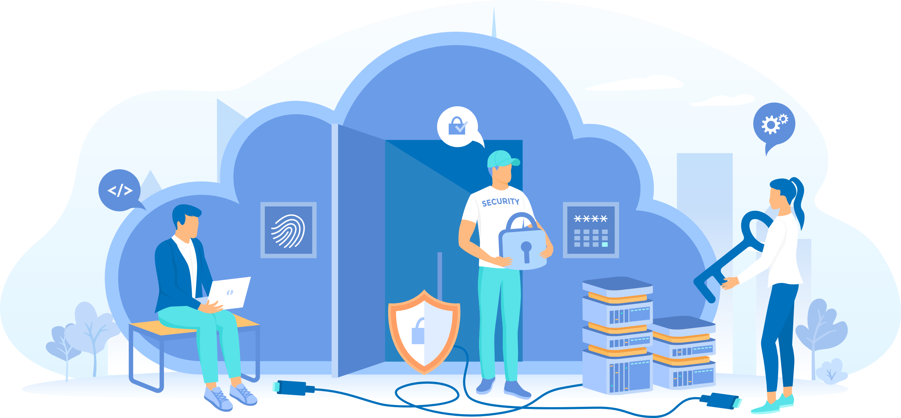
Responsibility Matrix or Shared Responsibility Model
A shared responsibility model is a cloud security framework that describes the security responsibilities of the cloud provider and the cloud customer.
The cloud provider is responsible for the security of the underlying infrastructure, while customers are responsible for their own areas of control.
The contract (SLA) between the cloud customer and provider clarifies individual and shared responsibilities.
The cloud customer is ultimately responsible for compliance and data security.
Notes:
Trainer Notes:
The Shared Responsibility Model is a security framework used in cloud computing that outlines the division of responsibility for securing cloud-based resources between the cloud service provider (CSP) and the cloud customer (you). In simpler terms, it defines who's responsible for securing which aspects of the cloud environment
Division of Responsibilities:
Cloud Service Provider (CSP):
Secures the physical infrastructure (data centers, network)
Maintains the security of the underlying cloud platform
Patches vulnerabilities in the core infrastructure
Offers baseline security controls
Cloud Customer (You):
Secures your data and applications in the cloud
Configures security settings for your cloud resources
Manages access controls for your data and applications
Implements additional security measures as needed (encryption, firewalls)

Slide 29
Shared Responsibilities of Cloud Services
This table outlines the shared responsibilities between enterprises and cloud service providers (CSP) across different service models:
IaaS
PaaS
SaaS
Enterprise responsibility
Shared responsibility
Security governance, Risk, and Compliance (GRC)
CSP responsibility
Data security
Application security
Platform security
Infrastructure security
Physical security
Notes:
Trainer Notes:
Please explain the shared responsibility models mentioned in slide above
The breakdown of security responsibilities in cloud computing is as follows:
Physical security is always the responsibility of the cloud provider, regardless of the service model
Security Governance, Risk, and Compliance (GRC), as well as Data security, are always the responsibility of the cloud customer, regardless of the service model.
Infrastructure security is a shared responsibility in the case of IAAS. For PAAS and SAAS, it is the responsibility of the cloud provider.
Platform security is the responsibility of the cloud service provider (CSP) in the case of IAAS. For PAAS, it is shared between the cloud provider and the customer, while in SAAS, it is the responsibility of the cloud provider.
Application security is the responsibility of the cloud provider in the case of IAAS and PAAS. For SAAS, it is a shared responsibility between the cloud provider and the cloud customer.

Slide 30
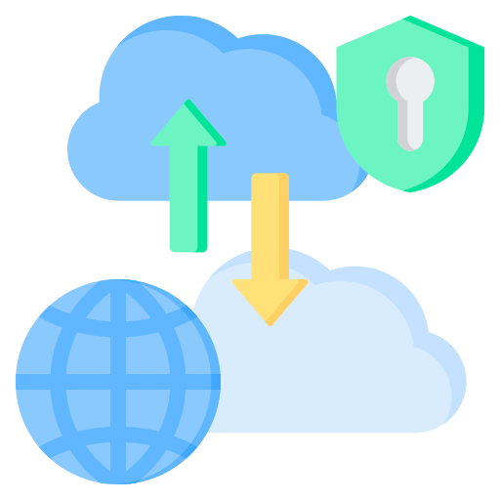
Hybrid Cloud
A hybrid cloud is an architecture that integrates private and public cloud services, facilitating data and application sharing between them.
Core aspect
Flexibility and scalability: A hybrid cloud provides flexibility, scalability, and diverse deployment options but demands careful consideration of data integration, network connectivity, security, compliance, and cost.
Control and efficiency: A well-architected hybrid cloud offers the control of a private cloud combined with the efficiency of a public cloud.
Notes:
Trainer Notes
Explain about Hybrid Cloud
A hybrid cloud integrates two or more distinct cloud computing environments (public, private, and community) into a single, flexible IT infrastructure.
Think of a hybrid cloud like a toolbox with various tools for different tasks. A hybrid cloud environment combines public cloud services, private cloud resources, and potentially even a community cloud component, all working together to address your IT needs
Use Cases for Hybrid Clouds:
Organizations with a mix of data security requirements: Highly sensitive data can be stored in the secure private cloud, while public-facing applications can benefit from the scalability and cost-efficiency of the public cloud.
Businesses with fluctuating workloads: A hybrid cloud allows you to partially shift workloads to the public cloud during peak periods for better scalability, avoiding investing in excess private cloud resources that sit idle most of the time.
Organizations with disaster recovery plans: Leverage the redundancy and failover capabilities offered by a hybrid cloud architecture to ensure business continuity in case of outages

Slide 31

Challenges in Hybrid Cloud
Data Integrations
Hybrid clouds allow seamless data sharing between private and public cloud environments, which can create complexities in data synchronization, consistency, and governance.
Proper data integration techniques are essential to ensure seamless data flow and accessibility.
Network connectivity
A hybrid cloud demands robust network connectivity to enable seamless communication between private and public environments.
Challenges include maintaining secure and fast connections, minimizing latency, and implementing consistent networking policies.
Security
Security considerations in a hybrid cloud can be complex as data and applications may reside in different environments, each with unique security protocols.
Unified security policies, encryption, and identity management are essential to safeguard data across all domains.
Notes:
Trainer Notes:
Explain the challenges in hybrid cloud mentioned in detailed in the cloud
Data Integration- Hybrid clouds involve disparate storage locations across public cloud providers, private cloud infrastructure, and potentially on-premises data centers. This distribution can lead to data silos, where data becomes isolated and inconsistent across different environments
Network Connectivity- Hybrid cloud architectures involve data transfer between public cloud providers, private cloud infrastructure, and potentially on-premises data centers. These data transfers can strain internet connection bandwidth, leading to slow performance and bottlenecks if not properly managed
Security -transferring sensitive data between public and private cloud environments requires secure connections to mitigate interception risks. This involves implementing encryption protocols and secure tunneling mechanisms.

Slide 32
Challenges in Hybrid Cloud
Regulatory compliance can be challenging due to differing legal requirements in public and private environments.
Careful alignment of privacy policies and compliance controls across the hybrid infrastructure is crucial.
Compliance
While a hybrid cloud provides flexibility, managing multiple environments can increase complexity and cost.
Effective cost management requires understanding the pricing structure of public cloud services and the overhead of maintaining private infrastructure.
Cost
Ensure your workloads can be easily migrated between cloud platforms with minimal reconfiguration. This flexibility gives you more control over your cloud environment.
Portability
Notes:
Trainer Notes:
Explain the challenges in hybrid cloud mentioned in detailed in cloud
Compliance-Organizations may need to comply with multiple industry standards and regulations, depending on their location and industry. Enforcing consistent compliance controls across disparate hybrid cloud environments becomes tricky.
Cost- Hybrid cloud environments involve multiple cost components, including public cloud service charges, private cloud infrastructure maintenance, data transfer fees, and management overhead. It can be difficult to gain clear visibility into all these costs,
Portability-

Slide 33

Third-Party Vendors
Third-party vendors are external suppliers or service providers engaged by organizations to deliver specific products or services.
They are used because of their ability to provide expertise and services that complement an organization’s core capabilities.
This alliance often requires granting these external entities varying degrees of access to sensitive systems, data, or infrastructure, resulting in many security risks.
Notes:
Trainer Notes:
Explain what is third-party vendors
Third-party vendors are essentially companies or individuals that provide goods or services to your organization, but they are not directly employed by you. They are considered "third-party" because they are separate from the two main parties involved in the transaction: you and your customer.
Examples: A wide range of businesses can be considered third-party vendors. This includes everything from the company that supplies your office furniture to a cloud-based software provider or a marketing agency you hire for a specific campaign.

Slide 34
Security Risks from Third-Party Vendors
Information security or data privacy
Business continuity
Insufficient experience and controls to protect information from unauthorized access, disclosure, modification, or destruction.
Inability to maintain services due to business disruption (e.g., ineffective redundancy procedures).
Financial viability
Contract compliance
Legal or regulatory
Lack of financial security to provide services at acceptable levels.
Inconsistency with policies, procedures, laws, regulations, and ethical standards.
Lack of necessary licenses to operate and expertise to remain compliant with laws and regulations.
Notes:
Trainer Notes:
Let’s walk through the third-party risks.
First is, Information Security or Data Privacy: Third party has insufficient experience and controls to protect the company's and customer's information from unauthorized access, disclosure, modification, or destruction.
Second risk is Business Continuity: Third party cannot continuously maintain its services due to business disruption (e.g., ineffective redundancy procedures). For example lack of expertise, not having redundant sites or proper backup
The third risk is Financial Viability: Third party is not financially secure to continue to provide you services at acceptable levels and they go out of business and not able to provide services
The fourth risk is Contract Compliance: Third party products, services, or systems are not consistent with your policies and procedures, applicable laws, regulations, and ethical standards. There standards and policies are lower in standard than your organization
And the fifth risk is Legal or Regulatory: Third party does not possess the necessary licenses to operate. It lacks the expertise to enable the company to remain compliant with domestic and international laws and regulations. Third-party suppliers may not be compliant with the same laws and regulations that your organization is subject to. This could lead to fines or other penalties for your company.

Slide 35
Infrastructure as a Code
Infrastructure as Code (IaC) is a method of managing and provisioning IT infrastructure through machine-readable code files instead of manual configuration or graphical interfaces.
Imagine your infrastructure (servers, networks, storage) as code. Instead of manually setting up everything, you write instructions in a code file that tells the system what to create and how.
IaC defines and manages IT infrastructure through machine-readable code or scripts.
Popular tools: Terraform, Ansible, AWS CloudFormation, Chef.
Notes:
Trainer Notes
Explain Infrastructure as a code
IAC stands for Infrastructure as Code. It's a method for managing and provisioning your computer data center resources through code instead of manual configuration. Essentially, you define your infrastructure (servers, storage, networking) in configuration files that can be read and executed by software tools.
Imagine building a house. Traditionally, you'd give instructions to construction workers one by one. With IAC, you provide a blueprint (the code) that specifies exactly how to build the house. This ensures consistency and reduces the chance of mistakes.

Slide 36
Advantages of IaC
Security:
Enforces consistent security policies across infrastructure
Version control:
Track changes and revert to previous configurations
Speed and agility:
Allows you to provision and deploy infrastructure quickly and easily
1
3
5
2
4
Automation:
Deploy and manage infrastructure consistently
Repeatable:
Spin up identical environments easily for testing or production
Notes:
Trainer Notes:
Explain Advantages of IAC mentioned in slides
Security-IaC can be used to enforce security best practices by automating security configurations and compliance checks.
Version Control-Since IaC is code, it can be version controlled. This allows you to track changes, revert to previous configurations if necessary, and collaborate with other teams on infrastructure management.
Automation-IaC automates the provisioning and configuration of infrastructure, eliminating the need for manual processes. This saves time, reduces errors, and improves consistency.
Repeatable IaC code can be reused to deploy the same infrastructure configuration multiple times. This saves time and effort, and ensures that all deployments are consistent.
Speed and Agility IaC allows you to provision and deploy infrastructure quickly and easily. This is essential for DevOps practices and continuous integration/continuous delivery (CI/CD) pipelines

Slide 37
Components of IaC
Provisioning tools:
Interpret the code and interact with cloud providers or on-premises infrastructure.
2
Code files:
Written in languages such as Terraform, Ansible, or Chef.
Version control system:
Track changes and manage different versions of configurations.
1
3
Notes:
Trainer Notes: Explain Components of IAC
Code Files: These are files Written in languages like Terraform, Ansible, or Chef used to create infrastructure.
Provisioning tools are a core component of Infrastructure as Code (IaC). They are the software programs that interpret your IAC configuration files and translate them into actions that create and configure your infrastructure resources
Version Control System: Version control systems (VCS) play a critical role in managing Infrastructure as Code (IAC). They bring the same benefits of version control to your infrastructure configurations as they do to traditional software code. It helps in tracking changes and provides you rollback capabilities

Slide 38
Common Use Cases
DevOps pipeline
Automates infrastructure provisioning and management within CI/CD pipelines
01
Bare-metal deployments:
Manages on-premises servers and network devices
Disaster recovery
Rebuilds infrastructure in case of outages
02
04
03
Cloud deployments:
Spins up resources on cloud platforms like AWS, Azure, or GCP
Notes:
Trainer Notes
Explain Use case of IAC
DevOps Pipeline-A DevOps pipeline is a set of automated processes and tools that helps development (Dev) and operations (Ops) teams work together more efficiently to build, test, and deploy software.
Baremetal Deployment-Bare-metal deployment refers to the process of installing an operating system (OS) or hypervisor directly onto the hardware of a physical server, rather than using a virtual machine (VM)
Cloud Deployment -Cloud deployment by Infrastructure as Code (IaC) is a powerful approach for provisioning and managing your cloud infrastructure in an automated and repeatable way
Disaster Recovery- Infrastructure as Code (IaC) can be a valuable tool for enhancing your disaster recovery strategy as you can deploy infrastructure in faster manner
Disaster Recovery
Cloud Deployment
Devops Pipeling

Slide 39
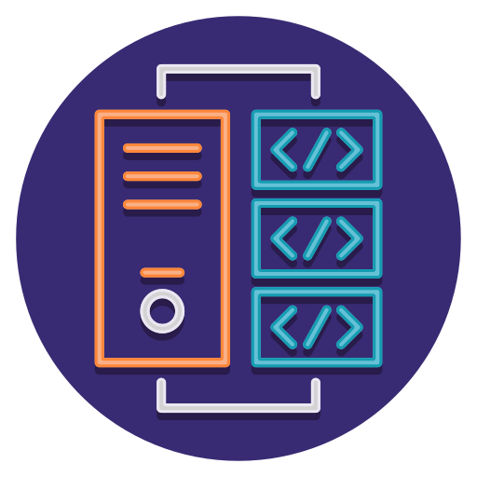
Monolithic Architecture
Refers to a traditional method of building applications
Describes a software style that uses a single code base for multiple business functions
Encompasses all software functionalities in a single, self-contained unit
Develops as a single component, with all processes tightly coupled and running as a single service
Resembles a giant rock with everything carved into it, illustrating a monolithic application
Notes:
Trainer Notes:
Explain Monolithic architecture
Monolithic architecture is a traditional approach where the entire application is built as a single, unified unit. Imagine a large building that houses all functionalities under one roof.
All the application's functionalities, including the user interface (UI), business logic, and data access layer, are contained within a single codebase.
The different components of the monolith are tightly coupled and interdependent.
The entire monolithic application is deployed as a single unit. This can make deployments complex and time-consuming, especially as the application grows in size and complexity

Slide 40

Characteristics of Monolithic Architecture
Single Codebase: The entire application's code, including the user interface (UI), business logic, and data access layers, is written and stored together in one place.
01
Tightly Coupled Components: Different parts of the application are highly dependent on each other, meaning a change in one component can potentially impact other parts.
02
03
Centralized Deployment: The entire application is deployed as a single unit, so any updates or changes require redeploying the entire application.
Notes:
Trainer Notes
Explain Characteristics of Monolithic Architecturs
Single Codebase: All the application's functionalities, including the user interface (UI), business logic, and data access layer, are contained within a single codebase. This codebase is typically written in a single programming language.
Tightly Coupled Components: The different components of the monolith are tightly coupled and interdependent. A change in one part of the code can potentially impact other parts, requiring extensive testing and redeployment of the entire application.
Centralized Deployment: The entire monolithic application is deployed as a single unit. This can make deployments complex and time-consuming, especially as the application grows in size and complexity.

Slide 41
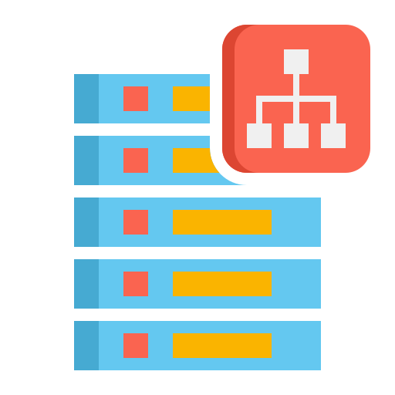
Microservices
Composes a single application from many loosely coupled and independent services in microservices architecture
Breaks down an application into smaller, self-contained services that communicate with each other through well-defined APIs
Handles a specific business capability, such as user authentication, payment processing, or data retrieval, with each microservice
Operates independently, allowing developers to work on these services separately without disrupting the entire application
Notes:
Trainer Notes:
Explain What is Microservices
Microservices, also referred to as microservices architecture, is a software development approach that structures an application as a collection of loosely coupled, service-oriented components. Imagine a large city built up of many smaller, independent districts, each with its own specialized function.

Slide 42
Advantages of Microservices
Agility
Empowers organizations to quickly respond to changing business needs
Scalability
Enables independent scaling to meet demand, ensuring optimal performance during traffic spikes
Faster development
Features smaller code bases and independent development cycles, accelerating development and reducing time-to-market
Easy Maintenance
Simplifies maintenance and troubleshooting by isolating services, confining issues to specific areas
Improved Fault Tolerance
Enhances fault tolerance, preventing cascading failures across services
Independence
Allows for the independent deployment of individual components
Notes:
Trainer Notes:
Explain the information given on slide.
Agility -This allows development teams to work on individual services independently, leading to faster development cycles.
Scalability-In microservices, individual services can be scaled independently by adding more instances of those services.
Faster Deployment-Microservices allow you to deploy individual services independently. This means smaller deployments that happen more frequently.
Easy Maintenance-The modular design makes it easier for developers to understand, modify, and test individual services in isolation
Improved Fault Tolerance-By breaking down the application into independent services, a failure in one service is less likely to impact others. This isolates the issue and allows the rest of the application to function normally
Independence-Independence is a key feature of microservices that allows individual services to be deployed independently

Slide 43

Uber: Case Study
Uber, like most startups, initially built their application with a monolithic architecture.
As Uber expanded worldwide, they faced issues with scalability, performance, and application stability.
Monolithic architecture combines all components into a single, popular single-tiered software application.
These components include the client-side user interface, server-side business logic, data access layer, and integrations.
Source: https://hackernoon.com/microservices-are-hard-an-invaluable-guide-to-microservices-2d06bd7bcf5d
And
https://dzone.com/articles/microservice-architecture-learn-build-and-deploy-a
Notes:
https://hackernoon.com/microservices-are-hard-an-invaluable-guide-to-microservices-2d06bd7bcf5d
https://dzone.com/articles/microservice-architecture-learn-build-and-deploy-a
Trainer Notes:
Explain the case study

Slide 44
Uber: Case Study
These components are interconnected and interdependent, which means that when one component needs to be updated, changes must be made to the entire application.
The failure of one component can bring down the entire system.
As the number of services increases, integrating and managing the entire product can become complicated.
To avoid such problems, Uber decided to break down its monolithic architecture into multiple applications, transitioning to a microservices architecture.
Source: https://hackernoon.com/microservices-are-hard-an-invaluable-guide-to-microservices-2d06bd7bcf5d
And
https://dzone.com/articles/microservice-architecture-learn-build-and-deploy-a
Notes:
https://hackernoon.com/microservices-are-hard-an-invaluable-guide-to-microservices-2d06bd7bcf5d
https://dzone.com/articles/microservice-architecture-learn-build-and-deploy-a
Trainer Notes:
Explain the case study

Slide 45
Uber: Case Study
Microservices divide and distribute the application workload, providing stable and scalable services.
Microservices decentralize data storage by managing their own data stores.
Uber manages each microservice individually, removing dependencies between features.
Uber benefits from shifting its architecture from monolithic to microservices.
Source: https://hackernoon.com/microservices-are-hard-an-invaluable-guide-to-microservices-2d06bd7bcf5d
And
https://dzone.com/articles/microservice-architecture-learn-build-and-deploy-a
Notes:
https://hackernoon.com/microservices-are-hard-an-invaluable-guide-to-microservices-2d06bd7bcf5d
https://dzone.com/articles/microservice-architecture-learn-build-and-deploy-a
Trainer Notes:
Explain the case study

Slide 46



Microservices
The figure illustrates the difference between a monolithic architecture and a microservice architecture:
UI
UI
Business logic
Data access layer
Microservice
Microservice
Microservice
Microservice
Microservice
Microservice
Monolithic architecture
Microservice architecture
Source: https://hackernoon.com/microservices-are-hard-an-invaluable-guide-to-microservices-2d06bd7bcf5d
Notes:
https://hackernoon.com/microservices-are-hard-an-invaluable-guide-to-microservices-2d06bd7bcf5d
Trainer Notes:
Explain the diagram given on the slide.
In monolithic architecture, All functions are part of the same program whereas you can see in microservices, there are different services working and deployed independently of each other

Slide 47
Monolithic vs. Microservices
S.No | Feature | Monolithic architecture | Microservices architecture
1 | Codebase | Single, unified codebase | Multiple, independent codebases
2 | Deployment | Entire application deployed together | Individual services deployed independently
3 | Scalability | Difficult to scale | Individual services can be scaled independently
4 | Maintenance | Changes can be complex | Easier to modify individual services
5 | Technology | Limited to chosen technologies | Different services can use different technologies
6 | Communication | Simple in-memory calls | Can involve API calls, message queues
Notes:
Trainer Notes:
Explain the difference between Monolithic and Microservices
Monolithic: A single, unified codebase containing the entire application's functionality (UI, business logic, data access). Imagine a large building housing all functionalities under one roof.
Microservices: Collection of smaller, independent services working together. Each service has a clearly defined purpose and operates independently. Think of a large city built up of many smaller districts, each with its own specialized function.

Slide 48
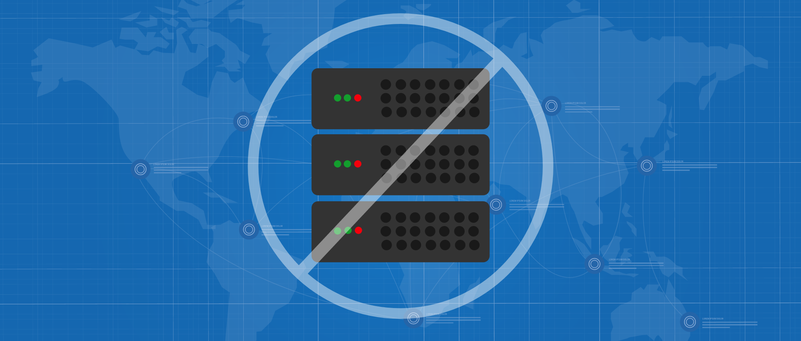
Serverless Computing
Allows developers to build and run application code without provisioning or managing servers.
Enables on-demand execution of code without managing server infrastructure.
Lets cloud service providers automatically provision, manage, and scale the resources required to execute the code.
Notes:
Trainer Notes:
Serverless computing, despite the name, doesn't literally mean there are no servers involved. It refers to a cloud computing execution model where the cloud provider manages the servers and underlying infrastructure that run your code. Here's a breakdown of the key concepts:
Focus on Code: With serverless, you focus on writing and deploying your code. You don't need to worry about provisioning, managing, or scaling servers.
Event-Driven Execution: Serverless code typically executes in response to events. These events can be triggers like HTTP requests, database changes, or queue messages.
Pay-Per-Use: You are only charged for the resources your code consumes while executing, typically measured by duration and memory usage. This can be cost-effective for applications with variable workloads

Slide 49
Serverless Computing Attributes
Event driven
Code executes in response to specific events, such as an HTTP request, a database change, or a file upload, without the need to provision or manage servers.
Pay per use
Pay only for the resources your code consumes while it’s executing, making it a cost-effective solution for applications with variable traffic.
Automatic scaling
The cloud provider automatically scales resources based on demand, eliminating the need for manual server scaling.
Focus on code
Focus on writing and deploying your code without worrying about the underlying infrastructure.
Notes:
Trainer Notes:
Explain Attributes of Server less computing
Event Driven Code executes in response to specific events, such as an HTTP request, a change in a database, or a file upload. We need not to worry about provisioning or managing servers
Pay Per Use-You only pay for the resources your code consumes while it's executing. This can be a cost-effective way to run applications that experience variable traffic
Automatic Scaling The cloud provider automatically scales the resources allocated to your code based on demand. This eliminates the need for you to manually scale your servers
Focus on Code -With serverless computing, you can focus on writing and deploying your code without worrying about the underlying infrastructure

Slide 50
Serverless Computing Advantages
Reduced costs
Increase scalability
Only paying for what we are using can lead to significant cost savings.
Serverless applications can automatically scale to meet demand, eliminating the need for manual scaling.
Faster deployment
Improved maintainability
Serverless computing allows you to develop and deploy applications faster by removing the need to manage servers.
There is no need to worry about patching or maintaining servers, which can simplify application maintenance.
Notes:
Trainer Notes:
Explain Advantages of Serverless
Reduced cost Only had to pay for what we are using, which can lead to significant cost saving
Increase scalability Serverless applications can automatically scale to meet demand, eliminating the need for manual scaling , leading to efficiency
Faster Deployment Serverless computing allows you to develop and deploy applications faster by removing the need to manage servers manually, platform does the job for you
Improve Maintainability- No need to worry about patching or maintaining servers, which can simplify application maintenance as managing the server, update , configuration is responsibility of cloud provide

Slide 51
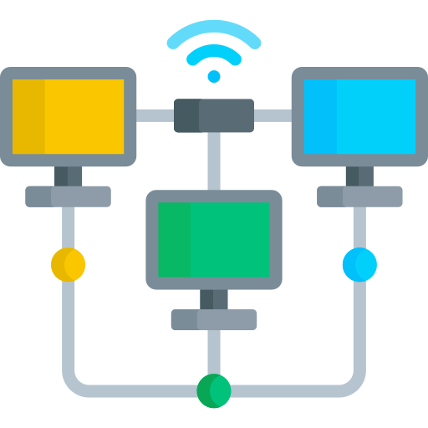
Network Infrastructure
Network infrastructure refers to hardware and software resources that facilitate network connectivity, communication, operations, and management within an enterprise network.
It comprises networking devices, protocols, and routing mechanisms that function together in an interconnected environment.
It provides communication paths and services between users, processes, applications, and external networks, enabling devices and components to connect and interact within both internal and external environments.
Notes:
Trainer Notes:
Explain Introduction to Network Infrastructure
Network infrastructure refers to the physical and software components that enable communication and data transfer between devices on a network. It's the foundation for connecting computers, printers, servers, and other devices to share resources and access the internet. Imagine it as the central nervous system of a network, carrying information around to keep everything functioning.
Network infrastructure is a mixture of networking devices, protocols, and routing packets that all work together in an interconnected environment.
It provides a communication path and services between users, processes, applications, and external networks, enabling various devices and components to connect and communicate within an internal and external environment.

Slide 52
Secure Network Design
A secure network design provisions the assets and services underpinning business workflows with the following properties:
Integrity
2
Confidentiality
1
3
Availability
Notes:
Secure Network Designs
A secure network design provisions the assets and services underpinning business workflows with the properties of confidentiality, integrity, and availability. Main objective is to ensure communication takes place in a secure manner

Slide 53

Network Devices: Router
Wireless access point
A router is a device used to connect two different networks and route packets between them.
It is set up as the default gateway when configuring a host machine.
It determines the best path to the destination.
Network intrusion prevention system
Router
Web application firewall
Switch
Load balancer
Notes:
Trainer Notes:
Explain Network Device: Router
A router, in the context of computer networking, is a device that connects two or more packet-switched networks or subnetworks. It acts like a traffic director, intelligently forwarding data packets to their intended destinations. Imagine a large city with different districts. A router would be like the central traffic control center, directing vehicles (data packets) to the specific neighborhoods (networks) they need to reach

Slide 54

Network Devices: Switch
Wireless access point
A switch is a device that connects devices on a network and forwards data packets to their intended destinations.
Unlike routers, which connect different networks, switches operate at Layer 2 (data link layer) of the OSI model and focus on communication within a single network segment.
Network intrusion prevention system
Router
Web application firewall
Switch
Load balancer
Notes:
Trainer Notes:
Explain Network Device: Switch
A switch is a device that connects devices on a network and forwards data packets to their intended destinations. Unlike routers, which connect different networks, switches operate at Layer 2 (data link layer) of the OSI model and focus on communication within a single network segment. Imagine a multi-lane highway intersection. A switch acts like a traffic director, efficiently routing vehicles (data packets) to their designated lanes (network devices) based on their exit signs (MAC addresses).

Slide 55

Network Devices: Load Balancer
Wireless access point
A load balancer is a device or software application that distributes incoming network traffic across multiple servers or resources.
It acts as a traffic cop, ensuring no single server is overloaded while others remain idle.
It helps to improve overall application performance, scalability, and availability.
Network intrusion prevention system
Router
Web application firewall
Switch
Load balancer
Notes:
Trainer Notes:
Explain Network Device:Load Balancer
A load balancer distributes incoming traffic evenly across multiple servers, ensuring efficient handling of high traffic loads. A load balancer distributes incoming traffic evenly across multiple servers, ensuring efficient handling of high traffic loads.

Slide 56


Network Devices: Web Application Firewall
Wireless access points
WAF stands for Web Application Firewall. It's a security tool designed to protect web applications from cyberattacks.
It act as a shield that sits in front of your web application, filtering and monitoring incoming traffic to block malicious requests and prevent attacks.
Network intrusion prevention system
Router
Web application firewall
Switch
Load balancer
Notes:
Trainer Notes:
Explain Network Device: Web Application Firewall
The WAF is a firewall that is used to protect the web server, its applications, and data from web application attacks. A WAF acts as an intermediary between the internet and your web application. It inspects all incoming HTTP traffic, including requests, headers, and parameters. WAFs are configured with a set of security rules that define what constitutes malicious traffic. These rules can be based on known attack patterns, vulnerabilities, or custom criteria.

Slide 57

Network Devices: NIPS
Wireless access point
Monitors the network, protecting it against attacks by continuously checking for signs of malicious activity and taking action to prevent or mitigate them.
Analyzes all incoming and outgoing network traffic, looking for suspicious patterns or signatures that might indicate an attack.
Network intrusion prevention system
Router
Web application firewall
Switch
Load balancer
Notes:
Trainer Notes:
Explain NIPS in brief
The NIPS is used to monitor the network and protect it against attacks by continuously monitoring network traffic for signs of malicious activity and promptly taking action to prevent or mitigate attacks. NIPS refers to a network security device that monitors network traffic for malicious activity and attempts to block it

Slide 58

Network Devices: Wireless Access Point
Wireless access point
Network intrusion prevention system
Router
A WAP is a device that enables wireless devices to connect to a wired network, providing Wi-Fi connectivity.
Web application firewall
Switch
Load balancer
Notes:
Trainer Notes:
Explain Wireless Access Point in brief
A wireless access point (WAP), also commonly referred to as an access point (AP), is a networking device that connects wireless-capable devices like laptops, smartphones, and tablets to a wired network or another wireless network. It acts as a bridge between the world of wires and the world of Wi-Fi.

Slide 59
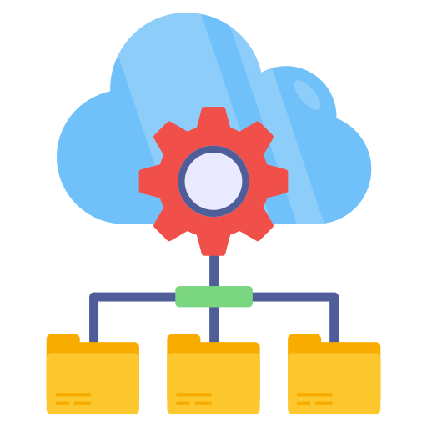
Network Isolation or Segmentation
Network isolation divides a computer network into subnets to limit communication between devices, enhancing security, performance, and manageability.
Notes:
Trainer Notes:
Explain Segregation
Network isolation involves dividing a computer network into smaller segments called subnets to limit communication between devices or groups of devices, with the aim of enhancing security, performance, and manageability. Network segmentation is a security and performance optimization technique used in computer networking. It involves dividing a large network into smaller, isolated subnetworks.

Slide 60
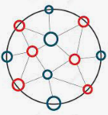
Types of Segregation or Segmentation
Physical separation
Airgaps
Logical (VLAN)
subnets
Notes:
Explain Types of Network Segregation
Physical separation-It is physically separated by having separate physical path, routers and Switches
Airgaps-Network segmentation is a security and performance optimization technique used in computer networking. It involves dividing a large network into smaller, isolated subnetworks.
VLAN-VLAN, which stands for Virtual Local Area Network, is a logical grouping of devices on a physical network that can communicate with each other as if they were on a separate physical network.
Subnets -Subnets are a fundamental tool for network isolation using IP addresses. Subnetting allows you to divide this large network block into smaller, more manageable subnetworks. Each subnet has its own unique address range within the larger block and traffic can restricted the subnet

Slide 61
Physical Isolation
Physical segregation involves using separate physical equipment to handle different classes of traffic, such as separate switches, routers, and cables.
This method is the most secure way to separate traffic, but it is also the most expensive.
Organizations often implement separate physical paths in the outermost sections of the network where connections to the internet are established.
Physical Separation
Air gap
Air gaps, a term familiar to network security professionals, refer to the isolation of two networks that are not connected in any way except via a physical air gap between them.
There is no direct physical or logical path between them.
It involves isolating a secure network or computer from all other networks, particularly the internet, to prevent unauthorized access.
Notes:
Trainer Notes:
Explain Physical Separation and Airgaps
Physical Separation Physical segregation involves using separate physical equipment to handle different classes of traffic, such as separate switches, routers, and cables. is the most extreme form of network isolation. It involves completely isolating a network from other networks, including the internet, using physical barriers.
This method is the most secure way to separate traffic, but it is also the most expensive. –
Organizations often use separate physical paths in the outermost sections of the network where connections to the Internet are established
Airgaps Air gaps, a term familiar to network security professionals, refer to the isolation of two networks that are not connected in any way except via a physical air gap between them. This approach is like creating a completely isolated island for your network, with no bridges or connections to the outside world.
Physically or logically, there is no direct path between them
It involves isolating a secure network or computer from all other networks, particularly the Internet, to prevent unauthorised access

Slide 62
Types of Segregation or Segmentation
Subnetting
VLAN
Subnetting is the process of breaking down a network into smaller networks called subnets.
This can provide a higher level of security by reducing the broadcast domain, which is the area where devices can broadcast to each other.
Imagine a fast-spreading virus. Using subnets can help contain the virus and prevent it from affecting too many devices.
Virtual Local Area Networks (VLANs) allow the ports on the same or different switches to be grouped so that the traffic is confined to the members of that group.
A VLAN creates an isolated broadcast domain, similar to a router with multiple broadcast domains.
VLANs aid in segmenting networks, reducing routing broadcasts, and segregating department functions.
They can be logically segmented.
Notes:
Trainer Notes:
Explain Subnetting and VLAN
Subnetting Subnetting is the process of breaking down a network into smaller networks called subnets. This can give you a higher level of security by reducing the broadcast domain, the area where devices can broadcast to each other. Imagine a fast-spreading virus. Using subnets can help contain the virus and prevent it from affecting too many devices. Subnetting allows you to subdivide this large block into smaller subnetworks. This creates a hierarchical addressing structure within your network, making it more organized and easier to manage.
VLAN A VLAN is established through the software on a network switch. It allows you to group multiple network ports together, effectively creating a distinct and separate network within the larger network. This method of network division aids in controlling traffic flow and segregating communications for particular functions or device groups. Each individual VLAN has an identification tag, which is readable by switches. A VLAN is a logical grouping of devices on a physical network that can communicate with each other as if they were on a separate physical network. It's like creating virtual walls within your existing network, segmenting it into smaller, more manageable sections based on function, department, or security needs

Slide 63
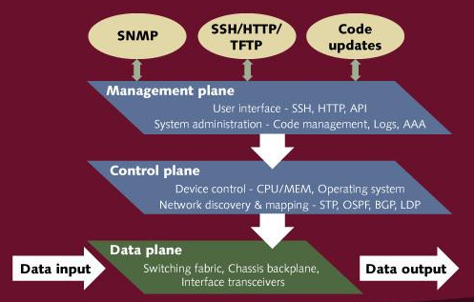
Software Defined Network: Initial Concept
Control plane
Management plane
The control plane is the part of a network that carries signaling traffic and is responsible for routing.
The management plane, which carries administrative traffic, is considered a subset of the control plane.
Data plane
The data plane (or forwarding plane) contains the traffic that the network exists to carry.
Notes:
Trainer Notes:
Explain Different planes
Control Plane
Management Plane
Data Plane

Slide 64
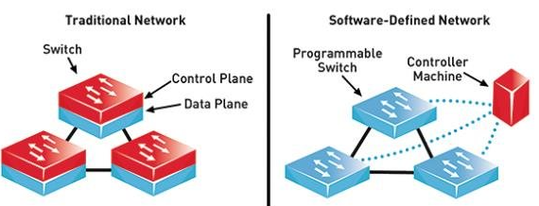
How Is SDN different from Traditional Networking?
Traditional networking
Software defined networking
In conventional networking, all three planes (control plane, data plane, and management plane) are implemented in the firmware of routers and switches.
It decouples the data and control planes, removes the control plane from network hardware, and implements it in software instead.
This enables programmatic access and, as a result, makes network administration much more flexible.
Notes:
Trainer Notes:
Explain How Traditional Networking is different from SDN
Traditional Networking- In Traditional Networking, all the 3 Planes traffic, control plane, management plane and Data plane are handled at device level itself
Software Defined Network- It separates the control plane and data plane traffic, data plane is handled by device itself and control palne traffic is handled from SDN controller . SDN controller interact with Data planes on individual through API(Application programming interface)

Slide 65


Software: Defined Networking (SDN)
Software-Defined Networking(SDN) allows network administrators to programmatically initialize, control, change, and manage network behavior dynamically via open interfaces and abstraction of lower-level functionality.
SDN aims to separate the infrastructure layer (hardware and hardware-based settings) from the control layer (network services for managing data transmission).
Notes:
Trainer Notes:
Software-Defined Networking(SDN) allows network administrators to programmatically initialize, control, change, and manage network behavior dynamically via open interfaces and abstraction of lower-level functionality.
SDN, which stands for Software-Defined Networking, is an approach to network management that decouples the control plane (decision-making) from the data plane (data forwarding) of network devices. Traditionally, these functions were intertwined within physical network hardware, making network configuration and management complex and time-consuming.
SDN aims at separating the infrastructure layer (i.e., hardware and hardware-based settings) from the control layer (i.e., network services of data transmission management).

Slide 66
Software - Defined Networking (SDN)
The SDN architecture is illustrated below :
Application layer
Business applications
API
API
API
Control layer
SDN control software
Network services
Infrastructure layer
Control data plan interface
(such as openflow)
Network device
Network device
Network device
Network device
Network device
Notes:
Trainer Notes:
Explain the image given on the slide.
Application layer consists of business applications, application devices i.e firewall, proxies
SDN controller- Centralised controller hosted on Server used for managing the business application and firewall
Infrastructure Layer: Consists of switches,router

Slide 67

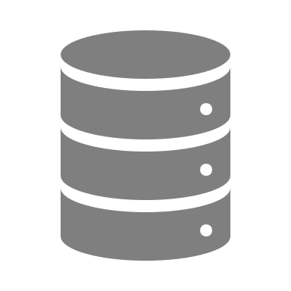



Software-Defined Networking (SDN)
The SDN architecture concept is given below :
Application layer
Applications, running on physical
or virtual hosts
Northbound APIs
Control layer
Network controller
Southbound API
Infrastructure layer
Programmable switches
Notes:
https://qmonnet.github.io/whirl-offload/2016/07/08/introduction-to-sdn/
Trainer Notes:
The SDN architecture concept is given below :
Application Layer
Applications, running on physical or virtual hosts. Application layer consists of business applications, application devices i.e firewall, proxies. Communication between SDN controller takes through Northbound API
Control Layer-Centralised controller hosted on a Server used for managing the business application and firewall. Communicates with application layer and Infrastructure layer through application programming interface
Infrastructure Layer
Programmable Switches, routers. Communication between SDN controller takes place through South bound APIs

Slide 68
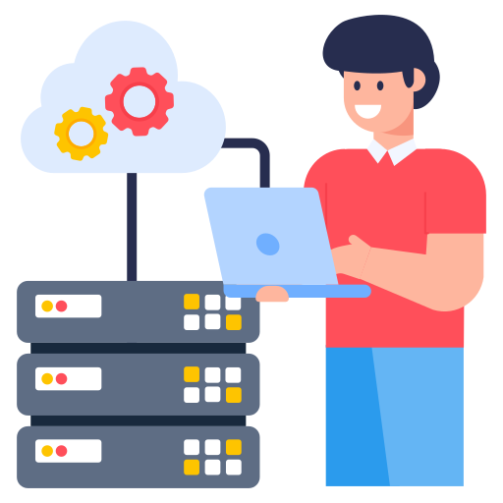
On Premise
On-premise refers to the network infrastructure that physically resides within an organization's own facilities, as opposed to cloud-based network resources.
Essentially, it's your own private network, not relying on external data centers.
It provides organizations with complete control over their infrastructure and software stack.
Notes:
Trainer Notes
Explain On Premises
An on-premises system, also abbreviated as "on-prem" and sometimes written as "on-premise," refers to IT infrastructure and software applications that are physically hosted and managed within an organization's own facilities, rather than being delivered over the internet from a remote location. Imagine having your own data center with all the servers and hardware needed to run your applications, instead of renting space and resources from a cloud provider.

Slide 69
On Premise - Benefits
Physical control
You have full physical control over network hardware, including firewalls, switches, and routers, enabling extensive customization and security control.
Security benefits
Network isolation techniques like firewalls and VLANs can create a more secure environment for sensitive data within your infrastructure.
Management considerations
Managing and maintaining the on-premises network infrastructure is your responsibility, necessitating dedicated IT staff with the necessary expertise.
2
1
3
Notes:
Trainer Notes: Explain Benefits of OnPremise System
Security Benefits-Network isolation techniques like firewalls and VLANs can create a more secure environment for sensitive data within your infrastructure..
Physical Control-You have full physical control over network hardware, including firewalls, switches, and routers, allowing for extensive customization and security control.
Management Consideration- Managing and maintaining the on-premises network infrastructure is your responsibility. This necessitates dedicated IT staff with the necessary expertise

Slide 70

On Premise - Use Cases
For industries with stringent regulations like finance, healthcare, or government, on-premise infrastructure provides the ultimate control over data security.
Organizations with real-time applications or high-bandwidth workloads may benefit from on-premise networks.
Local servers can offer lower latency and more predictable performance than cloud-based solutions.
Some organizations might have concerns about data privacy or intellectual property in a cloud environment.
An on-premise network keeps all data and resources physically located within the organization's control, potentially reducing these concerns.
For organizations with predictable network usage and a large existing IT staff, on-premise networks can be cost-effective in the long run.
Notes:
Trainer Notes:
Explain Use cases of On Premise System
For industries with stringent regulations, such as finance, healthcare, or government, on-premise infrastructure provides the ultimate control over data security.
Organisations with real-time applications or high-bandwidth workloads may benefit from on-premise networks. Local servers can offer lower latency and more predictable performance than cloud-based solutions
Some organisations might have concerns about data privacy or intellectual property in a cloud environment. An on-premise network keeps all data and resources physically located within the organization's control, potentially reducing these concerns
For organizations with predictable network usage and a large existing IT staff, on-premise networks can be cost-effective in the long run

Slide 71

Centralized System
A centralized system is characterized by consolidating control, data storage, and processing in a single location or server.
In a centralized system, only the IT department can add a user to the system, and HR is solely responsible for onboarding new employees.
This approach provides uniformity and consistency in decision-making and offers a single point for monitoring and control.
In enterprise architectures, centralized systems simplify management but pose the challenge of a single point of failure.
Notes:
Trainer Notes
Explain Centralized System
A centralized system is a type of system where control and processing are concentrated in a single location, often a single server or a small group of central servers. These central servers handle all the important tasks like data processing, storing information, and making decisions for the entire system.

Slide 72

Decentralized Systems
In a decentralized system, there's no single central authority making decisions for everyone.
In a decentralized system, there's no single central authority making decisions for everyone.
Decentralized systems distribute data and control across multiple locations, servers, or nodes.
A decentralized approach offers higher resilience and flexibility, allowing for independent operations, greater autonomy, and faster access times.
Decentralized systems may bring complexity in management, potential inconsistency, and the need for more robust coordination mechanisms.
Notes:
Trainer Notes:
Explain Decentralized System
In a decentralised system, there's no single central authority making decisions for everyone
Decentralized systems distribute data and control across multiple locations, servers, or nodes.
A decentralised approach offers higher resilience and flexibility, allowing for independent operations, greater autonomy, and faster access times.
Decentralized systems may bring complexity in management, potential inconsistency, and the need for more robust coordination mechanisms

Slide 73
Centralized vs Decentralized Systems
S.no | Feature | Centralized system | Decentralized system
1 | Control | Single authority | Distributed network
2 | Efficiency | Fast decisions | Slower decisions (consensus needed)
3 | Security | Single point of failure | More robust
4 | Transparency | Potentially opaque | Can be more transparent
Notes:
Trainer Notes:
Explain the difference between Centralized and Decentralized System
Control
Centralized: A single entity (server, mainframe, or management team) dictates control and makes decisions for the entire system. Think of a pyramid with a single point of authority at the top.
Decentralized: Control and decision-making are distributed across multiple nodes (servers, computers) in a network. There's no single ruler; it's more like a federation where multiple entities collaborate.
Efficiency
Centralized: Centralized systems can offer good performance for tasks requiring centralized processing or data access. However, bottlenecks can occur with high data volume or processing demands.
Decentralized: Distributing tasks across multiple nodes can improve performance, especially for tasks with high processing requirements
Security:
Centralized: Security breaches at the central location can compromise the entire system.
Decentralized: Security can be more complex as there's no central point to enforce security measures. However, a breach in one node might not affect the entire system

Slide 74

Virtualization
Virtualization is a technology that enables running multiple operating systems side-by-side on the same processing hardware.
Application
App
App
App
It adds a software layer between the operating system and the underlying computer hardware.
OS
OS
OS
Its benefits include efficiency, higher availability, and lower costs.
Operating system
Hypervisor
Traditional architecture
Virtual architecture
Notes:
Trainer Notes:
Virtualization is a technology that enables running multiple operating systems side-by-side on the same processing hardware.
It adds a software layer between an operating system and the underlying computer hardware.
It’s benefits include efficiency, higher availability, and lower costs.

Slide 75
Hypervisor
A hypervisor is a software that is installed to virtualize a given computer.
Host machine: A computer on which a hypervisor is installed.
Guest machine: Every virtual machine created by the hypervisor.
Type 1 hypervisors run directly on the host machine’s hardware.
Example: Microsoft Hyper-V hypervisor, VMware ESX/ESXi
Type 2 hypervisors run within an existing operating system environment.
Example: VMware workstation, VirtualBox
Type 1 Bare metal
Type 2 Hosted
App
App
App
App
OS
OS
OS
OS
Hypervisor
Hypervisor
Hardware
Operating System
Hardware
Notes:
Trainer Notes:
A hypervisor is a software that is installed to virtualize a given computer.
Host machine: A computer on which a hypervisor is installed
Guest machine: Every virtual machine
There are two types of Hypervisor
Type 1 hypervisors run directly on the host machine’s hardware
Example: Microsoft Hyper-V hypervisor, VMware ESX/ESXi
Type 2 hypervisors run within an existing operating system environment
Example: VMware Workstation, Virtual Box

Slide 76


Virtualization Vulnerabilities
VM sprawl
The ease of deploying VMs can lead to ‘VM sprawl,’ a situation in which an organization loses track of the number and state of its VMs.
Insecure interfaces and API
Virtualization platforms often provide various management interfaces, which, if not properly secured, can be a weak link in the security chain.
Resource exhaustion
VMs share the resources of the host machine. An attacker could deliberately overload a VM, causing resource exhaustion that affects all VMs on the host.
Data leakage
In multi-tenant environments, where multiple parties use the same physical hardware, misconfigurations can lead to data leakage between VMs.
Notes:
Trainer Notes:
Explain Virtualization Vulnerabilities mentioned in slides above
VM Sprawl-VM sprawl refers to the uncontrolled growth of virtual machines (VMs) within an IT environment. Imagine having a server room overflowing with unused or poorly managed VMs, consuming resources and creating a tangled mess
Insecure interfaces and API-Insecure interfaces and APIs (Application Programming Interfaces) can be a major entry point for cyberattacks. interfaces and APIs become insecure when they lack proper security measures, making them vulnerable to exploitation
Resource Exhaustion-Resource exhaustion occurs when a virtual machine (VM) consumes more of a critical resource (CPU, memory, storage, or network bandwidth) than is available, impacting its performance and potentially affecting other VMs on the same physical host server.
Data Leakage-Data leakage in virtual machines (VMs) refers to the unintended or unauthorized disclosure of sensitive information from within a VM. This can happen through various methods, potentially compromising the security and privacy of the data.

Slide 77
Controls for Virtualization Vulnerabilities
Regular patching: Consistently updating the hypervisor and VM operating systems is crucial to patch known vulnerabilities and reduce exploitation risks.
Resource allocation: Implementing resource quotas for VMs can prevent resource exhaustion attacks. For example, setting a CPU usage limit ensures no single VM can monopolize the host's resources.
Access control and monitoring: Implement robust access control, like multifactor authentication, for hypervisor access. Continuous monitoring can also detect unauthorized activities in real time.
Encryption and network segmentation: Encrypt data at rest and in transit. Network segmentation can isolate VMs handling sensitive data, making lateral movement by attackers harder.
Policy and governance: Establishing a governance policy for VM lifecycle management can prevent VM sprawl by setting guidelines for when VMs should be created, maintained, and decommissioned.
Notes:
Trainer Notes:
Explain controls for virtualization
Regular Patching: Consistently updating the hypervisor and the operating systems running on VMs is crucial. This ensures that known vulnerabilities are patched, reducing the risk of exploitation
Resource Allocation: Implementing resource quotas for VMs can prevent resource exhaustion attacks. For example, setting a CPU usage limit for each VM ensures that no single VM can monopolize the host’s resources
Access Control and Monitoring: It is important to implement robust access control mechanisms, such as multifactor authentication for hypervisor access. In addition, continuous monitoring can help detect unauthorized activities in real time
Encryption and Network Segmentation: Data should be encrypted at rest and in transit. Network segmentation can further isolate VMs handling sensitive data, making it harder for attackers to move laterally across the network
Policy and governance: Establishing a governance policy for the lifecycle management of VMs can prevent VM sprawl. This involves setting guidelines for when VMs should be created, maintained, and decommissioned

Slide 78
Containerization
Containerized applications
Containerization is packaging an application with its configuration files, libraries, and dependencies, ensuring it runs efficiently and bug-free across different computing environments.
A container is a lightweight, standalone executable package that includes everything needed to run an application: code, runtime, system tools, and libraries.
App A
App B
App C
App D
App E
App F
App C
Docker
Host operating system
Infrastructure
Source: https://tsa.com/top-5-benefits-of-containerization/
Notes:
Trainer Notes:
Containerization is the process of packaging an application with all its related configuration files, libraries, and dependencies required for it to run efficiently and bug-freeacross different computing environments. Containers are essentially standardized units of software that package up code and all its dependencies needed to run an application. Imagine a shipping container that can hold all the necessary parts and instructions .
Let's understand this with the help of a loose analogy. We all live in our homes, and wherever we go to work or party, we all come back home as our homes have everything required for us to live: our personal belongings, our personal bed, etc. Consider this a software program without containers. It has to be run from within a system where libraries, functions, codes, and other things are installed. Now, consider people with nomadic attitudes, although not popular in India. People living in camping vans arrange everything in one van, reducing dependency on one static place like our homes. They can stay in any place of their choice as their camping vans have everything required for their day-to-day living, which is what containers do. It eliminates dependency on one system and packages everything in one container with everything for software to run. You can run it anywhere if it supports containerization.
https://tsa.com/top-5-benefits-of-containerization/

Slide 79




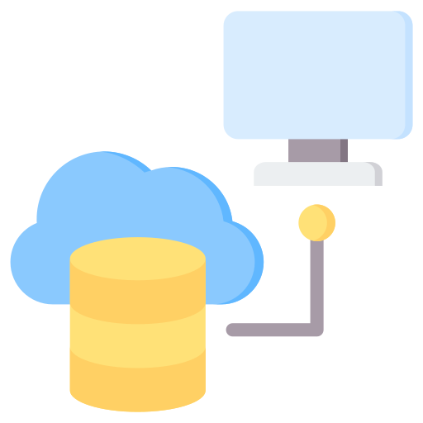
Containerization: Benefits
Enhanced productivity
Run anywhere
Simple and faster deployment
Scale quickly
Increased portability
Source: https://tsa.com/top-5-benefits-of-containerization/
Notes:
https://tsa.com/top-5-benefits-of-containerization/
Trainer Notes:
Containerization: Benefits
Enhanced productivity- Containers are much lighter than virtual machines because they share the host operating system kernel. This translates to faster startup times, lower resource consumption, and the ability to run more applications on a single server.
Improved scalability-Containers allow for scaling applications by adding or removing individual containers as needed. This provides greater flexibility and resource efficiency compared to scaling entire virtual machines.
Improved security-Container isolation creates an additional security layer, making it harder for malware or security breaches in one container to impact other applications or the host system
Increased portability- Containers can be easily moved between different environments (physical servers, virtual machines, cloud platforms) as long as the host system supports the container runtime engine. This portability simplifies deployments and facilitates hybrid cloud strategies.
Simple and faster deployment-Containers package everything an application needs to run (code, libraries, dependencies) into a single unit. This eliminates conflicts arising from different environments and simplifies the development process

Slide 80
Docker
Container 1
Container 2
Container 3
Container 4
Docker is an open-source containerization platform used to create, deploy, and manage containers.
It provides a simple and efficient way for developers to package and run applications in containers.
It streamlines the delivery of applications by isolating them from infrastructure.
Docker has a limitation: it requires manual container provisioning and is not scalable in large environments.
APP 1
APP 2
APP 3
APP 4
Bin/Lib
Bin/Lib
Bin/Lib
Bin/Lib
Docker engine
Host operating system
Infrastructure (Physical server)
Source: https://tsa.com/top-5-benefits-of-containerization/
Notes:
Trainer Notes:
Explain Dockers
Docker is a popular open-source platform for developing, deploying, and managing containerized applications. It provides a simple and efficient way to create, deploy, run, and manage customers.
Dockers allow developers to package and run applications in containers.
It streamlines the delivery of applications by isolating them from infrastructure.
It essentially provides a set of tools and technologies that make working with containers much easier. Imagine Docker as a comprehensive toolkit that simplifies building, shipping, and running containerized applications
Dockers have a limitation as it manually provision containers and it is not scalable in large environment.

Slide 81
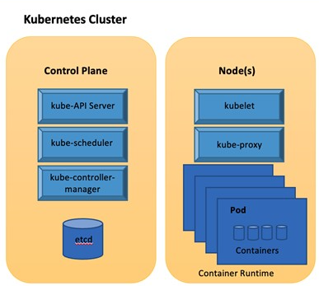
Kubernetes
Kubernetes is an open-source container orchestration platform designed to automate deploying, scaling, and managing containerized applications.
Orchestration refers to managing the lifecycle of containerized applications.
It enables automatic scaling, auto-healing, load balancing, and monitoring deployments.
Source: https://tsa.com/top-5-benefits-of-containerization/
Notes:
Trainer Notes:
Explain Kubernates
Kubernetes, often shortened to k8s, is an open-source system for automating deployment, scaling, and management of containerized applications. Imagine you have a massive orchestra with many musicians (containers) playing complex pieces (applications). Kubernetes acts like the supervisor, ensuring everyone plays their part in harmony, at the right time, and adapts to changes seamlessly

Slide 82
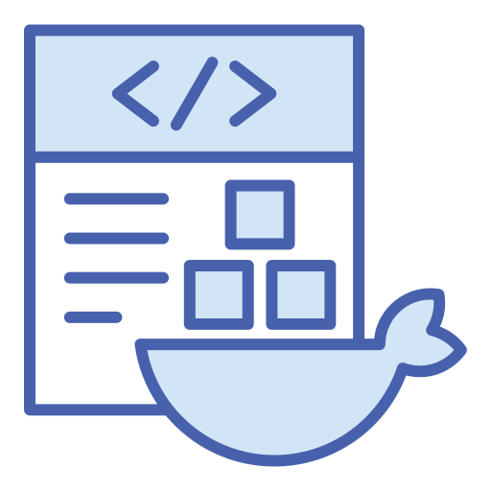
Kubernetes Key Features
Container orchestration
K8s excels at managing containerized applications and it is efficiently run across clusters of computers.
Deployment and scaling
Kubernetes automates deploying the containers across servers, scaling them up or down based on traffic, and restarting them if they fail.
Self-healing
If a container crashes, Kubernetes automatically detects it and restarts it, ensuring your application stays up and running.
Load balancing
Kubernetes distributes incoming traffic across multiple instances of your containerized application, improving performance and reliability.
Notes:
Trainer Notes:
Explain Kubernates Key Features
What is K8- K8 most likely refers to Kubernetes, an open-source system for automating deployment, scaling, and management of containerized applications.
Container Orchestration-K8s excels at managing containerized applications and it is efficiently run across clusters of computers
Deployment and Scaling-Kubernetes automates deploying these containers across servers, scaling them up or down based on traffic, and restarting them if they fail
Self Healing-If a container crashes, Kubernetes automatically detects it and restarts it, ensuring your application stays up and running
Load Balancing-Kubernetes distributes incoming traffic across multiple instances of your containerized application, improving performance and reliability

Slide 83
Benefits of Kubernetes
Efficiency
Scalability
Automates manual tasks associated with container management, freeing up developers and IT staff
Easily scales applications up or down based on demand
Portability
High availability
Ensures applications stay operational even if individual servers fail
Kubernetes applications can run on any infrastructure that supports it, providing flexibility in deployment options.
Notes:
Trainer Notes:
Let’s walk through the Benefits
Efficiency-Automates manual tasks associated with container management, freeing up developers and IT staff
Scalability- Easily scales applications up or down based on demand
Portability-Kubernetes applications can run on any infrastructure that supports it, providing flexibility in deployment options
High Availability-Ensures applications stay operational even if individual servers fail.

Slide 84
Internet of Things (IoT)
The IoT is a network of physical devices, vehicles, home appliances, and other items embedded with electronics, software, sensors, actuators, and connectivity, enabling them to connect and exchange data.
Any services
Anything
IoT
Any time
Anywhere
Any data
Anyone
Any path
Notes:
Trainer Notes:
The Internet of Things (IoT) is the network of physical devices, vehicles, home appliances, and other items embedded with electronics, software, sensors, actuators, and connectivity that enables these objects to connect and exchange data.
IOT can provide you any service , anywhere irrespective of location , to anyone who seek its, over any path be it internet, airgap, intranet, any data, Ay time irrespective of timing and different types of service

Slide 85





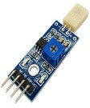






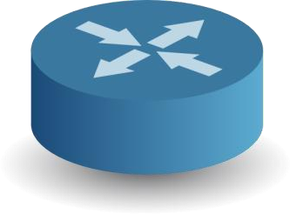



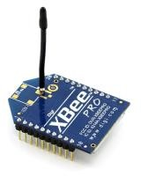

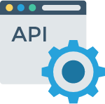




IoT Architecture
Hardware
Communication
Cloud
Applications
Sensors and actuators
Gateway
Data center or cloud
Mobile, tablet, laptop, or API
Embedded cloud
The Internet
Private cloud
Big data
Data acquisition
Data aggregation
Data analysis
Data presentation
Notes:
Trainer Notes:
Explain the diagram given on the slide.
Hardware: Actual devices like watch, thermostat which collects date
Communication: There are routers, network device where data aggregation takes place
Cloud- Data is send to cloud for further analysis
Application: Final Data is presented to application where you can see the final analysis

Slide 86

Components of IoT
Sensors
Sensors are the backbone of the IoT, acting as the eyes and ears of interconnected devices by gathering physical world data.
Facility automation
Facility automation with IoT integrates internet-connected devices, sensors, and software to optimize building operations and enhance the physical environment.
Wearables
These devices are designed to be worn, collecting real-time data and providing functionalities that seamlessly integrate with daily life.
Connectivity
Networks such as Wi-Fi, Bluetooth, and cellular enable these devices to connect to the internet.
Notes:
Explain Components of IOT
Sensors-Sensors are the backbone of the Internet of Things (IoT) - they act as the eyes and ears of these interconnected devices, gathering the physical world data that makes IoT systems so powerful
Facility Automation-Facility automation with IoT integrates internet-connected devices, sensors, and software to optimize building operations and create a smarter physical environment
Wearables- These electronic devices are designed to be worn on our bodies, collecting real-time data and often providing functionalities that seamlessly integrate with our daily lives
Connectivity-Networks that allow these devices to connect to the internet (Wi-Fi, Bluetooth, cellular etc.).

Slide 87
IoT Security Challenges
Lack of standardization
IoT lacks a standardized security framework, resulting in inconsistent security practices across devices and manufacturers.
This fragmentation makes ensuring uniform security measures challenging, resulting in gaps in the overall security posture.
IoT devices collect and transmit vast amounts of data, including personal and sensitive information.
Mishandling or unauthorized access to this data can lead to privacy breaches and identity theft.
Data privacy concerns
IoT devices may communicate over unsecured channels, making them susceptible to eavesdropping, where attackers intercept and alter communications, and man-in-the-middle attacks, where attackers alter communications.
Insecure communications
Notes:
Trainer Notes:
Explain IOT Security Challenges mentioned in Slides
Lack of Standardization: The IoT landscape is filled with devices from numerous vendors, each with their own communication protocols, data formats, and security practices. This fragmentation creates compatibility issues and hinders interoperability.
Data Privacy Concern-Unsecured data collection and transmission practices can lead to privacy violations for users
Insecure Communication-Web interfaces and mobile apps used to control IoT devices might have vulnerabilities that attackers can exploit to gain unauthorized access or manipulate device behavior.

Slide 88
IoT Security Challenges
Lifecycle management
IoT devices often have long lifecycles, and manufacturers may discontinue support and updates when new models enter the market.
This leaves devices vulnerable to known security flaws that go unpatched, posing a significant security risk.
Physical access to IoT devices can compromise their security, allowing attackers to tamper with hardware, extract sensitive data, or reprogram the device for malicious purposes.
Physical attacks
Risks: IoT components sourced globally make supply chains vulnerable to tampering or the insertion of malicious components.
Ensuring the integrity of the supply chain is crucial to prevent security breaches.
Supply chain risks
Notes:
Trainer Notes:
Explain IOT Security Challenges mentioned in Slides
Lifecycle Management-The absence of standardized processes across different IT assets or departments can lead to inefficiencies and inconsistencies in how lifecycles are managed. Imagine managing servers with different procedures compared to network devices - chaos!
Physical Attacks-Many IoT devices are designed for ease of use and affordability, and physical security might not be a top priority. This can make them easy targets for theft or tampering.
Supply Chain Risks in IOT-IoT supply chains often involve multiple vendors and subcontractors, making it challenging to maintain complete visibility and control over security practices throughout the entire process.

Slide 89

Real-Time Operating System (RTOS)
It is a specialized operating system designed for tasks with strict deadlines, particularly in embedded systems.
Unlike a general-purpose OS like Windows or macOS, an RTOS prioritizes responsiveness and determinism over features or a fancy user interface.
It is a software component that rapidly switches between tasks, creating the illusion of simultaneous execution of multiple programs on a single processing core.
Notes:
Trainer Notes:
Explain RTOS-a Real-Time Operating System (RTOS) is a specialized operating system designed for tasks that require guaranteed response times. Unlike a general-purpose OS you might find on a desktop computer or phone (like Windows or macOS), an RTOS prioritizes predictable performance over flexibility. Imagine an RTOS as a conductor in an orchestra, ensuring all the instruments (processes) play their parts precisely at the right time to create a flawless performance.
RTOS stands for Real-Time Operating System. It's a specialized operating system designed for tasks that require strict deadlines, especially in embedded systems.
Unlike a general-purpose OS like Windows or macOS, an RTOS prioritizes responsiveness and determinism over features or a fancy user interface.
It is a software component that rapidly switches between tasks, giving the impression that multiple programs are being executed at the same time on a single processing core.

Slide 90
Key Characteristics of RTOS
Deterministic behavior: An RTOS guarantees a predictable response time to events, ensuring the system reacts to stimuli within a known timeframe, which is crucial for real-time applications.
Minimal resource usage: RTOS is lightweight and designed for devices with limited processing power and memory, making them ideal for resource-constrained embedded systems.
Task prioritization: An RTOS efficiently manages multiple tasks, prioritizing them based on real-time requirements to ensure critical tasks meet deadlines.
Event-driven architecture: RTOS often uses an event-driven architecture, responding to events like sensor readings or external signals by triggering specific tasks.
Notes:
Trainer Notes
Explain Key Characteristics mentioned in slides
Deterministic Behavior: An RTOS guarantees a predictable response time to events. You know exactly how long it will take for the system to react to a stimulus, which is crucial for real-time applications.
Minimal Resource Usage: RTOSes are lightweight and designed to run on devices with limited processing power and memory. This makes them ideal for embedded systems that often have resource constraints
Task Prioritization: An RTOS efficiently manages multiple tasks running on the system. It prioritizes tasks based on their real-time requirements, ensuring critical tasks are completed within deadlines.
Event-Driven Architecture: RTOSes often rely on an event-driven architecture. The system responds to events (like sensor readings or external signals) by triggering specific tasks.

Slide 91

Applications of RTOS
Industrial automation and control systems:
Robots, factory machinery, and industrial controllers rely on RTOS for precise timing and control.
Medical devices:
Life-critical equipment like pacemakers and defibrillators use RTOS to ensure timely responses.
Telecommunication systems:
Routing calls, data packets, and ensuring network stability often involve RTOS.
Consumer electronics:
Printers, drones, and even some high-end smartwatches utilize RTOS for specific functions.
Notes:
Trainer Notes:
Explain Application of RTOS
Industrial Automation and Control System-Industrial automation systems often run on devices with limited processing power and memory. RTOSes are designed to be lightweight with a small footprint. This allows them to operate effectively on these resource-constrained devices, enabling them to control complex industrial processes without overloading the system.
Medical Devices-an RTOS prioritizes predictable, deterministic performance, making it ideal for tasks with strict timing requirements, like those found in medical equipment
Telecommunication Systems-RTOS prioritizes predictable, deterministic performance. This is essential for handling the constant flow of data and ensuring timely delivery of voice calls, video streams, and other communication services.
Consumer Electronics-RTOSes are lightweight and prioritize predictable performance, making them perfect for handling specific tasks within consumer electronics that require precise timing

Slide 92

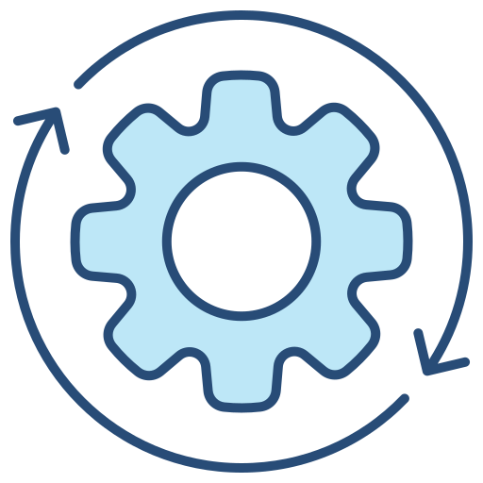
Advantages of RTOS
Guaranteed response times: Ensures critical tasks meet defined deadlines crucial for applications such as industrial control systems or medical devices.
Improved system reliability: Predictable behavior and minimal resource usage enhance system stability and reliability.
Faster development time: RTOS provides a foundation for real-time applications, streamlining development compared to coding everything from scratch.
Notes:
Trainer Notes
Explain Advantages of RTOS
Guaranteed Response Times: Ensures critical tasks are completed within defined deadlines, essential for applications like industrial control systems or medical devices.
Improved System Reliability: Predictable behavior and minimal resource usage contribute to a more stable and reliable system
Faster Development Time: RTOSes provide a foundation for building real-time applications, streamlining development compared to coding everything from scratch

Slide 93

Embedded System
An embedded system is a small computer designed to perform a specific task within a more extensive system.
It typically consists of a processor, memory, and input/output (I/O) devices.
Unlike a general-purpose computer, an embedded system is not designed for multiple tasks but excels at its singular function.
Many embedded systems have substantial design constraints compared to desktop computing applications.
Notes:
Trainer Notes:
Explain Embedded Systems
An embedded system is a small computer designed to perform a specific task within a larger system. It typically consists of a processor, memory, and input/output (I/O) devices.
Unlike a general-purpose computer, an embedded system is not designed for multiple tasks but excels at its singular function.
An embedded system is a little computer system designed to perform a specific task within a larger system. Imagine a tiny computer built into a toaster that controls the heating elements and timing, or a more complex system like a self-driving car that has numerous embedded systems working together to control steering, braking, and other functions.

Slide 94

Attributes of Embedded System
Dedicated function:
Embedded systems are designed for a specific task like controlling a traffic light or processing data from a medical device.
Part of a larger system:
They are often integrated into a larger mechanical or electronic system such as a car or a washing machine.
Real-time constraints:
Many embedded systems need to respond to events in real-time, meaning they have strict timing requirements.
Variety in complexity:
They can range from very simple devices with minimal components to more complex systems with multiple processors and a user interface.
Notes:
Trainer Notes:
Explain Attributes of Dedicated Functions
Dedicated Function-Embedded systems are designed for a specific task, like controlling a traffic light or processing data from a medical device
Part of larger system-They are often integrated into a larger mechanical or electronic system, such as a car or a washing machine
Real time Constraints-Many embedded systems need to respond to events in real-time, meaning they have strict timing requirements
Variety in complexity-They can range from very simple devices with minimal components to more complex systems with multiple processors and a user interface

Slide 95

Applications of Embedded System
Smartphones
Thermostats
Anti-lock braking system
Gaming consoles
Industrial robots
Notes:
Trainer Notes
Explain Application of Embedded System.
Smart Phones- while being miniaturised powerhouses of general-purpose computing, also rely on embedded systems for specific functionalities.
Anti locking braking system -An ABS system is a dedicated embedded system within a car. It's not part of the main engine control unit (ECU) but has its own microcontroller and software specifically designed to manage wheel lock prevention during braking.
Gaming console- a gaming console is designed specifically for playing video games. All its hardware and software components work together to render graphics, process audio, handle user input, and create a seamless gaming experience.
Industrial robots-Embedded systems are the backbone of industrial control systems (ICS) and programmable logic controllers (PLCs). They monitor sensors, analyze data, and make real-time decisions to control actuators, robots, and other automated equipment within factories and production lines
Themostats-thermostat is a common household example of an embedded system. modern thermostats are little computers dedicated to controlling your home's temperature efficiently

Slide 96
Comparison Between RTOS and Embedded System
S.no | Feature | Embedded system | RTOS (Real-time operating system)
1 | Purpose | Dedicated computer for a specific task | Software for managing tasks in an embedded system
2 | Focus | Efficiency in performing one function | Meeting real-time deadlines and deterministic performance
3 | Examples | Traffic light controller, thermostat, washing machine | Industrial control systems, robotics, medical devices, avionics
4 | Complexity | Simple to complex | Typically lightweight and focused
5 | Resource usage | Optimized for limited resources (memory, processing) | Minimizes overhead while providing real-time functionality
6 | Timing constraints | May or may not have strict timing requirements | Designed for guaranteed task completion within deadlines
8 | RTOS usage | Can function without an RTOS (for simpler tasks) | Designed for embedded systems with strict timing constraints
Notes:
Trainer Notes:
Explain the difference between RTOS and embedded system. Differences clearly mentioned in slides
Embedded System- An embedded system is a dedicated computer system designed to perform a specific task within a larger system. Imagine a mini-computer in a toaster controlling the heating elements or a more complex system like a self-driving car with numerous embedded systems working together.
RTOS-An RTOS is a specialized operating system designed for embedded systems. It prioritizes predictable, deterministic performance. Imagine an RTOS acting as a conductor in a complex orchestra of data packets in a router, making sure everything arrives at the right destination at the right time

Slide 97


Industrial Control System (ICS)
Industrial control system (ICS) is a general term that encompasses several types of
control systems, including supervisory control and data acquisition (SCADA) systems, distributed control systems (DCS), and other control system configurations such as programmable logic controllers (PLC) often found in the industrial sectors and critical infrastructures. ~ NIST
Notes:
Trainer Notes:
Industrial Control System (ICS) is a general term that encompasses several types of
control systems, including supervisory control and data acquisition (SCADA) systems, distributed control systems (DCS), and other control system configurations such as Programmable Logic Controllers (PLC) often found in the industrial sectors and critical infrastructures.
Programmable Logic Controllers (PLC)
Distributed Control Systems (DCS)
Supervisory Control and Data Acquisition (SCADA)

Slide 98
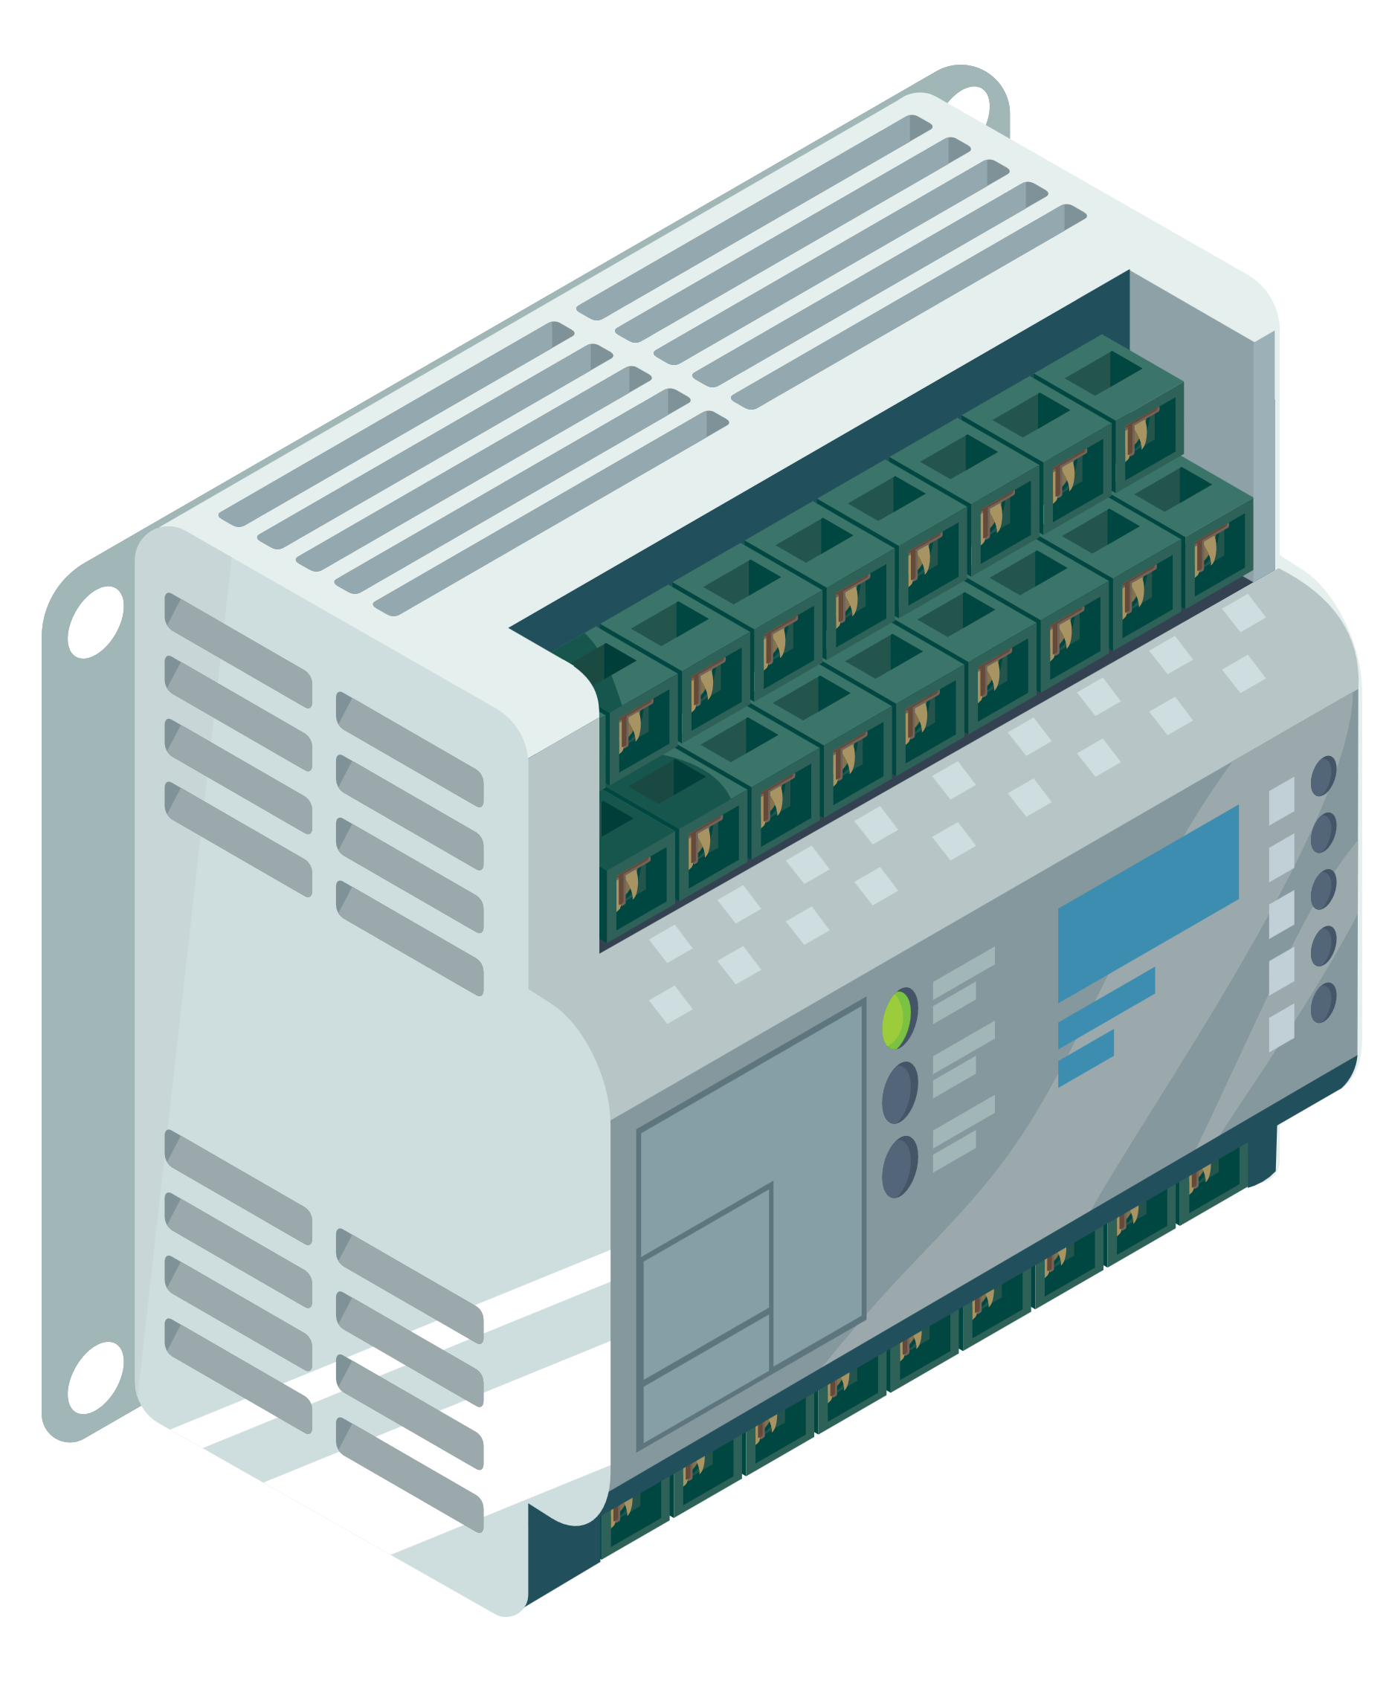
Programmable Logic Controller (PLC)
A programmable logic controller (PLC) is a small industrial computer originally designed for factory automation and industrial process control.
A PLC can be programmed as per the process that needs to be controlled.
PLCs have evolved into controllers with the capability of controlling complex processes, and they are used substantially in SCADA systems and DCS.
PLCs are also used as the primary controller in smaller system configurations.
PLCs are used extensively in almost all industrial processes.
Notes:
Trainer Notes:
A programmable logic controller (PLC) is a small industrial computer originally designed for factory automation and industrial process control.
A PLC can be programmed as per the process that needs to be controlled.
PLCs have evolved into controllers with the capability of controlling complex processes, and they are used substantially in SCADA systems and DCS.
PLCs are also used as the primary controller in smaller system configurations.
PLCs are used extensively in almost all industrial processes.

Slide 99

Distributed Control Systems (DCS)
A DCS is a specially designed automated control system used to monitor and control distributed equipment in process plants and industrial processes.
Unlike PLCs, which generally operate standalone and perform specific tasks, a DCS divides plant or process control into several areas of responsibility, each managed by its own controller.
The entire system is interconnected to function as a unified entity.
Notes:
Trainer Notes:
A distributed control system (DCS) is a specially designed automated control system used to monitor and control distributed equipment in process plants and industrial processes.
Unlike PLCs, which are generally standalone and perform a particular task, DCS is a system of dividing plant or process control into several areas of responsibility, each managed by its controller, with the whole system connected to form a single entity.

Slide 100

Supervisory Control and Data Acquisition (SCADA)
These systems monitor and control a plant or equipment in industries such as telecommunications, water, waste control, energy, oil and gas refining, and other public transportation systems (airport, traffic control, and rails).
Notes:
Trainer Notes:
SCADA (Supervisory Control and Data Acquisition) systems are used to monitor and control a plant or equipment in industries such as telecommunications, water, waste control, energy, oil and gas refining, and other public transportation systems (airport, traffic control, and rails).

Slide 101
Supervisory Control and Data Acquisition (SCADA)
SCADA consists of many remote terminal units spread geographically across for the collection of data and is connected to the master station for centralized data acquisition via any communication system.
SCADA provides management with real-time data on production, improves plant and personnel safety, and reduces costs of operation.
SCADA systems have increasingly adopted Internet of things technology to significantly improve
interoperability, reduce infrastructure costs, and increase ease of maintenance and integration.
Notes:
Trainer Notes:
SCADA consists of many remote terminal units spread geographically across for the collection of data and is connected to the master station for centralized data acquisition via any communication system.
SCADA provides management with real-time data on production, improves plant and personnel safety, and reduces costs of operation.
SCADA systems have increasingly adopted Internet of things technology to significantly improve interoperability, reduce infrastructure costs, and increase ease of maintenance and integration.

Slide 102

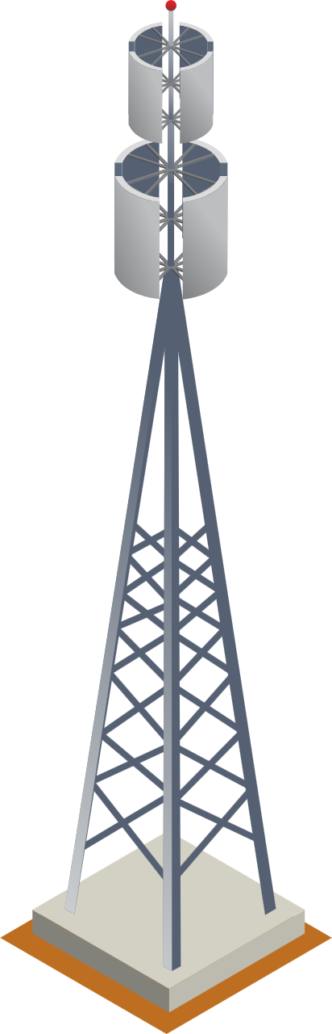



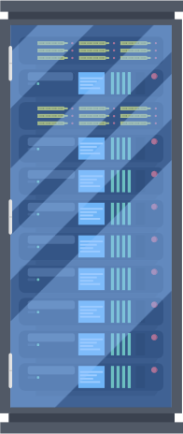



Supervisory Control and Data Acquisition (SCADA)
SCADA master station/control center
Comm. links
Remote substation
1200 bps +
(down to 300 bps in actual installation)
Intelligent electronic devices
Remote terminal
Unit (RTU)
Actuator
SCADA
master
Radio
Microwave
Spread-spectrum
Meter
Accumulator
Twisted-pair
Fiber-optics
Dial-up
Leased line
External control
points
Programmable logic controller (PLC)
Notes:
Trainer Notes:
Explain the image given on the slide.
There is one master SCADA controlled which is hosted on the main site, communicating between the Programming Logic controller responsible for maintaining different factories.

Slide 103
Difference Between PLC, DCS, and SCADA
 | PLC | DCS | SCADA
Usage | Used for controlling the medium or large-scale applications | Used for controlling the entire plant | Used for supervising and acquiring data from remote plants
Location | Local | Local | Geographically dispersed
Communication | LAN | LAN | Any communication system
Performance | High | Medium | Slow
Notes:
Trainer Notes:
Explain the table given on the slide.
Usage: PLC can be used for controlling individual application like temperature controller, DCS can control the entire plant and SCADA can be used for managing different sites
Location: PLC and DCS are located in a single location whereas SCADA is geographically dispersed
Communication: PLC and DCS communicate over LAN whereas SCADA communicates over WAN
Performance: Performance-wise, PLC is the fastest as that is a standalone controller, DCS is a collection of many PLCs and SCADA is the slowest.

Slide 104

Security Concerns with ICS
ICS poses the following security concerns:
Control system protocols with little or no security
Migration to TCP/IP networks with its inherent vulnerabilities
Interconnection with enterprise networks
Old operating systems and applications with poor patching practices
Little monitoring of control systems to detect and prevent attacks
Poor security practices followed by vendors resulting in insecure products
Increased risk of insider attacks by outsourced IT services
Increased attacks on ICS by terrorists and foreign governments
Notes:
Trainer Notes:
Industrial Control System (ICS) poses the following security concerns:
Control systems protocols with little or no security
Migration to TCP/IP networks with its inherent vulnerabilities
Interconnection with enterprise networks
Old operating systems and applications with poor patching practices
Little monitoring of control systems to detect and prevent attacks
Poor security practices followed by vendors resulting in insecure products
Increased risk of insider attacks by outsourced IT services
Increased attacks on ICS by terrorists and foreign governments

Slide 105

Case Study: Scenario
ICS malware targets European energy companies:
The SFG malware, discovered in June 2016 on the networks of a European energy company, created a backdoor on targeted industrial control systems.
backdoor delivered a payload that was used to extract data from or potentially shut down the energy grid, according to security researchers at endpoint security firm SentinelOne.
Notes:
Trainer Notes:
ICS Malware Targets European Energy Company:
The SFG malware, discovered in June 2016 on the networks of a European energy company, created a backdoor on targeted industrial control systems.
The backdoor delivered a payload that was used to extract data from or potentially shut down the energy grid, according to security researchers at endpoint security firm SentinelOne Labs

Slide 106
Case Study: Impact
The Windows-based SFG malware is designed to bypass next-generation antivirus software and firewalls.
It also encrypts key features of its code so that it cannot be discovered and analyzed.
The malware even skips features such as facial recognition, fingerprint scanners, and other advanced biometric access control systems running inside target organizations.
The malware shuts down when put into a sandboxed environment or a virtual machine to escape the notice of security teams.
Notes:
Trainer Notes:
The Windows-based SFG malware is designed to bypass next-generation antivirus software and firewalls.
It also encrypts key features of its code so that it can not be discovered and analyzed.
The malware even skips features such as facial recognition, fingerprint scanners, and other advanced biometric access control systems running inside target organizations.
Furthermore, the malware shuts down when put into a sandboxed environment or a virtual machine to escape the notice of security teams.

Slide 107

Case Study
For nation-states, identifying weaknesses in critical infrastructures of adversaries can be used strategically in case of conflicts, where cyber-attacks can be launched to paralyze a nation's key sectors, such as power, water, and transportation.
Cyber-criminals are shifting their focus to industrial facilities as a lucrative target, where they can blackmail facilities through techniques such as ransomware.
Notes:
Trainer Notes:
Cyber-criminals are shifting their focus to industrial facilities as a lucrative target, where they can blackmail facilities through techniques such as ransomware.
For nation-states, identifying weaknesses in critical infrastructures of adversaries can be used strategically in case of conflicts, where cyber-attacks can be launched to paralyze a nation's key sectors, such as power, water, and transportation

Slide 108

High Availability (HA)
HA refers to a system’s ability to remain operational and accessible even in the face of hardware failures, software issues, or other unexpected disruptions.
This is a characteristic of a system that aims to ensure an agreed-upon level of operational performance usually uptime for a higher-than-normal period.
It is about ensuring a system functions at a high level for an extended period, often measured by a specific uptime target.
Notes:
Trainer Notes:
Explain High Availability
High availability (HA) refers to a system’s ability to remain operational and accessible even in the face of hardware failures, software issues, or other unexpected disruptions.
High Availability is a characteristic of a system that aims to ensure an agreed-upon level of operational performance usually uptime for a higher-than-normal period.
In the realm of technology, particularly critical systems, high availability (HA) refers to the ability of a system to remain operational for a very high percentage of time. Imagine a system designed to be available 99.999% of the time, experiencing only a few seconds of downtime per year. This translates to extremely reliable performance, minimizing disruptions and ensuring continuous service

Slide 109

Principles of High Availability
01
Elimination of single points of failure: This means adding or building redundancy into a system so that failure of a component does not mean failure of the entire system.
02
Reliable crossover: In redundant systems, the crossover point tends to become a single point of failure. Reliable systems must provide for reliable crossover.
03
Detection of failures as they occur: If the preceding two principles are observed, a user may never see a failure, but the maintenance activity is a must.
Notes:
Trainer Notes:
Explains Principle of High Availability mentioned in slides
Elimination of single points of failure: This means adding or building redundancy into a system so that failure of a component does not mean failure of the entire system.
Reliable crossover: In redundant systems, the crossover point tends to become a single point of failure. Reliable systems must provide for reliable crossover.
Detection of failures as they occur: If the preceding two principles are observed, a user may never see a failure, but the maintenance activity is a must

Slide 110

High Availability Techniques
Multiple servers work together, with one acting as primary and others as backups.
If the primary fails, a secondary server takes over.
Distributes incoming traffic across multiple servers to prevent overloading any single server
Duplicates critical components like hardware, storage, and network connections to have backups in case of failure
Clustering
Load balancing
Redundancy
Notes:
Trainer notes:
Clustering -Refers to a group of independent computers (called nodes) that work together as a single unit. Imagine multiple servers acting in concert to provide increased processing power, storage capacity, or improved reliability
Load Balancing Distributes incoming traffic across multiple servers to prevent overloading any single server. Load balancing acts as a traffic cop, efficiently distributing incoming network requests across multiple servers. Load balancing distributes the workload amongst multiple servers, just like a restaurant with several waiters, ensuring tasks are handled efficiently and wait times are minimized.
Redundancy Duplicating critical components like hardware, storage, and network connections to have backups in case of failure. redundancy refers to the practice of duplicating critical components or systems to ensure continued function in case of failures.

Slide 111

Secure Infrastructure Considerations
Securing an enterprise infrastructure demands a multifaceted approach.
Assess the organization’s unique risk profile, understand the ever-evolving threat landscape, and align security measures with business objectives.
Set up security zones, organize device placement, implement preventative and detective controls, protect access points, and ensure the enterprise infrastructure maintains adaptability in the face of emerging trends, such as cloud computing, remote workforces, and IoT proliferation.
Notes:
Trainer Notes:
Explain Introductory slide
Securing an enterprise infrastructure demands a multifaceted approach.
Beyond the deployment of security tools and technologies, one must consider the holistic picture.
This entails an assessment of the organization’s unique risk profile, understanding the ever-evolving threat landscape, and aligning security measures with business objectives.
You also need to set up security zones, organize device placement, implement preventative and detective controls, protect access points, and ensure your enterprise infrastructure maintains adaptability in the face of emerging trends, such as cloud computing, remote workforces, and IoT proliferation.
Physical Security: Restrict physical access to data centers and server rooms with security measures like key cards, biometric authentication, and security cameras.
Environmental Controls-Maintain proper temperature, humidity, and fire suppression systems to protect hardware from damage.
Perimeter Security: Secure the physical boundaries of your infrastructure with fences, alarms, and security patrols (if applicable).
Firewalls: Implement firewalls to filter incoming and outgoing network traffic, blocking suspicious activity.Intrusion Detection and Prevention Systems (IDS/IPS): Monitor network traffic for malicious activity and take preventive measures to stop attacks

Slide 112



Considerations for Infrastructure
Availability: You must ensure that data is always available. This may involve building another data center or using geographically dispersed cloud regions.
. .
Resilience: Resiliency is measured by the time it takes for an organization to recover from a critical failure. A load balancer can enhance a web server's resiliency by distributing the load.
Cost: When we invest in new architecture, we consider not only the purchase cost but also the total cost of ownership, maintenance, and any third-party service-level agreements (SLAs).
Responsiveness: Responsiveness ensures timely and efficient interactions, enhancing user satisfaction and engagement.
Notes:
Trainer Notes:
Explained the parameters mentioned above in slides
Availability: Availability refers to the readiness and accessibility of a system or resource for authorized users at a given time. It essentially measures the percentage of time a system is operational and able to perform its intended function.
You must ensure that data remains available at all times. This might mean building another datacenter or holding the data in the cloud using geographically dispersed regions.
Resilience: Resilience refers to a system's ability to withstand, adapt to, and rapidly recover from a variety of disruptions, attacks, or failures.
Resiliency is measured by the amount of time it takes the organization to recover from a critical failure. A load balancer can make a web server resilient by balancing the load.
Cost: The cost of infrastructure can be a significant factor to consider when designing, deploying, and maintaining a system. It's an umbrella term encompassing various expenses associated with the physical and logical foundation upon which your system operates
When we invest in new architecture, we not only look at the cost of making the purchase but also consider the total cost of ownership, maintenance, and any third-party service-level agreement (SLA).
Responsiveness: Responsiveness refers to the ability of a system to react quickly and efficiently to changes in demand or events. Responsive infrastructure ensures smooth operation and minimizes disruptions for users. For instance, a responsive network can handle surges in internet traffic without noticeable slowdowns.
Responsiveness ensures timely and efficient interactions, enhancing user satisfaction and engagement.

Slide 113




Considerations for Infrastructure
Scalability: This is the ability of the cloud to increase the resources needed.
. .
Ease of deployment: In a cloud infrastructure, we can use automation tools such as IaC, VDI, and machine templates to roll out virtual machines, or containerization to deploy applications seamlessly.
Risk transference: Setting up an SLA for your infrastructure is a case of risk transference, as you are transferring the risk to a third party.
Ease of recovery: Cloud provider use geographically distributed regions, each holding three or four copies of the data. This ensures that if any data centers go offline, customers can still access other copies of the data.
Notes:
Trainer Notes:
Explained the parameters mentioned above in slides
(IAC IAC stands for Infrastructure as Code. It's a practice where infrastructure resources (like servers, networks, databases) are defined and managed using code.
VDI stands for Virtual Desktop Infrastructure. It's a technology that allows you to deliver virtual desktops to users from a centralized server.)
Scalability: Scalability refers to a system's ability to seamlessly adapt its capacity (resources) to meet changing demands. Imagine a business that can easily expand its IT infrastructure (servers, storage) as its customer base grows, or a cloud service that automatically allocates more resources when processing surgesThis is the ability of the cloud to increase the resources needed.
Ease of deployment: Ease of deployment refers to the simplicity and efficiency with which a system or application can be set up and made operational
In a cloud infrastructure, we could use automation such as IaC, VDI, and machine templates to roll out virtual machines or containerization to deploy applications seamlessly.
Risk transference: Risk Transference refers to the practice of shifting the financial responsibility for potential problems or losses from one party to another.
Setting up an SLA for your infrastructure is a case of risk transference as you are transferring the risk to a third party.
Ease of recovery: In the realm of infrastructure, ease of recovery refers to the speed and efficiency with which a system or service can be restored after an outage, disruption, or data loss.
CSPs use geographically distributed regions, each of which holds three or four copies of the data, so that should any datacenters go offline, the customer is still able to access other copies of the data.
What is IAC IAC stands for Infrastructure as Code. It's a practice where infrastructure resources (like servers, networks, databases) are defined and managed using code.
VDI stands for Virtual Desktop Infrastructure. It's a technology that allows you to deliver virtual desktops to users from a centralized server.

Slide 114





Considerations for Infrastructure
Patch availability: CSPs must maintain the most recent copies of patches to ensure that devices are updated with security updates and feature releases.
attempt (p. 317). Packt Publishing. Kindle Edition. . .
Inability to patch: A CSP might host clients with critical applications in the cloud. These applications are the responsibility of the customer, and the CSP might be contractually prevented from applying patches.
Power: A CSP needs to ensure it can meet the energy demands of its devices and workloads. Power usage from higher compute resources increases costs.
Compute: Compute capabilities in the cloud allow a CSP to provide additional resources immediately on demand.
Notes:
Trainer Notes:
Explained the parameters mentioned above in slides
Patch availability: Patch availability, in the context of information technology, refers to the timely access and dissemination of software updates designed to fix vulnerabilities or bugs in a system.
CSPs must maintain the most recent copies of patches to ensure that devices are up to date with security updates and feature releases.
Inability to patch: In some cases, a new patch may not be compatible with older versions of the software or other applications on the system. Installing the patch could lead to conflicts or unexpected behavior.
A CSP might host clients that host critical applications in the cloud. These applications are the responsibility of the customer, and the CSP might be contractually prevented from applying patches,
Power: Electrical power is the foundation of modern infrastructure. It's the invisible force that breathes life into everything from data centers and communication networks to transportation systems and buildings
A CSP needs to ensure that it can meet the energy demands of its devices and workloads. Power usage through higher compute resources increases costs.
Compute: Compute infrastructure encompasses the hardware and software components that provide processing power, storage capacity, and memory resources for running various applications and services within an infrastructure system.
Compute capabilities in the cloud allow a CSP to provide additional resources immediately on demand.

Slide 115
Security Principles to Secure Enterprise Infrastructure
Notes:
Let’s talk about Security Principles to Secure Enterprise Infrastructure

Slide 116

Device Placement
It determines the strategic positioning of security, connectivity, and traffic management elements, serving as the blueprint for a network’s functionality and security.
This architectural decision defines how a network will defend, communicate, and operate in the digital landscape, making it the foundation of network design and cybersecurity.
Notes:
Trainer Notes:
Device placement in a network determines the strategic positioning of security, connectivity, and traffic management elements and serves as the blueprint for a network’s functionality and security.
Device placement refers to the strategic positioning of hardware components within a physical space (data center, server room, etc.) or a logical network environment. It's like arranging furniture in your home – you place the couch for comfortable viewing, the router near the center for optimal Wi-Fi coverage, and each device with its function and purpose in mind. Effective device placement optimizes performance, security, and manageability of your infrastructure.

Slide 117
Security Zones
These are distinct segments or partitions within a network. Each zone has its own security policies, access controls, and trust levels.
These zones compartmentalize a network, dividing it into manageable segments and limiting access and privileges granted to users, devices, and systems.
Notes:
Trainer Notes:
Explain Security Zones
Security zones, in essence, are distinct segments or partitions within a network. security zones refer to logical divisions that group devices and resources based on their trust level and security requirements. Security zones create internal barriers within your network, segmenting it into areas with varying levels of access control.
Each zone has its security policies, access controls, and trust levels.
These zones compartmentalize a network, dividing it into manageable segments and reducing the extent of access and privileges granted to users, devices, or systems.

Slide 118
Types of Network Zone
A campus network or data center divided into zones implies that each zone has a different security configuration. The main zones are as follows:
Network zone
Internal zones
External zones
Demilitarized zones
Wireless zones
Specialized zones
Notes:
Trainer Notes:
Explain types of Zones, details are mentioned in following slides

Slide 119
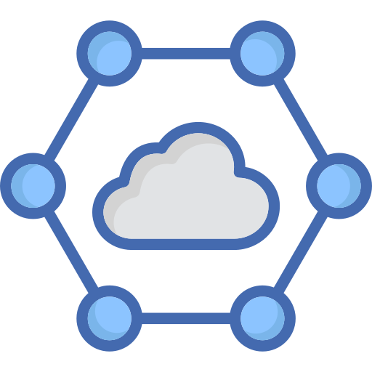
Types of Zones
Internal Zones
Referred to as trusted zones, internal zones include segments where sensitive or internal data is processed.
They often have more relaxed security policies than external, or untrusted, zones, but access is limited to authorized personnel.
External or Untrusted Zones
Demilitarized zones or Screened subnets
Wireless Zones
Specialized Zones
Notes:
Trainer Notes:
Explain Internal Zones
It is referred to as trusted zones; internal zones include segments where sensitive or internal data is processed.
Internal zones are specific segments within a network that group devices and resources based on their function and location within the internal network
Internal zones often have more relaxed security policies than do external, or untrusted, zones, but access is limited to authorized personnel.

Slide 120
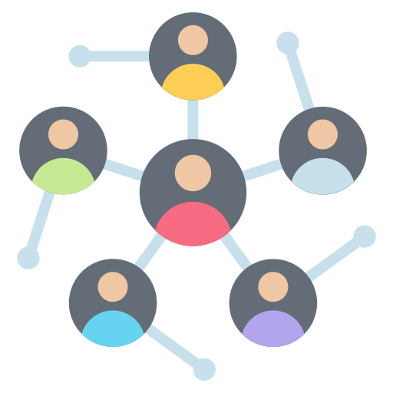
Types of Zones
Internal Zones
External zones are areas where connections from the public Internet or other untrusted networks are permitted.
Rigorous security measures are implemented in these zones to prevent unauthorized access to internal resources.
External or Untrusted Zones
Demilitarized zones or Screened subnets
Wireless Zones
Specialized Zones
Notes:
Trainer Notes:
Explain Untrusted Zones
External zones are areas where connections from the public Internet or other untrusted networks are allowed.
Untrusted zones refer to any network segment or environment where a high level of suspicion exists regarding the devices and users attempting to access resources
Rigorous security measures are usually implemented in these zones to prevent unauthorized access to internal resources.
untrusted zones are treated with caution in network security.

Slide 121

Types of Zones
Internal Zones
This is a specialized external zone where public-facing services like web or mail servers.
A DMZ is isolated from the Internet and the internal trusted zones to provide additional protection for the internal network.
External or Untrusted Zones
Demilitarized zones or Screened subnets
Wireless Zones
Specialized Zones
Notes:
Trainer Notes:
Explain DMZ
Demilitarized Zone (DMZ), also sometimes referred to as a perimeter network or screened subnet, is a vital component for organisations that want to provide some level of public access to their network resources while maintaining a strong security posture for their internal network
It is a specialized external zone where public-facing services like web or mail servers are placed.
A DMZ is isolated from the Internet and the internal trusted zones to provide additional protection for the internal network.

Slide 122

Types of Zones
Internal Zones
A wireless network uses radio waves instead of cables to connect devices to each other.
This allows you to connect to the internet or other devices on the network without being tethered to a physical location.
External or Untrusted Zones
Demilitarized zones or Screened subnets
Wireless Zones
Specialized Zones
Notes:
Trainer Notes:
Explain Wireless Zones.
A wireless network is a computer network that uses radio waves instead of cables to connect devices and transfer data. It allows users to connect to the internet, access shared resources, and communicate with each other without being physically tethered to a specific location
A wireless network is a computer network that uses radio waves instead of cables to connect devices.
This allows you to connect to the internet or other devices on the network without being tethered to a physical location.

Slide 123

Types of Zones
Internal Zones
Specialized zones are required to meet regulatory compliance requirements such as a PCI zone for handling credit card data. They are also used to isolate environments with different security requirements, for example, separating a development zone separated from a production zone.
External or Untrusted Zones
Demilitarized zones or Screened subnets
Wireless Zones
Specialized zones
Notes:
Trainer Notes:
Explain Specialized Zones
Specialized zones are required to meet regulatory compliance requirements (for example, a PCI zone for handling credit card data) or to isolate environments with different security requirements (for example, a development zone separated from a production zone).
Specialized zones are designated areas within a larger infrastructure framework that are subject to specific rules, regulations, and incentives to promote particular economic activities or address specific challenges.

Slide 124
Features of Security Zones
Segmentation
They segregate the network into logical or physical segments.
These segments can be based on various criteria, such as user roles, device types, or data sensitivity.
Granular access control policies can be applied to the data in the zones.
Access Control
Isolations
They isolate potential breaches or cyberattacks, preventing them from spreading laterally across the network and reducing their threat.
Notes:
Trainer Notes:
Explain Features of Security Zones
Segmentation Security zones segregate the network into logical or physical segments.These segments can be based on various criteria, such as user roles, device types, or data sensitivity.
Access Control- Granular access control policies can be applied to the data in the zones based on policies .
Isolations-Security zones isolate potential breaches or cyberattacks, preventing them from spreading laterally across the network and reducing their threat.

Slide 125
Features of Security Zones
In the event of a breach or cyberattack, security zones limit the lateral movement of attackers, contain the impact, and facilitate effective incident response.
Incident Containment
Many regulatory frameworks, such as HIPAA and PCI DSS, mandate the use of security zones to protect sensitive data. Compliance is critical for organizations in various industries.
Compliance
Operational efficiency
They streamline network management, allowing IT administrators can focus on specific zones, making it easier to monitor, configure, and respond to security events.
Notes:
Trainer Notes:
Explain the Features of Security Zones
Incident Containment-In the event of a breach or cyberattack, security zones limit the lateral movement of attackers, contain the impact, and facilitate effective incident response.
Compliance- Many regulatory frameworks, such as HIPAA and PCI DSS, mandate the use of security zones to protect sensitive data. Compliance is critical for organisations in various industries.
Operational efficiency-Security zones streamline network management so IT administrators can focus their efforts on specific zones, making monitoring, configuring, and responding to security events easier.

Slide 126

Attack Surface
It encompasses all of an organization’s or system's exposed points that malicious actors could exploit to gain unauthorized access, steal data, or disrupt operations.
To minimize potential vulnerabilities, a key strategy in cybersecurity is to reduce the attack surface.
Notes:
Trainer Notes:
Explain Attack Surface
An attack surface is the sum total of vulnerabilities, pathways, or methods that a hacker can use to gain unauthorized access to a network or system. It's essentially all the potential entry points for a cyberattack
An attack surface is the entirety of an organization’s or system's exposed points that malicious actors could exploit to gain unauthorised access, steal data, or disrupt operations.
It's essentially all the areas an attacker could potentially target.

Slide 127

Attack Surface Encompasses
01
Vulnerabilities
02
Attack vectors
03
Access points
Notes:
Trainer Notes:
Explain what is Attack Surface
Vulnerabilities: Weaknesses or flaws in software, hardware, firmware, or configurations that can be leveraged by attackers. Examples include unpatched security holes, weak passwords etc
Attack vectors: The methods or paths attackers use to exploit vulnerabilities. These can be phishing emails, malware downloads, network intrusions, or social engineering tactics
Access points: All the ways a network or system can be interacted with, including physical access points (e.g., USB ports), network connections (wired or wireless), and remote access methods

Slide 128


Types of Attack Surfaces
Digital Attack Surface:
This encompasses vulnerabilities in software, hardware, firmware, and configurations of IT systems.
Physical Attack Surface:
This refers to physical access points that could be exploited to enter a system, such as unauthorized USB devices.
Notes:
Trainer Notes:
Explain Types of Attack Surfaces
Digital Attack Surfaces- A digital attack surface encompasses all the potential entry points or vulnerabilities that a cyberattacker could exploit to gain unauthorized access to a system, application, device, or network. It's essentially the sum of all the ways a malicious actor can infiltrate your digital environment..
Physical Attack Surfaces- The physical attack surface refers to the tangible and vulnerable points of access that an attacker can physically manipulate in order to compromise a system or network. This includes hardware components, physical facilities, and even the people within an organization

Slide 129

Attack Surfaces
End Points
An endpoint is any device that connects to and communicates with a computer network. It is the final point where data converges before entering or exiting a network.
Devices like computers, smartphones, and IoT devices that connect to the network are primary targets.
Network Services
Ports and Protocols
User accounts and credentials
Third-party integrations
Cloud Services
Human Factor
Notes:
Trainer Notes:
Explain Attack Surfaces:
An endpoint is any device that connects to and communicates with a computer network. It's the final point where data converges before entering or exiting a network.
Endpoints are often considered the frontline of cybersecurity defenses. They're the devices most likely to be exposed to threats like malware, phishing attacks, and data breaches. This is why endpoint security has become a critical component of overall cybersecurity strategies.
Devices such as computers, smartphones, and IoT devices that connect to the network are primary targets.
Vulnerabilities in endpoint operating systems, software, or configurations can provide a foothold for attackers.

Slide 130

Attack Surfaces
End Points
Network services are the applications and functionalities provided within a computer network that enables communication, resource sharing, and data exchange among connected devices.
Services like web servers, email servers, and VPN gateways expose themselves to the Internet and become potential entry points.
Network Services
Ports and Protocols
User accounts and credentials
Third-party integrations
Cloud Services
Human Factor
Notes:
Trainer Notes:
Explain Network Services as an attack Surfaces
Network services are the applications and functionalities provided within a computer network that enable communication, resource sharing, and data exchange among connected devices. They form the backbone of modern digital infrastructure, facilitating everything from simple file sharing to complex cloud computing services.
Inadequate patching, misconfigurations, or outdated software can lead to exploitation.

Slide 131
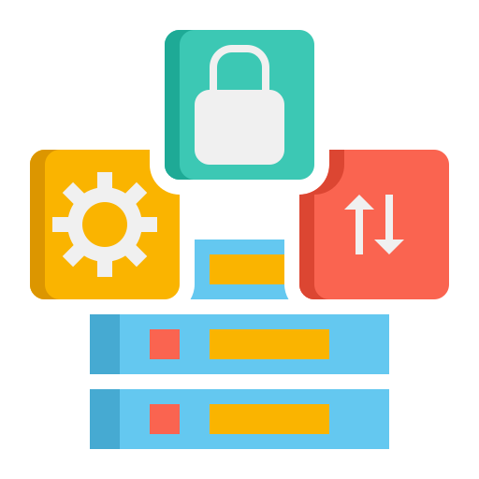
Attack Surfaces
End Points
Ports and protocols are fundamental concepts in computer networking that enable devices to communicate effectively. They work together to ensure data is sent to the correct application or service on a specific device.
Open ports and protocols on network devices create opportunities for attackers to probe and exploit weaknesses.
Network Services
Ports and Protocols
User accounts and credentials
Third-party integrations
Cloud Services
Human Factor
Notes:
Trainer Notes:
Explain Ports and Protocols as an attack surface
Ports and protocols are fundamental concepts in computer networking that enable devices to communicate effectively. They work together to ensure data is sent to the correct application or service on a specific device
Open ports and protocols on network devices create opportunities for attackers to probe and exploit weaknesses.
Unnecessary open ports or unused services should be closed or disabled

Slide 132

Attack Surfaces
End Points
Weak or compromised passwords pose a significant security risk as attackers may employ brute-force attacks or phishing to obtain legitimate credentials and gain unauthorized access.
Network Services
Ports and Protocols
User accounts and credentials
Third-party integrations
Cloud Services
Human Factor
Notes:
Trainer Notes:
Explain User Accounts and credentials as an attack surface
Weak user accounts and credentials are a primary target for cybercriminals. They represent a significant vulnerability in any system, allowing attackers to gain unauthorized access, steal data, or disrupt operations.

Slide 133
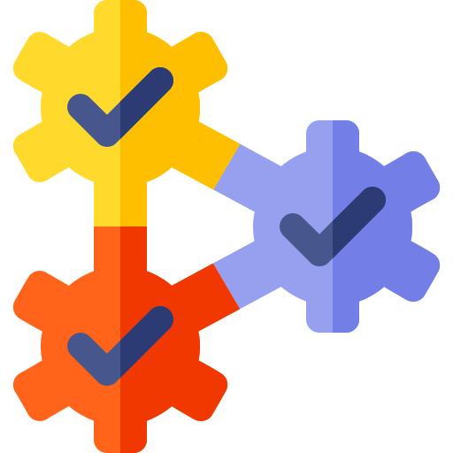
Attack Surfaces
End Points
Third-party integration (TPI) is a connection between two or more software applications that allows them to share data and functionality.
They offer benefits such as increased functionality, efficiency, and streamlined workflows, but they also introduce additional attack surfaces for malicious actors.
Network Services
Ports and Protocols
User accounts and credentials
Third-party integrations
Cloud Services
Human Factor
Notes:
Trainer Notes:
Explain Third Party Integration as an attack surface
Third-party integration (TPI) is a connection between two or more software applications that allows them to share data and functionality.
Third-party integrations, while offering enhanced functionality and efficiency, can significantly expand an organization's attack surface. These integrations often involve sharing sensitive data and granting access to critical systems, creating potential vulnerabilities
Third-party integrations (TPIs) are a double-edged sword. They offer many benefits, such as increased functionality, efficiency, and streamlined workflows, but they also introduce additional attack surfaces for malicious actors.

Slide 134
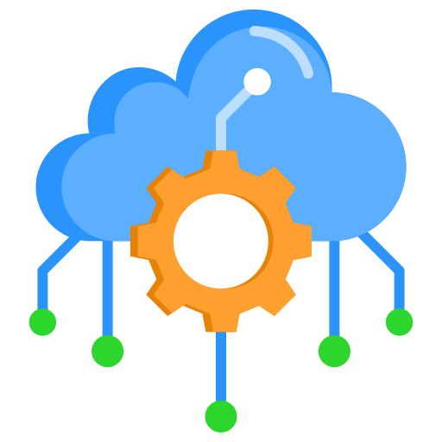
Attack Surfaces
End Points
The cloud offers numerous benefits for businesses, from scalability and cost-efficiency, increased agility, and accessibility. However, this flexibility also comes with an expanded attack surface.
As organizations migrate to the cloud, cloud-based assets become potential targets. Misconfigured cloud resources can expose sensitive data.
Network Services
Ports and Protocols
User accounts and credentials
Third-party integrations
Cloud Services
Human Factor
Notes:
Trainer Notes:
Explain Cloud as an attack surface
The cloud, while offering numerous benefits, also introduces a new and complex attack surface. As organizations increasingly migrate their operations to the cloud, they expose themselves to a broader range of potential threats..
As organizations migrate to the cloud, cloud-based assets become potential targets. Misconfigured cloud resources can expose sensitive data.
Unique Cloud Attack Vectors
Misconfigurations: Incorrectly configured cloud resources can expose vulnerabilities.
Data Exposure: Accidental or intentional exposure of sensitive data through misconfiguration or unauthorized access.
Supply Chain Attacks: Targeting vulnerabilities in the cloud provider's infrastructure or software supply chain.
Insider Threats: Malicious actions by employees or contractors with cloud access.
API Abuse: Exploiting vulnerabilities in cloud APIs to gain unauthorized access.

Slide 135

Attack Surfaces
End Points
Employees, whether through ignorance or malicious intent, can inadvertently contribute to the attack surface.
Security awareness training is an essential preventive measure.
Network Services
Ports and Protocols
User accounts and credentials
Third-party integrations
Cloud Services
Human Factor
Notes:
Trainer Notes:
Explain Human Factor as an Attack surface
Employees, whether through ignorance or malicious intent, can inadvertently contribute to the attack surface.
The human attack surface refers to the vulnerabilities and risks posed by human behavior and actions in the context of cybersecurity. It highlights the fact that people, often unintentionally, can be the weakest link in an organization's security defenses.
Security awareness training is an essential preventative measure.

Slide 136
Controls for limiting attack surface
Vulnerability assessment
Security updates
Access control
Strong authentication
Network segmentation
Regular auditing
Single point of failure
Security awareness
Notes:
Trainer Notes:
Explain Controls for limiting attack surface
Vulnerability assessment: Regularly scan and assess your network for vulnerabilities. Identify and patch or mitigate weaknesses promptly.
Access control: Implement strict access controls and the principle of least privilege. Limit user access and permissions to only what’s necessary.
Network segmentation: Divide your network into segments to limit lateral movement for attackers. This isolates critical assets from less secure areas.
Single point of failure: When you are deploying network appliances, ensure that you are not reliant on a single device lest it fail and take your entire network down with it.
Security updates: Keep all software, operating systems, and devices up to date with security patches. Remove or disable unnecessary services.
Strong authentication: Enforce robust password policies and consider Multi-Factor Authentication (MFA) for critical systems.
Regular auditing: Conduct regular security audits, penetration testing, and monitoring to detect and respond to suspicious activity. Ensure proper change management controls are in place.
Security awareness: Educate employees about security best practices, including how to recognize and report potential threats.

Slide 137

Connectivity
Connectivity in a network refers to the ability of devices to connect and communicate with each other.
It encompasses the physical links, hardware components, and software protocols that enable data transmission and exchange within a network.
Notes:
Trainer Notes:
Explain Connectivity
Connectivity refers to the ability of devices, systems, or networks to communicate and exchange data with each other. It's the foundation of our modern digital world, enabling everything from simple file sharing to complex global communication networks.
Types of Connectivity
Wired Connectivity: Uses physical cables to connect devices, such as Ethernet cables for local networks or fiber optic cables for long-distance communication.
Wireless Connectivity: Employs radio waves to connect devices without physical cables, including Wi-Fi, Bluetooth, cellular networks, and satellite communication.
Network Connectivity: The ability of devices to communicate within a network, whether it's a local area network (LAN), wide area network (WAN), or the internet.
Internet Connectivity: The ability of a device or network to connect to the global internet, providing access to a vast array of information and services

Slide 138

Components of Connectivity
Physical Connection
Communication Protocols
Network Devices
Security Devices
Notes:
Trainer Notes:
Explain Components of Connectivity
Physical Connection- These are the tangible components that establish a physical pathway for data transmission. Examples include cables (ethernet, fiber optic), wireless signals (Wi-Fi, Bluetooth), and satellites
Network Devices- These are the hardware components that facilitate communication between devices on a network. They include routers, switches, and access points
Communication Protocols- These are sets of rules and specifications that govern how data is formatted, transmitted, and received on a network. Common protocols include TCP/IP (Transmission Control Protocol/Internet Protocol) suite, which underpins the internet.
Security Devices- These are security components that provides security to network and protocols . Ex Firewalls, Web application firewall,Intrusion prevention system, Data loss Prevention, DLP etc

Slide 139
Attributes of Effective Connectivity
01
Reliability: Data is transmitted accurately and consistently with minimal errors or disruptions
02
Performance: Data transfer occurs efficiently, with minimal delays or lags
03
Security: Data is protected from unauthorized access or modification during transmission
Notes:
Trainer Notes:
Explain Attributes of Effective Connectivity
Reliability: Data is transmitted accurately and consistently with minimal errors or disruptions
Performance: Data transfer occurs efficiently, with minimal delays or lags
Security: Data is protected from unauthorized access or modification during transmission

Slide 140

Failure Modes
They determine how a device or system behaves during a failure or malfunction, making them essential to engineering and safety systems.
They help identify and analyze potential points of failure to improve reliability and mitigate risks.
Notes:
Trainer Notes:
Explain Failure Modes
Failure modes determine how a device or system behaves when it encounters a failure or malfunction, making them a valuable component of various engineering and safety systems.
Two types of failure modes available
Fail open
Fail close

Slide 141

Failure Modes
This mechanism focuses on failing with minimum harm to personnel.
Example: In case of power failure in datacenter, an electronic door will fail to open or remain open to let people exit safely.
There are two types of failure modes available:
This mechanism focuses on failing in a controlled manner to block access while the systems are in an inconsistent state.
Example: In case of firewall failure, traffic will stop flowing to prevent unauthorized access or malicious traffic.
Fail-Open
Fail-Close
Notes:
Trainer Notes:
Explain Fail Open and Fail Close
Fail Open-If a portion of the system fails, the rest of the system will still be available, or “open.”Example In case of power failure in Datacenter, electronic door will fail open or remain open to let people exit safely
Fail Close- If a portion of system fails, then rest of system will also become unavailable. Example: In case of Firewall failure, traffic will stop flowing to prevent slipping of hacker or malicious traffic

Slide 142
Device Attributes
These are characteristics and functionalities that determine how a security device operates in a network environment.
Attributes, such as active versus passive monitoring or inline versus tap/monitor configurations, play a crucial role in defining a device’s behavior, capabilities, and impact on network traffic.
Notes:
Trainer Notes:
Explain What is device Attribute
The attributes of a network security device can vary widely depending on its specific function and manufacturer. Device attributes are specific characteristics and functionalities that determine how a security device operates in a network environment.
Attributes, such as active versus passive monitoring or inline versus tap/monitor configurations, play a crucial role in defining a device’s behavior, capabilities, and impact on network traffic.

Slide 143



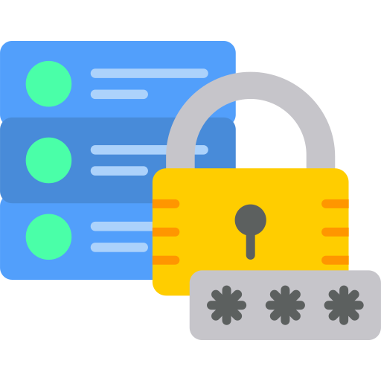

Device Attributes
Active devices
Passive devices
Inline
Tap/Monitor
Notes:
Trainer Notes:
Explain device attributes
Active Devices-Active devices are essential components of a computer network that actively manipulate and process data signals. They are responsible for the efficient and reliable transmission of data between network devices
Passive Devices- Passive devices are essential components of a computer network that facilitate data transmission but do not modify or regenerate the signal. They play a crucial role in connecting network devices and ensuring signal integrity.
Inline Devices-Inline devices are network security appliances that are inserted directly into the data path of a network. Unlike passive devices that simply monitor traffic, inline devices actively process and can modify network traffic
Tap/Monitor-Network taps and network monitors are essential tools for observing and analyzing network traffic. They provide a crucial vantage point into the network's behavior, enabling troubleshooting, security analysis, and performance optimization.

Slide 144

Active Devices
These are a proactive force within your network security arsenal. They intervene and act when potential threats are detected.
These devices block or mitigate threats in real time, helping to maintain the integrity and security of your network.
Examples: Firewalls, Intrusion Prevention System, Network Access control.
Notes:
Trainer Notes:
Explain Active Devices
Active Devices-Active devices are essential components of a computer network that actively manipulate and process data signals. They are responsible for the efficient and reliable transmission of data between network devices They actively intervene and act when potential threats are detected. These devices can block or mitigate threats in real time, helping to maintain the integrity and security of your network.
Examples : Firewalls, Intrusion Prevention system, Network Access control

Slide 145
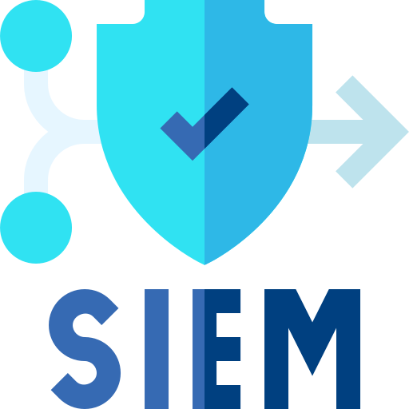
Passive Devices
These are observers. They monitor network traffic, analyze patterns, and provide insights into potential threats and vulnerabilities.
Unlike active devices, passive devices do not take immediate action to block threats. Instead, they focus on visibility and analysis.
Examples: Intrusion Detection System , Security Information and Event Management.
Notes:
Trainer Notes:
Explain Passive devices
Passive Devices- Passive devices are essential components of a computer network that facilitate data transmission but do not modify or regenerate the signal. They play a crucial role in connecting network devices and ensuring signal integrity. Passive devices are observers. They monitor network traffic, analyze patterns, and provide insights into potential threats and vulnerabilities.Unlike active devices, passive devices do not take immediate action to block threats; they are instead focused on visibility and analysis.

Slide 146

Inline Devices
These are placed directly in the network traffic path. They actively process traffic, making real-time decisions to allow or block data packets.
Examples of inline devices include firewall appliances, which actively control inbound and outbound traffic, and load balancers, which distribute network traffic across multiple servers and Intrusion Prevention Systems (IPSs).
Notes:
Trainer Notes:
Inline Devices-Inline devices are network security appliances that are inserted directly into the data path of a network. Unlike passive devices that simply monitor traffic, inline devices actively process and can modify network traffic. Inline devices are placed directly in the data path of network traffic. They actively process traffic as it flows through the network, making real-time decisions about whether to allow or block data packets.
Examples of inline devices include firewall appliances, which actively control inbound and outbound traffic, and load balancers, which distribute network traffic across multiple servers and IPSs.

Slide 147
Tap/Monitor
They do not interfere with the flow of network traffic. Instead, they monitor the traffic and duplicate it for analysis or monitoring purposes.
These devices provide visibility without affecting the original data flow.
An example of a tap/monitor device is a network packet analyzer, also known as a packet sniffer, which captures and analyzes network traffic for troubleshooting or security analysis.
Notes:
Trainer Notes:
Explain Tap/Monitor
Tap/Monitor-Network taps and network monitors are essential tools for observing and analyzing network traffic. They provide a crucial vantage point into the network's behavior, enabling troubleshooting, security analysis, and performance optimization. Tap or monitor devices, as the name suggests, do not interfere with the flow of network traffic. Instead, they “tap” into the traffic and duplicate it for analysis or monitoring purposes.
An example of a tap/monitor device is a network packet analyzer (packet sniffer), which captures and analyzes network traffic for troubleshooting or security analysis.

Slide 148

Network Appliances
These are essential for maintaining and securing network connectivity, ensuring reliable and efficient network operations.
They are specialized hardware devices designed to perform specific network functions. They offer dedicated hardware, software, and resources for efficient operation.
Notes:
Trainer Notes:
Explain Network Appliances
The backbone of a network's infrastructure is composed of network appliances, which are essential for establishing, maintaining, and securing network connectivity. They ensure that data flows smoothly and securely across various segments of an organization's network. A network appliance is a specialized hardware device designed to perform a specific network function. Unlike general-purpose computers, network appliances are optimized for their designated tasks, offering dedicated hardware, software, and resources for efficient operation.

Slide 149


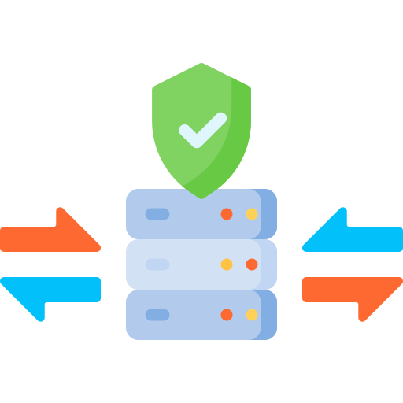



Considerations for Infrastructure
Jump Box
Firewall
Proxy Server
Load balancer
Web Application Firewall
Network Access Control
Notes:
Trainer Notes:
Explain different devices-
Jump Box-A jumpbox, also known as a bastion host or jump server, is a hardened system on a network that acts as a secure gateway to access and manage devices in a separate security zone.
Firewall-A firewall is a network security device that monitors and controls incoming and outgoing network traffic based on a set of security rules. It acts as a barrier between a trusted internal network and an untrusted external network, such as the internet
Proxy Server-A proxy server acts as a gateway between you and the internet. It's an intermediary server that separates end users from the websites they browser
Load Balancer- A load balancer is a device or software application that distributes network or application traffic across a group of servers. It acts as a traffic cop, directing incoming requests to available servers to optimize resource utilization, improve performance, and ensure high availability
Web Application Firewall-A Web Application Firewall (WAF) is a security application that filters and monitors HTTP traffic between a web application and the internet. It acts as a shield, protecting web applications from common web exploits, such as SQL injection, cross-site scripting (XSS), and cross-site request forgery (CSRF)
Network Access Control-Network Access Control (NAC) is a comprehensive security approach that determines what devices and users are authorized to access a network and what resources they can access. It ensures that only compliant devices and users are granted network access

Slide 150


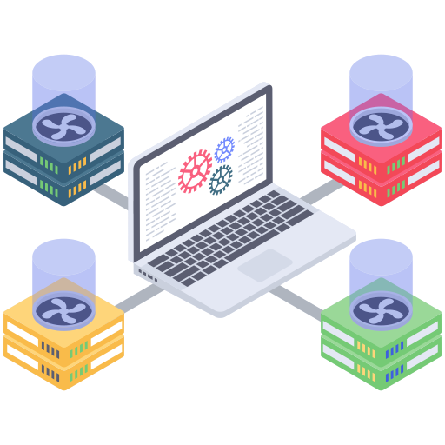

Jump Box
It serves as a bastion host or intermediary server within the cloud network.
Protected Network
Jump Box
Benefits include enhanced security, improved network segmentation, and centralized logging.
Notes:
Trainer Notes:
A Jump Box acts as a bastion host or intermediary server located within the cloud network.
It serves as a single point of entry for remote access attempts.
Once authenticated, you can then use the Jump Box to access other resources within the cloud network, such as:
Virtual machines (VMs)
Databases
Applications
Management consoles

Slide 151




Firewall
It has been the first line of defense in network security for over 25 years. It is typically located at the intersection of two networks, usually a private network and a public network such as the internet.
Secure Private Network
Firewall
Internet
It completely isolates your computer from the Internet by inspecting each data packet as it reaches either side of the firewall.
Notes:
Trainer Notes:
A firewall is like a security guard for your computer or network. It monitors and controls incoming and outgoing network traffic based on predefined security rules. Think of it as a barrier between your private network and the public internet.
Examines traffic: It inspects every packet of data entering or leaving your network.
Applies rules: It compares the traffic to a set of security rules to determine if it should be allowed, blocked, or modified.
Protects your network: By blocking malicious traffic, it helps prevent unauthorized access, viruses, and other cyber threats.
A firewall is a network security device that analyzes incoming and outgoing network traffic and determines whether specific traffic should be allowed or blocked based on security rules.
It can be hardware, software, or a combination of both whose purpose is to enforce a set of network security policies across network connections
Used to restrict access to one network from another network
Work from Layer 3 to Layer 7.

Slide 152

Firewall Designing Goals
The firewall must allow all traffic to pass from the inside to the outside and vice versa.
Only permitted traffic will be allowed to pass, as stated by the local security policy.
The firewall must be resistant to penetration attempts to ensure network security.
Notes:
Trainer Notes:
Explain the Firewall Designing Goals
All traffic from Inside to outside are permitted by default unless you explicitly deny the sam
All traffic from Outside the inside is denied by default unless you explicitly allowed.
There is implicit deny rule which will drop the traffic if it is not allowed

Slide 153
Rules
Firewall rules are instructions that dictate how incoming and outgoing network traffic should be handled.
Rules can be defined in terms of directions, i.e., Inbound and Outbound.
They can be categorized into allow and deny rules.
They can also be based on port numbers and protocol types.
In firewall configurations, the sequence of rules is crucial for effective security.
Notes:
Trainer Notes:
Explain Firewall rules;
To protect our networks and devices from attacks, firewalls rely on an established set of rules to determine which traffic should be permitted and denied.
Each rule typically includes the following elements:
Source IP address: The IP address of the computer or network sending the traffic.
Destination IP address: The IP address of the computer or network receiving the traffic.
Protocol: The type of network communication (e.g., TCP, UDP, ICMP).
Ports: The specific ports used for communication (e.g., port 80 for HTTP).
Action: The action to be taken (allow, deny, drop, log, etc.).
Firewalls use outbound rules that dictate what your internal network can access externally, while inbound rules regulate incoming traffic to determine what external requests can access your network.
In firewall configurations, the sequence of rules is crucial for effective security.
Explicit deny rules serve as the first line of defense, blocking specific traffic types or sources that should never gain entry, while allow rules specify what’s allowed after the denial criteria have been established.
Port numbers: These specify which ports are open for communication (e.g., port 80 for HTTP)
Protocol types: These determine the allowed communication protocols (e.g., TCP and UDP).
IP address: Firewall rules can be configured based on the source or the destination of the IP address being used.

Slide 154

Access Control Lists
They identify traffic flows using characteristics such as a source and destination IP address, IP protocol, ports, EtherType, and other parameters, depending on the ACL type.
Notes:
Trainer Notes:
Explain the Access Control Lists
An Access Control List (ACL) is essentially a set of rules that define who can access specific resources and what actions they can perform on those resources. It's like a digital gatekeeper that determines who gets in, and what they can do once they're inside.
How ACLs Work
ACLS are associated with specific objects or resources, such as files, directories, network interfaces, or even entire systems. Each ACL entry specifies:
Subject: The user, group, or process that wants to access the resource.
Object: The resource being accessed (file, directory, network interface, etc.).
Permissions: The actions allowed (read, write, execute, etc.).

Slide 155
Access Control Lists
Action | Protocol | Source Address | Destination Address | Source Port | Destination Port | Flag Bit
Allow | TCP | Outside of 140.114/16 | 140.114.44.2 | >1023 | 80 | SYN
Allow | UDP | Outside of 140.114/16 | 140.114/16 | >1023 | 53
Deny | All | All | All | All | All | All
Notes:
Trainer Notes:
Apply rules from top to bottom
Implicit deny all clause at the end

Slide 156
Firewall Categories

Slide 157

Network-Based Firewall
A network-based firewall protects the entire network. It can make decisions throughout the traffic.
Firewall
Internet
Personal computers
Notes:
Explain how Network-Based Firewall protects the network
A network firewall is a security device, either hardware or software-based, that monitors and controls incoming and outgoing network traffic based on a predetermined set of security rules. It acts as a barrier between your private network and the public internet, protecting your valuable data and resources from unauthorized access, cyberattacks, and other threats

Slide 158
Host-Based Firewall
Host-based firewalls contain filtering rules that can be tailored to the host environment. They provide protection that is independent of topology.
A host-based firewall is installed on each server
It controls incoming and outgoing network traffic
It determines whether to allow traffic into a particular device
Personal computer
Internet
Notes:
Trainer Notes:
Explain Host Firewall
A host firewall is a software application installed directly on an individual computer or device to protect it from malicious network traffic. Unlike network firewalls that guard the entire network, host firewalls focus on securing a single machine.
host firewalls examine incoming and outgoing network traffic and apply security rules to determine whether to allow, block, or modify it. These rules can be configured based on various criteria, such as IP addresses, ports, protocols, and applications.

Slide 159
Network and Host-Based Firewall
 | Network-Based Firewall | Host-Based Firewall
Terminology | Filters traffic going from internet to secured LAN and vice versa | Filters incoming and outgoing traffic on each device
Placement | At the perimeter of the border | Placed at the host system
Hardware/Software | Hardware-based | Software-based
Functionality | Network level | Host level
Scalability | Easy to scale | More effort required to scale
Mobility | Cannot be moved | Mobile friendly
Notes:
Distinguish between Network and Host-Based Firewall
Host-based firewalls: Ideal for additional protection on individual devices, especially in environments with sensitive data or high security requirements.
Network firewalls: Essential for protecting the entire network from external threats, particularly in larger networks or those with public exposure.
A combination of host-based and network firewalls often provides the strongest security posture. This layered approach helps to protect against a broader range of threats.

Slide 160
Types of Firewall
Firewall
On the basis of technology
On the basis of architecture
Packet filtering
Proxy firewall
Stateful firewall
Multi-homed
Screened host
Screened subnet
Notes:
Trainer Notes:
Explain types of firewall
Firewall can be categorized on the basis of technologies and on the basis of architecture. Details are covered in next slides

Slide 161
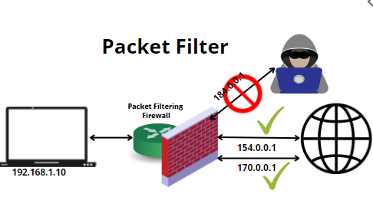
Packet Filtering Firewall
Works in layers 3 and 4
Stateless firewalls
Takes decisions based on source and destination IP/port numbers, protocol type, and direction
Inbound, outbound, or both
Based on rule-based access control
Notes:
Trainer Notes:
Packet filtering is a fundamental firewall technique that examines individual network packets and decides whether to allow or block them based on predefined rules. It's like a security guard inspecting each person entering a building based on their appearance and credentials

Slide 162




Proxy Firewall
Works at layer 7 of OSI
Had a capability to look till layer 7 of OSI
Inbound, outbound, or both
Can thwart application attacks
Client system
Proxy firewall
Server
Notes:
Trainer Notes:
A proxy firewall, also known as an application-level gateway or application firewall, operates at the application layer of the OSI model, offering a more granular level of security compared to packet filtering firewalls.
Unlike packet filtering firewalls that examine packet headers, proxy firewalls inspect the entire content of data packets. They act as intermediaries between internal network users and external resources, establishing connections on behalf of users and filtering traffic at the application level

Slide 163
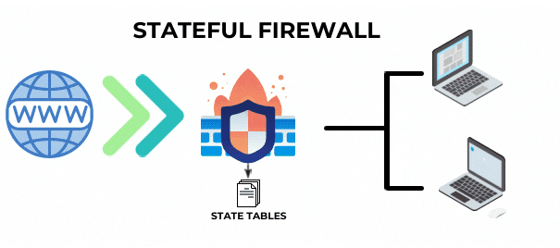
Stateful Firewall
Limits information that is allowed into a network based not only on destination and source address but also contents of the state table
Maintains a state table of all connections; only the first packet is deep inspected, subsequent connections are not inspected
Provides high degree of security and does not introduce a performance hit
Scalable and transparent to the user
Notes:
Trainer Notes:
A stateful firewall goes beyond the basic packet inspection of traditional firewalls by maintaining a record of active network connections. It tracks the state of each connection, allowing it to make more informed decisions about incoming and outgoing traffic.
Connection Tracking: When a new network connection is initiated, the stateful firewall creates a session entry in its state table.Packet Inspection: Each subsequent packet related to that connection is examined based on the connection's state.Decision Making: The firewall allows or blocks packets based on the connection state and predefined rules.

Slide 164




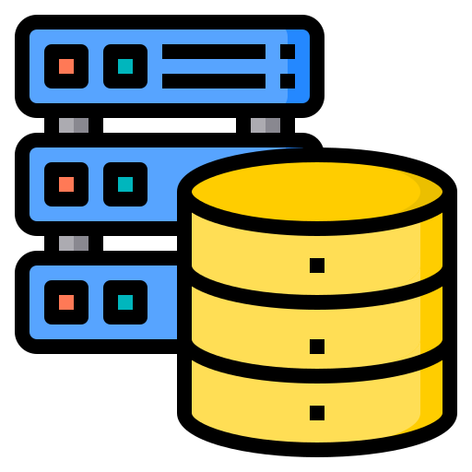

Dual Homed Firewall
Dual-homed firewall has two interfaces, one inside and one outside. One NIC is connected to an untrusted network (like the internet), and the other is connected to a trusted network (like a corporate network).
Traffic, once passed through this firewall, directly reaches the internal network as there is only one layer of defense. This is used in SOHO (small office, home office) or small remote locations.
Outside network
Internal network
Notes:
Trainer Notes:
A dual-homed firewall is a firewall architecture where a firewall system has two network interfaces (NICs). One NIC is connected to the untrusted network (like the internet), and the other is connected to the trusted network (like a corporate network). This configuration acts as a barrier between the two networks, preventing direct communication between them. There is only one firewall in between inside and outside network, traffic once make it pass through firewall will reach internal network

Slide 165

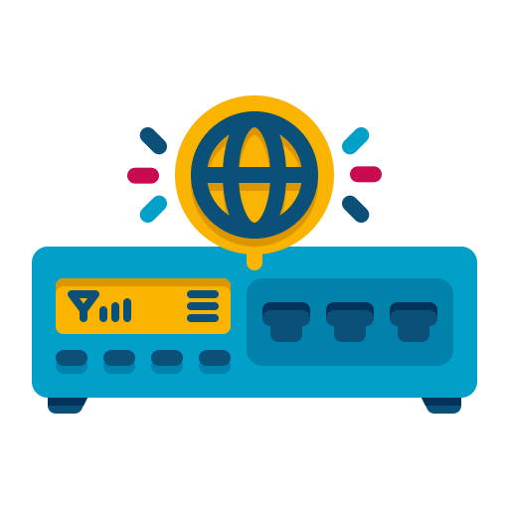

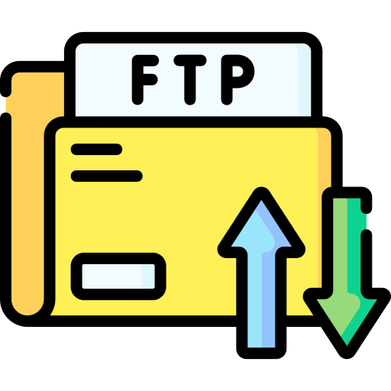
Screened Host Firewall
Internet
A device that is connected to the internet router, segregating the internal network
Traffic from the internet router can only connect to this firewall; after inspection, it is passed on to the internal network
Traffic received from the internet is first filtered via packet filtering on the outer router
The traffic that makes it past this phase is sent to the screened-host firewall, which applies more rules to the traffic and drops the denied packets
Internet router
Firewall
Internal network
Notes:
Trainer Notes:
A screened host firewall is a network security architecture that combines a packet-filtering router with a bastion host to protect an internal network. It provides an additional layer of security compared to a simple packet-filtering firewall.
It has packet filtering router whichacts as the first line of defense, examining incoming and outgoing packets based on predefined rules. It blocks unauthorized traffic and forwards allowed traffic to the Firewall.
Then next is firewall which is secured server located within the internal network, designed to handle specific services (e.g., web, email). It acts as a proxy between the external network and the internal network, providing an additional layer of protection.

Slide 166

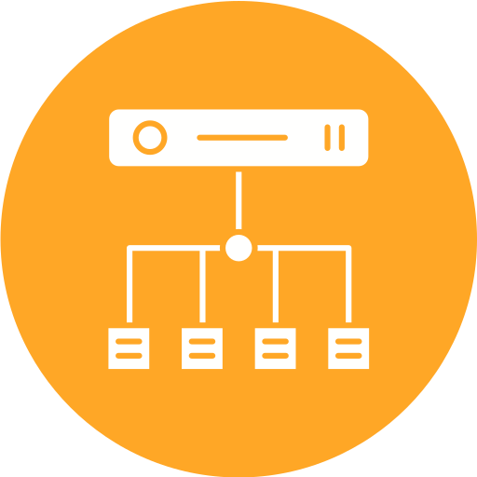

Screened Subnet Firewall
Internet
A screened subnet firewall is a network security architecture that uses two firewalls to create three separate subnets: external, demilitarized zone (DMZ), and internal network.
Traffic first reaches the packet filtering router. Once it passes through the router, it reaches the outer firewall where the DMZ is hosted.
Traffic for the DMZ network is forwarded after an access list check by the outer firewall. Traffic destined for the internal network will be forwarded to the internal firewall, which performs further checks before allowing it into the internal network.
Internet router
DMZ
Outer firewall
Internal firewall
Internal network
Notes:
Trainer Notes:
A screened subnet firewall is a network security architecture that uses two firewalls to create three separate subnets: external, demilitarized zone (DMZ), and internal network.
Traffic first reaches the packet filtering router. Once it passes through the router, it reaches the outer firewall where the DMZ is hosted.
Traffic for the DMZ network is forwarded after an access list check by the outer firewall. Traffic destined for the internal network will be forwarded to the internal firewall, which performs further checks before allowing it into the internal network.

Slide 167
Unified Threat Management (UTM)

Slide 168
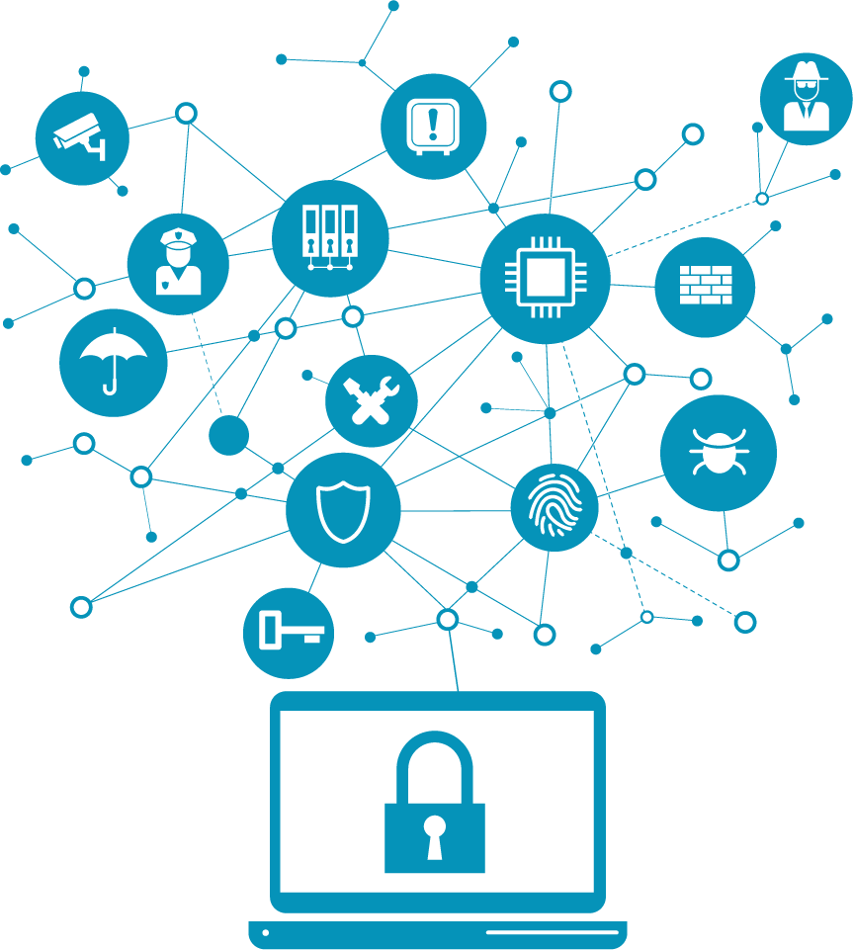
Unified Threat Management
Unified Threat Management (UTM) is an information security solution that protects against threats, malware, and network attacks from a single point.
UTM integrates multiple security functions into a single hardware or software platform.
This consolidation simplifies security management, reduces costs, and enhances overall protection.
Notes:
A UTM appliance usually includes functions such as antivirus, anti-spyware, anti-spam, Web filter, network firewall, intrusion detection and prevention, content filtering, and VPN.
It combines security, performance, management, and compliance capabilities into a single installation, making it easier for administrators to manage networks.

Slide 169
Advantages and Disadvantages of UTM
Advantages | Disadvantages
Affordable solution | Single point of failure (SPOF)
Centralized solution | Performance bottleneck when fully utilized
Reduced support costs | Less specialized than dedicated solutions
Reduced hardware footprint | Lower performance compared to alternatives
Easier to integrate into existing solutions | Hard to scale in large environments
Low power consumption | Limited features compared to point product alternatives
Notes:
Explain the Advantages and Disadvantages of UTM

Slide 170
Next Generation Firewall (NGF)

Slide 171
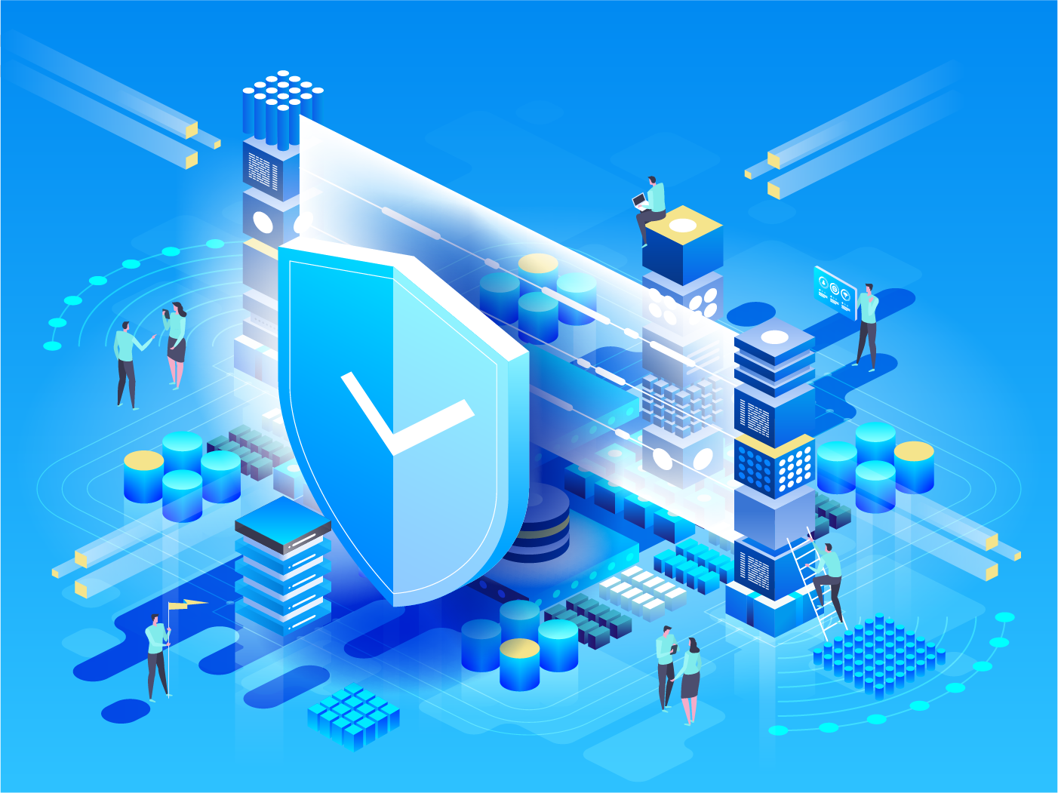
Next Generation Firewall (NGF)
The Next Generation Firewall (NGFW) is a deep-packet inspection firewall that adds application-level inspection, intrusion prevention, and intelligence from outside the firewall to go beyond port/protocol inspection and blocking.
Notes:
Explain Next Generation Firewall
A Next-Generation Firewall (NGFW) is a network security device that goes beyond the capabilities of traditional firewalls. While traditional firewalls focus on basic packet filtering and stateful inspection, NGFWs incorporate advanced features to address modern security threats.
NGFWs combine traditional firewall functions with deep packet inspection (DPI), application awareness, and threat intelligence to provide comprehensive protection. They can analyze network traffic at the application layer, identify malicious activities, and block threats before they cause harm.

Slide 172



UTM Versus NGFW
Next-generation firewalls (NGFWs) and Unified Threat Management (UTM) solutions are both designed to consolidate multiple security functions into a single solution.
Experts agree that the difference between UTM and NGFW is blurring. The technologies used in both are essentially the same and generally have the same capabilities.
UTM devices are typically rated with lower performance than their NGFW counterparts, but the differences are mostly in the marketing for all practical purposes.
Notes:
The term NGFW was coined by vendors working with Gartner to create a class of products that adapt to an enterprise network containing all the UTM features.
The reason for the name change is that there was a widespread line of thinking that indicated that a device capable of all the functions of a UTM vs. NGFW would never be fast enough to run on an enterprise network.

Slide 173
Web Application Firewall

Slide 174
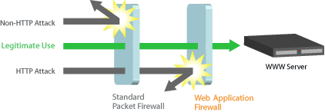
Web Application Firewall
WAF is defined as a security policy enforcement point positioned between a web application and the client endpoint.
This feature can be implemented in either software or hardware and run on an appliance device or a standard server with a common operating system.
It can be used as a stand-alone device or as part of a larger network.
Notes:
Explain the definition of Web Application Firewall
A Web Application Firewall (WAF) is a security application that filters and monitors HTTP traffic between a web application and the internet. It acts as a shield, protecting web applications from common web exploits, such as SQL injection, cross-site scripting (XSS), and cross-site request forgery (CSRF).
Inspection: A WAF examines incoming and outgoing HTTP traffic for malicious patterns and threats.Filtering: Based on predefined rules, it blocks malicious requests and allows legitimate traffic to reach the web application.Protection: By filtering out malicious requests, a WAF helps prevent attacks that could compromise the web application or its underlying infrastructure.

Slide 175


Web Application Firewall
HTTP traffic inspection can help avoid attacks that exploit a web application's known flaws, such as SQL injection and cross-site scripting (XSS).
WAF is a specialized application firewall designed to protect web applications by filtering and monitoring HTTP traffic between a web application and the internet.
Notes:
Key Features of a WAF:
Protection against common web attacks: SQL injection, XSS, CSRF, file inclusion, and more.
Protection against DDoS attacks: Can mitigate DDoS attacks by filtering out malicious traffic.
Bot management: Can identify and block malicious bots.
Customizable rules: Allows administrators to create custom security policies

Slide 176
Proxy Server

Slide 177
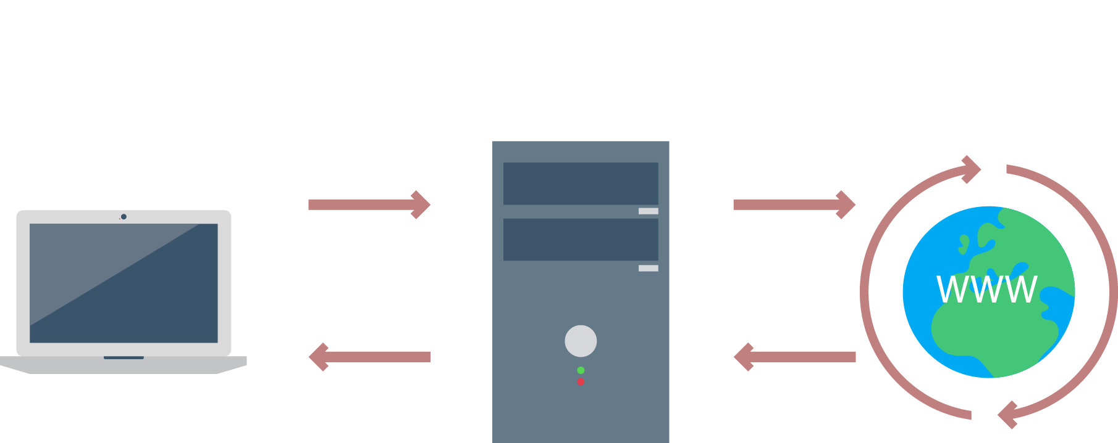
Proxy Server
It acts as a middleman between clients and servers, frequently protecting internal clients from external threats.
Notes:
Trainer Notes:
A proxy server acts as a middleman between your computer and the internet. It intercepts your web requests and forwards them to the destination server, then returns the response to you.
How Does a Proxy Server Work?
Request: When you request a webpage, your computer sends the request to the proxy server.
Forwarding: The proxy server forwards the request to the actual website.
Response: The website sends the requested data back to the proxy server.
Delivery: The proxy server then delivers the data to your computer.

Slide 178
Forward Proxy Server
It acts on behalf of clients, gathering data from a variety of sources and delivering it to them.
The proxy server is aware of the clients, but the providers (servers) are not.
Proxy
Internal Network
Internet
Notes:
Trainer Notes:
Explain Forward Proxy Server
A forward proxy server is an intermediary that sits between one or more user devices and the internet. Instead of sending a request directly to a web server, user devices send their requests to the forward proxy server. The proxy then evaluates the request, takes any needed actions, and routes the request to the destination on the client's behalf.

Slide 179
Forward Proxy Server
Improves performance
Monitoring and filtering:
Filtering content
Filtering encrypted data
Logging and monitoring
Translates data formats or languages
Access services anonymously
Implement security
Notes:
Trainer Notes:
Monitoring and Filtering : Proxy servers allow us to do several kind of filtering such as:
Content Filtering, Filtering encrypted data, Logging and eavesdropping
Improving performance : It accelerates service requests by retrieving content saved from a previous request made by the same client or even other clients.
Translation : It helps to customize the source site for local users by excluding source content or substituting source content with original local content. In this the traffic from the global users is routed to the source website through Translation proxy.
Accessing services anonymously : The destination server receives the request from the anonymizing proxy server and thus does not receive information about the end user.
Security : Since the proxy server hides the identity of the user hence it protects from spam and hacker attacks.

Slide 180

Reverse Proxy Server
It acts on behalf of other servers, forwarding requests to one or more regular servers, which process them.
Proxy
Internet
Internal Network
The response from the proxy server is sent back as if it came directly from the original server, leaving the client with no awareness of the origin servers.
Notes:
Trainer Notes:
Reverse proxies forward requests to one or more ordinary servers which handle the request. The response from the proxy server is returned as if it came directly from the original server, leaving the client with no knowledge of the origin servers.
A reverse proxy server, (surrogate server) in contrast, acts on behalf of its servers. Clients contact the reverse proxy server, which gathers information from its associated server(s) and hands that information to the clients. The clients don’t know about the servers behind the scenes. The reverse proxy server is the only machine with which they interact.

Slide 181


Reverse Proxy Server
Security and Anonymity
Load Balancing
It can divide the load from incoming requests over numerous servers, maximizing speed and capacity utilization while preventing any server from being overloaded, and causing performance degradation.
Reverse proxies can mask the existence and features of an origin server or servers. They act as a secondary line of defense against cyber attacks.
Notes:
Trainer Notes:
Web acceleration: Reverse proxies can compress inbound and outbound data, as well as cache commonly requested content, both of which speed up the flow of traffic between clients and servers. They can also perform additional tasks such as SSL encryption to take load off of your web servers, thereby boosting their performance.

Slide 182
Intrusion Detection and Prevention System

Slide 183

Intrusion
Intrusion refers to any unauthorized access, unauthorized attempt to access or damage, or malicious use of information systems.
An intrusion may compromise the confidentiality, integrity, and availability of the information assets.
Notes:
Trainer Notes
Intrusion in a system refers to unauthorized access to a computer system, network, or device. It's a cyberattack where an attacker gains entry without permission.
Types of Intrusions:
Unauthorized access: Gaining access to a system without proper credentials.
Data breaches: Stealing sensitive information from a system.
Malware infection: Introducing malicious software into a system.
Denial of service (DoS) attacks: Overloading a system to prevent legitimate users from accessing it.
Privilege escalation: Gaining higher-level access within a system.

Slide 184


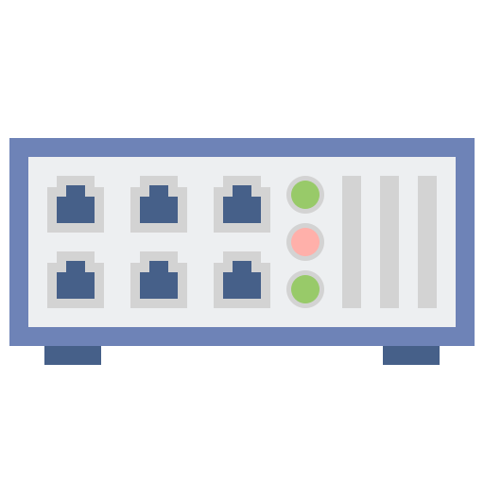
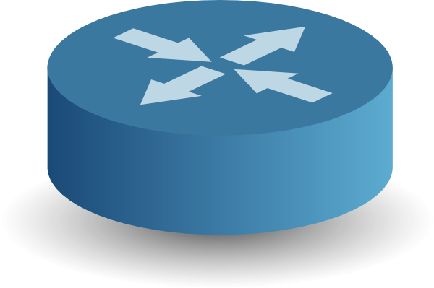
Intrusion Detection System
Intrusion Detection System (IDS) is a solution that continuously monitors the environment and detects and alerts malicious attempts to gain unauthorized access.
IDS in promiscuous mode
Internet
Router
Firewall
Server
Personal computer
Notes:
Trainer Notes:
An Intrusion Detection System (IDS) is a security tool that monitors networks or systems for malicious activity or policy violations. It's like a security guard for your digital world, constantly watching for suspicious behavior.
How does an IDS work?
Monitoring: It continuously observes network traffic, system logs, and other relevant data.
Analysis: Compares the collected data against a database of known attack signatures or predefined rules.
Detection: Identifies suspicious activities or anomalies that might indicate an intrusion attempt.
Alerting: Sends notifications to administrators when potential threats are detected.

Slide 185
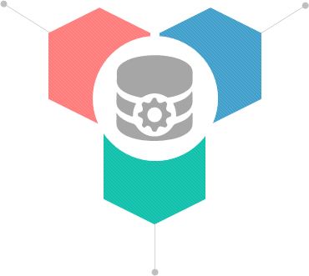
Main Functions of IDS
IDS gathers and analyzes information from within a computer or a network to identify violations of the security policy, including unauthorized access and misuse.
It is also referred to as a packet sniffer, which intercepts packets traveling via various communication media and protocols, usually TCP/IP.
It evaluates traffic for suspected intrusions and raises the alarm upon detecting such intrusions.
Notes:
Function of IDS
How does an IDS work?
Monitoring: It continuously observes network traffic, system logs, and other relevant data.
Analysis: Compares the collected data against a database of known attack signatures or predefined rules.
Detection: Identifies suspicious activities or anomalies that might indicate an intrusion attempt.
Alerting: Sends notifications to administrators when potential threats are detected.

Slide 186
Intrusion Prevention System
Intrusion Prevention System (IPS) is a technology that monitors the environment and responds automatically when malicious attempts to gain unauthorized access are detected.
IPS in inline mode
Internet
Router
Firewall
Switch
Personal computer
Notes:
Trainer Notes:
An Intrusion Prevention System (IPS) is a network security appliance that monitors network traffic for malicious activity and takes action to block or stop it. Unlike an Intrusion Detection System (IDS), which only detects threats, an IPS can actively prevent attacks.

Slide 187
False Positive or False Negative?
 | IDS detected it | IDS didn’t detect it
Malicious traffic | True positive (Attack and alert) | False negative (Attack and no alert)
Normal traffic | False positive (No attack and alert) | True negative (No attack and no alert)
Notes:
Explain the terms
True Positive: Attack is going and alerts are observed on IDS which is what is expected
True Negative: No Attack and no alert on IDS which is again good thing.
False Positive: No attack but false attack is generated which can create a confusion
False negative: Attack is going on but alert is not generated which can lead to attack remain undetected.

Slide 188
Perimeter
The IDS/IPS can be placed at the edge of the perimeter network, where it inspects traffic leaving and entering the network environment inside the demilitarized zone (DMZ).
Router
Internet
IDS/IPS
Personal computers
Notes:
Placement of IPS at Perimeter:
Depending upon the IDS/IPS technology used, it can either work in tandem with gateway devices or fulfill the functions of the gateway connecting the perimeter network to the Internet.
An IPS (Intrusion Prevention System) placed at the network perimeter is a crucial component of a robust cybersecurity strategy.
Why the Perimeter?
Early Detection: Detects threats before they penetrate deeper into the network.
Protection of Critical Assets: Safeguards sensitive data and systems.
Performance Optimization: Reduces the load on internal network devices.
Centralized Management: Allows for easier monitoring and control.

Slide 189
Host Based
IDS/IPS agents (HIDS/HIPS) can be installed on various endpoint systems to detect malicious or suspect traffic between hosts. This adds a layer of defense if an attacker could make it through perimeter defenses.
Router
Internet
IDS/IPS installed on personal computer
Notes:
IDS/IPS may also detect internal threats attempting unauthorized activity.
An IPS (Intrusion Prevention System) deployed at the host level, often referred to as Host-Based IPS (HIPS), provides a layer of security directly on individual devices. This granular approach offers unique advantages in protecting endpoints from threats.

Slide 190
Network Based
IDS/IPS elements (NIDS/NIPS) can be placed at various points of the network to monitor internal traffic and recognize malicious or suspect activity internally.
Router
Internet
Personal computers
Notes:
In this type of deployment- IPS can be placed at different places of various points in network so that threats can be detected at different points in network

Slide 191

Signature-Based Detection
Signature-Based Detection or Pattern-Matching Detection refers to detecting attacks by looking for specific patterns, such as byte sequences in network traffic or known malicious instruction sequences used by malware.
An example of a signature is a packet with the same source IP address and destination IP address.
Real-time traffic is matched against the database, and if the IDS finds a match, it raises an alert.
A primary benefit of this method is that it has a low false-positive rate.
Although this method can easily detect known attacks, it is difficult to detect new attacks for which no pattern is available.
Notes:
A signature-based IPS relies on predefined patterns or signatures to identify and block known threats. These signatures are essentially fingerprints of specific attacks, vulnerabilities, or malicious code
A primary benefit of this method is that it has a low false-positive rate.
Although this method can easily detect known attacks, it is difficult to detect new attacks, for which no pattern is available

Slide 192
Anomaly-Based Detection
Anomaly-based (heuristic) detection method monitors network traffic, builds a model of acceptable behavior, and flags exceptions to that model.
Heuristic method uses feature comparisons and likenesses rather than specific signature matching to identify whether the target of observation is malicious.
The primary approach is to use machine learning to create a model of trustworthy activity and then compare new behavior against this model.
Notes:
Anomaly-based detection is a method used to identify threats by identifying deviations from normal behavior patterns. Unlike signature-based detection which relies on known attack patterns, anomaly-based detection focuses on identifying unusual activities that might indicate a potential threat.
A significant benefit of a behavior-based IDS is that it can detect newer attacks with no signatures and are not detectable with the signature-based method.
The primary drawback of a behavior-based IDS is that it often raises many false alarms, also called false alerts or false positives.

Slide 193
Virtual Private Network

Slide 194



Introduction to Remote Access
Remote access technologies can be defined as the data networking technologies that are uniquely focused on providing access to the remote user into a network.
Advantages of remote access technologies:
Reduce networking costs
Build efficient ties
Provide flexible work styles
Notes:
Trainer Notes:
Remote access technologies can be defined as the data networking technologies that are uniquely focused on providing access to the remote user into a network.
Remote access refers to the ability to control and operate a computer or network from a remote location. It allows users to access and manage their devices or systems without being physically present.
Advantages of remote access technologies:
Reduce networking costs
Build efficient ties
Provide flexible work styles

Slide 195


Virtual Private Network
A Virtual Private Network (VPN) is a private network that uses a public network (usually the internet) to connect remote sites or users together.
Internet
Regional office
Head office
Remote/Roaming users
Notes:
Explain Virtual Private Network
A VPN (Virtual Private Network) is a technology that creates a secure encrypted connection over a public network, such as the internet. It acts as a tunnel, protecting your online activities from prying eyes.
How does a VPN work?
Connection: You connect to a VPN server operated by a VPN provider.
Encryption: Your internet traffic is encrypted, making it unreadable to outsiders.
Tunneling: The encrypted data is sent through a secure tunnel to the VPN server.
Access: The VPN server then sends the data to its intended destination.

Slide 196




VPN Security
Access control
Authentication
Ensuring that the data originates at the source that it claims
Restricting unauthorized users from gaining admission to the network
Confidentiality
Integrity
Preventing anyone from reading or copying data as it travels across the internet
Ensuring that no one tampers with data as it travels across the internet
Notes:
Explain VPN Security
Authentication-VPN authentication is the process of verifying the identity of a user or device attempting to establish a connection to a virtual private network (VPN)
Access Control-Access control in a VPN refers to the mechanisms used to determine who can access the VPN and what resources they can access once connected. It's essential for protecting sensitive data and ensuring that only authorized users can access network resources.
Confidentiality-Confidentiality is a core principle of VPN technology, ensuring that data transmitted over the network remains private and inaccessible to unauthorized parties.
Integrity -Integrity in a VPN context means ensuring that data transmitted over the network remains unaltered during transit. It protects against unauthorized modifications, ensuring that the data received at the destination is identical to the data sent by the source.

Slide 197

VPN Tunnel
VPN is the tunnel that connects the user to the VPN server. To keep each data packet secure, it gets wrapped in an outer packet which is encrypted through a process known as encapsulation.
This outer packet keeps the data secure during the transfer. At the VPN server, the outer packet is removed to access the data of the inner packet.
Notes:
Explain VPN Tunnel
A VPN tunnel is the encrypted connection established between your device and a remote VPN server. It's like a secure, private passageway through the public internet.
VPN is the tunnel that connects the user to the VPN server. To keep each data packet secure, it gets wrapped in an outer packet which is encrypted through a process known as encapsulation.
How it works:
Connection: Your device initiates a connection to a VPN server.
Encryption: Data is encrypted using strong encryption protocols before transmission.
Tunneling: The encrypted data is encapsulated within a tunnel and sent over the public internet.
Decryption: The VPN server decrypts the data and forwards it to the intended destination.

Slide 198



Advantages of VPN
Ensure the confidentiality and integrity of the data in transit
Hide your browsing activity from your local network and ISP
Help in bypassing internet censorship to access blocked websites or bypassing internet filters
Notes:
Advantages of VPN
It ensure confidentiality and integrity of data in transit
It hide user’s browsing activity from local network and ISP
It Help in bypassing internet censorship to access blocked websites or for bypassing internet filters

Slide 199


Disadvantages of VPN
Security issues occur if VPN is not configured and managed correctly
Performance issues may occur due to ISP and their quality of service
Complexity and incompatibility may arise due to issues with VPN technology standards
Notes:
Explain the disadvantages of VPN
Security issues occur if VPN is not configured and managed correctly.
Performance issues as encryption and integrity add it to performance woes
It add complexity

Slide 200

Site-to-Site VPN
Site-to-Site VPNs, or intranet VPNs, allow a company to connect its remote sites to the corporate backbone securely over a public medium like the internet.
Notes:
Explain Site-to-Site VPN
A site-to-site VPN (S2S VPN) is a secure connection established between two or more separate networks, often across different geographic locations. It allows these networks to communicate and share resources as if they were a single, unified network.
How it works:
VPN Gateways: Devices (hardware or software) are configured at each network location to act as gateways for the VPN.
Tunnel Establishment: A secure, encrypted tunnel is created between the VPN gateways.
Data Transfer: Data is transmitted between the networks through this encrypted tunnel.
Routing: Network routing protocols ensure data is directed correctly within the VPN.

Slide 201

Host-to-Host VPN
Host-to-Host VPN is somewhat like a site-to-site VPN in concept except that the endpoints of the tunnel are two individual hosts.
Notes:
Explain Host-to-Host VPN
A host-to-host VPN establishes a secure, encrypted connection between two individual devices (hosts) over an untrusted network, typically the internet. It's different from a site-to-site VPN, which connects entire networks.
How it works:
Endpoint Configuration: Both devices are configured with VPN client software and necessary credentials.
Tunnel Establishment: The devices initiate a secure, encrypted tunnel between them.
Data Transfer: Encrypted data is exchanged through the tunnel.

Slide 202

Host-to-Site VPN
Host-to-Site or remote access VPNs allow remote users like telecommuters to securely access the corporate network wherever and whenever they need to.
Notes:
Explain Host-to-Site VPN
A Remote Access VPN enables users to securely connect to a private network (like a company's intranet) from a remote location, such as home or a public Wi-Fi hotspot. It creates an encrypted tunnel between the user's device and the network, protecting data and ensuring privacy.
How it works:
User Connection: A user establishes a connection to a VPN server using VPN client software.
Authentication: The user's credentials are verified.
Encrypted Tunnel: A secure, encrypted tunnel is created between the user's device and the VPN server.
Network Access: The user can access network resources as if they were physically present on the network

Slide 203








Internet Security Protocol (IPsec)
Internet Protocol Security (IPsec) is a protocol suite used for securing Internet Protocol (IP) communications.
The protocols mutually authenticate agents at the beginning of the session and negotiate cryptographic keys to be used during the session.
A cryptographic layer to both IPv4 and IPv6 using a suite of protocols is added.
Each IP packet of a communication session is authenticated and encrypted.
It provides virtual private networks (VPN) and is used for creating a secure connection between client and server and between networks.
Network Data
VPN tunnel
Internet
Alice’s network1
Bob’s Network
Encrypted
text
?
?
Eavesdropper
Typical IPSEC Tunnel
Notes:
Trainer Notes:
Internet Protocol Security (IPsec) is a protocol suite used for securing Internet Protocol (IP) communications.
The protocols mutually authenticate agents at the beginning of the session and negotiate cryptographic keys to be used during the session.
A cryptographic layer to both IPv4 and IPv6 using a suite of protocols is added.
Each IP packet of a communication session is authenticated and encrypted.
It provides virtual private networks (VPN) and is used for creating a secure connection between client and server and between networks.

Slide 204
IPsec
Authentication header
Provides only authentication and integrity
Protocols
Encapsulating security payload
Provides confidentiality, authentication and integrity
ISAKMP
Defines procedures and packet formats to establish, negotiate, modify ,and delete security associations.
IPSec
Confidentiality algorithm
AES,3DES
Algorithms
Integrity algorithm
MD5 , SHA
Authentication algorithm
Pre-shared key , certificates
Notes:
IPSEC is collection of protocols and algorithm.
Encapsulating Pay load, Authentication headed, Internet security association and key management protocols are protocols of IPSEC. ESP can provide confidentiality, authentication and Integrity whereas AH can only provide integrity and authentication , AH is deprecated in most of security devices long way back.
IPSEC has confidentiality algorithm, integrity and authentication algorithm to support security

Slide 205

IPsec Modes: Transport Mode
Transport mode
In transport mode, only the data is encrypted
It is designed for peer-to-peer communication
Notes:
Trainer Notes:
In transport mode, only the payload of the IP packet is usually encrypted or authenticated. The destination and source IP addresses and other IP header information are still readable. This mode is designed for peer-to-peer communication

Slide 206
IPsec Modes: Transport Mode
IP
Header
TCP Header
Payload
IP data packet
IP
Header
AH Header
TCP Header
Payload
Authentication Header (AH)
Authenticated
IP
Header
ESP Header
Encrypted
TCP Header
Payload
ESP Trailer
ESP
Auth
Encapsulating Security Payload (ESP)
Notes:
Trainer Notes:
Explain the image given on the slide.
When IPSec is operating at Transport mode, AH header is inserted between the IP header and the Transport Layer protocol header (TCP or UDP).
Encapsulating Security Payload (ESP) uses shared key encryption to provide data privacy.

Slide 207
IPsec Modes: Tunnel Mode
Tunnel mode
In tunnel mode, the entire data packet including the header is encrypted.
It is designed for gateway-to-gateway communication.
Notes:
Trainer Notes:
When it’s used in tunnel mode, the entire packet, including the header, is encrypted and then placed into an IPsec endpoint where it is encapsulated inside another IP packet.
This mode is designed for gateway-to-gateway communication.

Slide 208
IPsec Modes: Tunnel Mode
IP
Header
TCP Header
Payload
IP Data Packet
New IP Header
AH Header
IP
Header
TCP Header
Payload
Authentication Header (AH)
Authenticated
New IP Header
ESP Header
Encrypted
IP
Header
TCP Header
Payload
ESP Trailer
ESP
Auth
Encapsulating Security Payload (ESP)
Notes:
Trainer Notes:
Explain the image given on the slide.
In tunnel mode new IP headers is added in front of the original IP header thus securing IP payload and IP header.

Slide 209

IPsec Process
The steps in the IPsec process are as follows:
Host A
Router A
Router B
Host B
Step 1 : “Interesting traffic” initiates the IPSec process
Step 2 : IKE phase 1
IKE SA
IKE phase 1
IKE SA
Step 3 : IKE phase 1
IPSec SA
IKE phase 2
IPSec SA
Step 4: Data transfer
IPSec tunnel
Step 5 : IPSec tunnel termination
Notes:
Trainer Notes:
"Interesting traffic" initiates the IPSec process. Traffic is deemed interesting when the IPSec security policy configured in the IPSec peers starts the IKE process.
IKE phase 1. IKE authenticates IPSec peers and negotiates IKE SAs during this phase, setting up a secure channel for negotiating IPSec SAs in phase 2.
IKE phase 2. IKE negotiates IPSec SA parameters and sets up matching IPSec SAs in the peers.
Data transfer. Data is transferred between IPSec peers based on the IPSec parameters and keys stored in the SA database.
IPSec tunnel termination. IPSec SAs terminate through deletion or by timing out.

Slide 210

Transport Layer Security
Transport Layer Security (TLS) protocols are a family of cryptographic protocols designed to ensure secure communication over networks, primarily the internet. They provide three key functionalities, which include:
Confidentiality: Encrypting data transmission to prevent eavesdropping and unauthorized access.
Integrity: Ensuring data hasn't been tampered with during transmission.
Authentication: Verifying the identity of communicating parties (client and server) for trust and security.
TLS
These functionalities are crucial in maintaining secure and reliable communication in various internet-based applications.
Notes:
Trainer notes:
Explain TLS and how it is used to ensure a secure network
TLS (Transport Layer Security) is a cryptographic protocol designed to provide security and privacy for communications over a computer network. It's the successor to SSL (Secure Sockets Layer) and is widely used to encrypt internet traffic.
How TLS Works
TLS establishes a secure connection between two communicating parties, typically a client (like a web browser) and a server. It involves the following steps:
Handshake: The client and server exchange messages to authenticate each other and agree on encryption methods.
Encryption: Data is encrypted using a shared secret key established during the handshake.

Slide 211
TLS Protocols
The handshake establishes a secure connection, verifying identities and granting access.
TLS 1.3 has improved simplicity and performance.
Client and server exchange messages to:
Identify themselves: The server presents a digital certificate, and the client might also provide credentials.
Agree on encryption methods: They negotiate the strongest ciphers and algorithms both support.
Create a shared secret key: This key is used to encrypt the actual data transmission.
TLS handshake protocol(Authentication and access)
TLS record protocol(Secure communication)
Notes:
TLS Handshake Protocol:
The handshake establishes a secure connection, like verifying your identity and getting access.
TLS 1.3 has improved the simplicity and performance is also improved.
Client and server exchange messages to:
Identify themselves: Server presents a digital certificate, client might also provide credentials.
Agree on encryption methods: Negotiate the strongest ciphers and algorithms both support.
Create a shared secret key: This key will be used to encrypt the actual data transmission.

Slide 212
TLS Protocols
The record protocol uses the secured connection established by the handshake to transmit data like encrypted messages in the building.
After the handshake, data is divided into small encrypted chunks called records.
Each record is:
Encrypted with the agreed-upon key: Ensuring confidentiality.
Authenticated with a message integrity code: Preventing tampering.
TLS handshake protocol(Authentication and access)
TLS record protocol(Secure communication)
Notes:
TLS Record Protocol
The record protocol uses that secured connection to transmit data like encrypted messages in the building.
After the handshake, data is divided into small encrypted chunks called records.
Each record is:
Encrypted with the agreed-upon key, ensuring confidentiality.
Authenticated with a message integrity code, preventing tampering

Slide 213


Secure Shell
SSH, or Secure Shell, is a cryptographic network protocol for secure remote access and management over insecure networks.
It provides strong encryption and authentication mechanisms to ensure the confidentiality and integrity of data transmitted between two machines,
SSH plays a crucial role in interacting with and managing resources in the cloud environment.
offer the ability to connect directly to your virtual machines (VMs) within the cloud using an SSH client
SSH server
SSH client
22

Slide 214
Secure Shell
SSH, or Secure Shell, is a cryptographic network protocol for secure remote access and management over insecure networks. It provides strong encryption and authentication mechanisms to ensure the confidentiality and integrity of data transmitted between two machines.
SSH server
Confidentiality and integrity: SSH ensures that data transmitted between two machines is protected from eavesdropping and tampering.
Cloud environment interaction: SSH plays a crucial role in interacting with and managing resources in the cloud environment.
Direct VM connection: SSH offers the ability to connect directly to your virtual machines (VMs) within the cloud using an SSH client.
SSH client
22
SSH is essential for maintaining secure communication and management of remote systems, particularly in cloud-based infrastructures.

Slide 215
Network Access Control (NAC)

Slide 216

Network Access Control (NAC)
It is a concept of controlling access to an environment through strict adherence to and implementation of security policy.
It is a method of bolstering the security of a proprietary network by restricting the availability of network resources to endpoint devices that comply with a defined security policy.
Notes:
Trainer Notes:
NAC (Network Access Control) is a security solution that determines what devices and users can access a network and under what conditions. It ensures that only authorized and compliant devices are allowed to connect to the network.
How NAC works:
Device Identification: NAC identifies the device attempting to connect to the network.
Policy Enforcement: The device is checked against predefined security policies.
Access Granted or Denied: Based on policy compliance, the device is granted or denied network access

Slide 217
Network Access Control: Posture Assessment
Posture assessment is the process by which host health checks are performed against a client device to verify compliance with the health policy.
Network access control solutions can be:
Agent-based
Agentless
Notes:
Posture assessment is the process by which host health checks are performed against a client device to verify compliance with the health policy. Most NAC solutions use client software called an agent to gather information about the device, such as its antivirus and patch status, presence of prohibited applications, or anything else defined by the health policy.
Agent-Based: "An agent can be persistent, in which case it is installed as a software application on the client, or non-persistent. A non-persistent (or dissolvable) agent is loaded into memory during posture assessment but is not installed on the device."
Agentless: Some NAC solutions can perform agentless posture assessment. This is useful when the NAC solution must support a wide range of devices, such as smartphones, tablets, and Internet of Things (IoT) devices, but less detailed information about the client is available with an agentless solution.

Slide 218
Goals of NAC
Prevent/Reduce day zero attack
Enforce security policy throughout the network
Use identities to perform access control
1
2
3
Notes:
You can mention zero-trust and unified endpoint management (UEM) solutions as modern implementations of NAC.
Prevent Reduce Day/Zero Attack: NAC helps in preventing day zero attacks which were previously unknown to the security fraternity
Enforce Security Policies throughout the network- It helps in proactively enforcing security policies across the systems and network
Identity and Access control: It helps ensure the authorized entities connect to the network and systems

Slide 219

NAC Implementation
Pre-admission policy
Post admission policy
It requires a system to meet all current security requirements, such as patch application and antivirus updates before it is allowed to communicate with the network.
It refers to the set of rules and actions applied to a device after it has been granted access to the network
Notes:
Trainer Notes:
Preadmission Policy in NAC-A dissolvable agent in Network Access Control (NAC) is a temporary software component that is downloaded and executed on a device only when needed for network access assessment. Once the assessment is complete, the agent removes itself from the device.
Post Admission Policy in NAC-Post-admission policy in Network Access Control (NAC) refers to the set of rules and actions applied to a device after it has been granted access to the network. Unlike pre-admission policies which focus on preventing unauthorized access, post-admission policies aim to monitor and control device behavior within the network.

Slide 220
NAC Agent
The use of NAC technologies requires an examination of a host before allowing it to connect to the network. This examination is performed by a piece of software, frequently referred to as an agent.
Permanent agent
Dissolvable agent
Agents can be permanently deployed to hosts, ensuring that the functionality is always in place, or provided on an as-needed basis by the endpoint at the time of use.
When agents are pre-deployed to endpoints, these permanent agents act as the gateway to NAC functionality. One of the first checks is agent integrity, followed by machine integrity.
In cases where deployment on an as-needed basis is chosen, an agent can be deployed upon request and discarded after use.
These agents are often referred to as dissolvable agents because they essentially disappear after use.
Notes:
Trainer Notes:
Explain NAC Agents
Permanent Agent-A permanent agent in Network Access Control (NAC) refers to a software application that is installed on a device and continuously runs in the background to facilitate network access control. It acts as a liaison between the device and the NAC system.
Dissolvable Agent-A dissolvable agent in Network Access Control (NAC) is a temporary software component that is downloaded and executed on a device only when needed for network access assessment. Once the assessment is complete, the agent removes itself from the device.

Slide 221
Port Security
Port security is a network security feature implemented on switches to control and limit access to specific switch ports.
It helps safeguard a network from unauthorized devices and malicious attacks by restricting which devices can connect to a particular port.
Notes:
Port Security
Port security is a network security feature that restricts access to a network port by limiting the number of MAC addresses allowed to connect to it. It's a crucial layer of defense against unauthorized access and Layer 2 attacks like MAC spoofing

Slide 222
Port-Based Network Access Control
Some methods of ensuring port security are:
Physical port security
Provides secure access to physical switch ports and switch hardware
Physically disconnects unused ports
Disables switch port using the management software
MAC filtering
Dynamic Host Configuration Protocol (DHCP) snooping
Configures permitted MACs
Limits the number of MAC changes
Inspects traffic arriving on access ports
Dynamic ARP Inspection (DAI) ensures ARP packets use valid IP addresses
Notes:
Make sure students understand the difference between physical network ports and TCP/UDP application ports.
Physical Port Security and MAC Filtering
Because of the risks from rogue devices and the potential to create loops by incorrect placement of patch cables, access to the physical switch ports and switch hardware should be restricted to authorized staff, using a secure server room and/or lockable hardware cabinets. To prevent the attachment of unauthorized client devices at unsecured wall ports, the switch port that the wall port cabling connects to can be disabled by using the management software, or the patch cable can be physically removed from the port. Completely disabling ports in this way can introduce a lot of administrative overhead and scope for error. Also, it doesn't provide complete protection, as an attacker could unplug a device from an enabled port and connect their own laptop. Consequently, more sophisticated methods of ensuring port security have been developed.
MAC Filtering and MAC Limiting
Configuring MAC filtering on a switch means defining which MAC addresses are allowed to connect to a particular port. This can be done by creating a list of valid MAC addresses or by specifying a limit to the number of permitted addresses. For example, if port security is enabled with a maximum of two MAC addresses, the switch will record the first two MACs to connect to that port, but then drop any traffic from machines with different MAC addresses that try to connect This provides a guard against MAC flooding attacks.
DHCP Snooping
Another option is to configure Dynamic Host Configuration Protocol (DHCP) snooping. DHCP is the protocol that allows a server to assign IP address information to a client when it connects to the network. DHCP snooping inspects this traffic arriving on access ports to ensure that a host is not trying to spoof its MAC address. It can also be used to prevent rogue (or spurious) DHCP servers from operating on the network. With DHCP snooping, only DHCP messages from ports configured as trusted are allowed.
Additionally dynamic ARP inspection (DAI), which can be configured alongside DHCP snooping, prevents a host attached to an untrusted port from flooding the segment with gratuitous ARP replies. DAI maintains a trusted database of IP:ARP mappings and ensures that ARP packets are validly constructed and use valid IP addresses

Slide 223

802.1x NAC
802.1X authentication involves:
Supplicant: The client device (such as a laptop) that wants to be authenticated to LAN or WLAN
Authentication server: The trusted server that authenticates the supplicant, typically a RADIUS server
Authenticator: The device that provides a data link between the supplicant and the authentication server and allows or blocks traffic between the two
Example: Wireless access point or an Ethernet switch
Supplicant (Clients)
Switch
authenticator
Authentication
server
Source: https://www.tp-link.com/us/configuration-guides/configuring_802_1x/?configurationId=18220
Notes:
Trainer Notes:
802.1X is an IEEE standard that provides a framework for port-based network access control (PNAC) for wired and wireless LANs (Local Area Networks). In simpler terms, it's a security protocol that ensures only authorized devices can access a network. It not only checks MAC address but also checks for username and password before allowing it to connect it to network
802.1X authentication involves three parties: a supplicant, an authenticator, and an authentication server.
Supplicant: The client device (such as a laptop) that wants to be authenticated to LAN/WLAN.
Authentication server: The trusted server that authenticates the supplicant, typically a RADIUS server.
Authenticator: The device that provides a data link between the supplicant and the authentication server and can allow or block traffic between the two, such as a wireless
access point or an Ethernet switch.

Slide 224





802.1x Architecture
Supplicants
Authenticators
Authentication server
Identity sources
EAP
Computers
Radius
LDAP
Microsoft AD
Wired access switches
EAP
Trust
Mobile devices
Radius
Policy service node
Wireless LAN controllers
Microsoft PKI
MAB
Non-supplicant’s devices (Printers)
Source: https://sudonull.com/post/31574-Configuring-8021X-on-Cisco-Switches-Using-Failover-NPS-Windows-RADIUS-with-AD
Notes:
https://sudonull.com/post/31574-Configuring-8021X-on-Cisco-Switches-Using-Failover-NPS-Windows-RADIUS-with-AD
Trainer Notes:
This is an example of the 802.1X infrastructure using Windows RADIUS with Active Directory.
The 802.1x authentication system uses EAP packets to exchange information between the switch and the clients. The EAP packets with authentication data are encapsulated
in the advanced protocol (such as RADIUS) packets and transmitted to the authentication server via wired or wireless connections.
Supplicant devices such as printers that do not support 802.1X authentication can use MAC Authentication Bypass (MAB). When MAC is enabled, the switch will try to
authenticate to the AAA server with the device’s MAC address as username and password.
802.1x authentication process uses a RADIUS server to provide an interface between the network switch and an existing authentication infrastructure provided by Microsoft
Active Directory.

Slide 225

Software Defined Wide Area Network
It is a virtualized WAN architecture that allows enterprises to connect multiple locations using a variety of transport services like MPLS, 4G LTE, and broadband internet.
Unlike traditional WANs that rely heavily on hardware, SD-WAN leverages software to manage and optimize network traffic.
SD-WANs use encryption to protect data and route traffic based on application needs.
They integrate with firewalls to enhance defense against threats and simplify centralized network security management for comprehensive protection.
Notes:
Explain SDWAN
It's a virtualized WAN architecture that allows enterprises to connect multiple locations using a variety of transport services like MPLS, 4G LTE, and broadband internet.
Unlike traditional WANs that rely heavily on hardware, SD-WAN leverages software to manage and optimize network traffic.
SD-WANs use encryption to protect data and route traffic based on application needs. They integrate with firewalls to enhance defense against threats and simplify centralized network security management for comprehensive protection..
(MPLS, which stands for Multiprotocol Label Switching, is a networking technology that speeds up and controls data traffic flow across private Wide Area Networks (WANs). It works differently from traditional IP routing by using labels instead of full network addresses to direct data packets.
4G LTE stands for Fourth Generation Long-Term Evolution. It's the most common type of 4G network technology used for mobile internet access on smartphones and other devices.)

Slide 226
How SD-WAN Works
Overlay network
Centralized control
SD-WAN creates a virtual overlay network on top of existing physical networks.
A centralized controller manages the SD-WAN network, making it easier to configure and manage.
Application-aware routing
Dynamic selection
Traffic is intelligently routed based on application requirements and network conditions.
SD-WAN can dynamically choose the best path for traffic based on factors like latency, jitter, and packet loss.
Notes:
Explain Working of SD-WAN
How SD-WAN Works
Centralized Control: A centralized controller manages the SD-WAN network, making it easier to configure and manage.
Overlay Network: SD-WAN creates a virtual overlay network on top of existing physical networks.
Application-Aware Routing: Traffic is intelligently routed based on application requirements and network conditions.
Dynamic Path Selection: SD-WAN can dynamically choose the best path for traffic based on factors like latency, jitter, and packet loss.

Slide 227

Secure Access Service Edge (SASE)
It is a relatively new cloud-based approach to network security that combines and delivers several network and security functionalities as a single service.
SASE blends robust security with cloud agility, offering centralized end-to-end protection and simplified access, regardless of user location.
This innovative network architecture combines WAN technologies and cloud-based security under a zero-trust model, incorporating identity and access management (IAM) and a suite of threat prevention features such as intrusion prevention and content filtering.
Notes:
Explain Secure Access Service Edge
SASE stands for Secure Access Service Edge. It's a cloud-based security architecture that combines traditional WAN functions with numerous cloud-based security services. The goal is to deliver secure access to applications and data for users regardless of their location.

Slide 228
Key Components of SASE
SD-WAN (Software-defined wide area network): Optimizes internet connectivity across various connections (broadband, MPLS, LTE) for better performance and reliability
FWaaS (Firewall as a service): Provides cloud-based firewall functionality to filter and control network traffic
CASB (Cloud access security broker): Monitors and secures access to cloud applications to prevent data breaches.
SWG (Secure web gateway): Filters web traffic to block malware, phishing attempts, and other online threats.
ZTNA (Zero trust network access): Provides secure, role-based access to applications without requiring users to connect to the corporate network.
Notes:
Trainer Notes
SD-WAN (Software-defined wide area network): Optimizes internet connectivity across various connections (broadband, MPLS, LTE) for better performance and reliability
FWaaS (Firewall as a service): Provides cloud-based firewall functionality to filter and control network traffic.
CASB (Cloud access security broker): Monitors and secures access to cloud applications to prevent data breaches.
SWG (Secure web gateway): Filters web traffic to block malware, phishing attempts, and other online threats.
ZTNA (Zero trust network access): Provides secure, role-based access to applications without requiring users to connect to the corporate network.

Slide 229
Key Aspects of SASE
Unified service
Cloud-delivered
SASE operates from the cloud, eliminating the need for complex on-premise security infrastructure.
It merges networking (SD-WAN) and security functions (FWaaS, CASB, SWG, ZTNA) into a single platform for centralized management and policy enforcement.
Improved security
Enhanced user experience
By consolidating security controls, it provides a more consistent and comprehensive security posture across the entire network.
It enables secure access to applications from anywhere, on any device, with minimal latency.
Notes:
Trainer Notes
Cloud-Delivered: SASE operates from the cloud, eliminating the need for complex on-premise security infrastructure.
Unified Service: It merges networking (SD-WAN) and security functions (FWaaS, CASB, SWG, ZTNA) into a single platform for centralized management and policy enforcement
Improved Security: By consolidating security controls, it provides a more consistent and comprehensive security posture across the entire network.
Enhanced User Experience: It enables secure access to applications from anywhere, on any device, with minimal latency.
Done

Slide 230
Benefits of SASE
Improved security
Enhanced agility
Reduced costs
Scalable and adaptable to meet the demands of modern distributed networks
Eliminates the need for on-premise security hardware and simplifies network management
Comprehensive security controls and consistent policy enforcement
Simplified administrations
Improved user experience
Centralized control and visibility across all security functions
Secure and reliable access to applications from anywhere, on any device
Notes:
Benefits of SASE:
Improved Security: It enhance security by implementing control consistently
Enhance Eligibility: It can be scalable to meet demands of distributed network
Reduced Costs: It reduce cost as it reduce the dependency on on premise
Simplified administration: It provides Centralized control and visibility across all security functions
Improved User Experience: Secure and reliable access to applications from anywhere, on any device which enhance user satisfaction

Slide 231
Concepts and Strategies to Protect Data

Slide 232
Data Types
Data is a critical part of modern businesses and needs to be protected from malicious actors.
There are different types of data, ranging from personal data to regulated data, business data, and medical data.
These data need to be protected from unauthorized access.
Notes:
Explain Data Types:
Data is essentially raw facts and figures that, on their own, may not have much meaning. It's like a collection of puzzle pieces without a picture to guide you. However, when organized, processed, and interpreted, data transforms into valuable information and knowledge.
There are different types of data ranging from personal to regulated data, business data, medical data.
These data needs to be protected from unauthorized access.

Slide 233
Types of Data
Human readable data:
Human-readable data is information formatted in a way that can be easily understood and interpreted by humans without requiring specialized tools or knowledge
Non-human readable data:
This data includes binary code, machine language, and encrypted data.
To protect non-human-readable data, cryptographic algorithms, secure key management.
Notes:
Types of Data
Human Readable Data: Human-readable data is information formatted in a way that can be easily understood and interpreted by humans without requiring specialized tools or knowledge. This encompasses vulnerabilities in software, hardware, firmware, and configurations of IT systems
Examples of Human-Readable Data
Text documents: Reports, articles, emails, books.
Spreadsheets: Tables with rows and columns of data.
Presentations: Slides with text, images, and charts.
Infographics: Visual representations of data.
Printed reports: Physical documents with data summaries.
Non Human Readable Data-
Non-human readable data, often referred to as machine-readable data, is formatted in a way that computers can easily process and understand, but humans find difficult or impossible to interpret directly. It's optimized for efficiency and speed rather than human comprehension.
Characteristics of Non-Human Readable Data
Binary Format: Often represented as sequences of 0s and 1s.
Structured: Organized in specific patterns for machine processing.
Compact: Efficiently stores data, sometimes with compression.
Specialized Software: Requires specific tools to read and interpret
Non-Human Readable Data

Slide 234
Different Data Types
Personal identifiable information (PII)
Protected health information (PHI)
PHI is health data that is unique to a person, such as their medical history including diseases and treatments, and various test results such as MRI scans or X-rays.
PII is data that is unique to a person, for example, their social security number, biometric data, driving license number, and employee records.
Financial data
Legal data
This is data related to electronic payments, including bank account details, credit card information, and transaction records, which are subject to financial regulations and laws.
This refers to data regarding legal proceedings, such as court cases. This data is very confidential and subject to privacy laws.
Notes:
Explain Different types of Data-
Personal Identifiable Information
PII stands for Personally Identifiable Information. It's any data that can be used to identify a specific individual. This includes information like:
Direct identifiers: Name, Social Security number, driver's license number, passport number, biometric data (fingerprints, facial recognition, etc.)
Indirect identifiers: Email address, phone number, physical address, date of birth, place of birth, credit card number, medical records, financial information, etc.
Protected Health Information
PHI stands for Protected Health Information. It's a specific subset of PII (Personally Identifiable Information) that relates to an individual's health status, provision of healthcare, or payment for healthcare.
Examples of PHI include:
Medical records
Diagnosis and treatment information
Prescription information
Insurance claims
Billing records
Financial Data
Financial data is numerical information that provides insights into the financial health and performance of an individual, organization, or economy. It's the backbone of decision-making in business, finance, and economics.
Types of Financial Data
Financial data can be categorized into various types:
Personal Finance: Income, expenses, savings, investments, loans, credit scores.
Corporate Finance: Revenue, costs, profits, assets, liabilities, cash flow, stock prices, market capitalization.
Legal Data
Legal data encompasses a vast array of information used within the legal system to support legal processes, decision-making, and the administration of justice. It includes both structured and unstructured data, and its scope is continually expanding due to technological advancements.
Types of Legal Data
Case Law: Court decisions, precedents, and legal opinions.
Statutes: Laws enacted by legislative bodies.
Regulations: Rules and standards issued by administrative agencies.
Contracts: Agreements between parties.

Slide 235
Different Data Types
Consumer data
Intellectual property (IP)
IP rights are your creative innovations and may include trade secrets, patents, or copyright material. They are highly protected by regulations such as patents and copyright laws.
Consumer data, including purchase histories, preferences, and online behavior, may be regulated by consumer protection laws and privacy regulations.
Proprietary data
Biometric data
Often overlapping with IP or trade secrets, proprietary data is data generated by a company and can include research or product development work.
This is data collected from fingerprints or facial recognition scans.
Notes:
Explain Different Data Types
Intellectual Property
Intellectual property (IP) refers to creations of the mind, such as inventions; literary and artistic works; designs; and symbols, names and images used in commerce.
Types of Intellectual Property
There are several types of intellectual property, each with its own specific protections:
Patents: Protect inventions and provide exclusive rights to the inventor for a limited period.
Copyright: Protects original works of authorship, such as literary, dramatic, musical, and artistic works.
Trademarks: Protect words, phrases, symbols, and designs used to identify and distinguish products or services.
Consumer Data
Consumer data refers to the information collected about individuals as they interact with businesses, products, and services. It encompasses a wide range of personal, behavioral, and demographic details.
Types of Consumer Data
Demographic data: Age, gender, location, income, education, occupation.
Psychographic data: Interests, hobbies, values, lifestyle, personality traits.
Behavioral data: Purchase history, browsing habits, website interactions, app usage, social media activity.
Proprietary Data
Proprietary data is information owned and controlled by a specific organization or individual. It's considered a valuable asset as it provides a competitive advantage.
Key Characteristics of Proprietary Data
Ownership: Clearly defined ownership rights.
Confidentiality: Restricted access and dissemination.
Economic Value: Contributes to the company's revenue or cost reduction.
Competitive Advantage: Provides a unique edge over competitors
Biometric data-
Biometric data refers to distinctive, measurable characteristics used to label and describe individuals. These are primarily used for identification and access control.
Types of Biometric Data
Biometric data can be categorized into two main groups:
Physiological characteristics: These are related to the shape of the body.
Fingerprints
Face
Iris
Retina

Slide 236
Privacy Regulations

Slide 237





Some Common Privacy Regulations
General Data Protection Act (GDPR)
Health Insurance Portability and Accountability Act (HIPAA)
California Consumer Privacy Act (CCPA)
CCPA
Sarbanes-Oxley Act (SOX)
Gramm-Leach-Bliley Act (GLBA)
Data Protection Act (1998)
GLBA
Notes:
Trainer Notes:
All Regulation are discussed in details in next slides

Slide 238
Privacy Regulations
The Gramm-Leach-Bliley act of 1999
Sarbanes – Oxley Act of 2002
Applies to financial institutions; driven by the Federal Financial Institutions Examination Council (FFIEC)
Requires protection of the confidentiality and integrity of consumer financial information (enacted in 1999)
Mandates financial institutions to develop privacy notices and give customers the option to prohibit the sharing of their information
Holds the board of directors responsible for many security issues within a financial institution
Requires financial institutions to have a written security policy in place
Relates directly to the financial scandals in the late 90s
Establishes regulatory compliance standards for financial report
Imposes criminal penalties for intentional violations
Requires firms to provide real-time disclosures of any events that may affect a firm's price or financial performance
Notes:
Trainer Notes:
GLBA
GLBA stands for the Gramm-Leach-Bliley Act, also known as the Financial Services Modernization Act of 1999. It's a US federal law that aims to:
Deregulate the financial industry by removing barriers between banks, securities firms, and insurance companies.
Protect consumers by requiring financial institutions to explain their information-sharing practices and safeguard sensitive customer data.
Key Components of GLBA:
Financial Privacy Rule: Requires financial institutions to explain their information-sharing practices to customers and protect sensitive data.
Safeguards Rule: Establishes standards for safeguarding customer information
SOX-SOX is short for the Sarbanes-Oxley Act of 2002. It's a US law designed to protect investors from fraudulent corporate financial reporting. In essence, SOX is a regulatory framework to restore investor confidence in financial reporting.
Imposes stricter regulations on financial reporting and auditing.
Increases penalties for corporate fraud.
Enhances corporate governance and financial transparency.

Slide 239
Privacy Regulations
Health insurance portability and accountability act:
HITECH 2009
Establishes U.S. federal regulation with national standards and procedures for the storage, use, and transmission of personal medical information and health care data.
Provides a framework and guidelines to ensure security, integrity, and privacy, with HIPAA mandating steep federal penalties for noncompliance.
Defines a business associate as a person or entity that performs certain functions or activities involving the use or disclosure of protected health information on behalf of, or providing services to, a covered entity.
Specifies that a business associate agreement (BAA) is a contract between a HIPAA-covered entity and a HIPAA business associate (BA), protecting PHI in accordance with HIPAA guidelines.
In 2009, Congress amended HIPAA by passing the Health Information Technology for Economic and Clinical Health Act.
The new regulations mandated changes in how the law treats business associates (BAs) and organizations handling protected health information (PHI).
HITECH introduced new data breach notification requirements.
The HITECH Breach Notification Rule mandates that HIPAA-covered entities experiencing a data breach must notify affected individuals and notify both the Secretary of Health and Human Services and the media if the breach affects more than 500 individuals.
Notes:
Trainer Notes:
HIPAA
HIPAA stands for the Health Insurance Portability and Accountability Act. It's a US law designed to protect sensitive patient health information (PHI).
Key goals of HIPAA:
Protect patient privacy: Ensures that patient health information is kept confidential.
Improve healthcare efficiency: Simplifies administrative processes for healthcare providers.
Prevent healthcare fraud: Combats fraud and abuse in the healthcare industry.
HITECH
HITECH stands for the Health Information Technology for Economic and Clinical Health Act. It's a part of the American Recovery and Reinvestment Act of 2009.
Essentially, HITECH aimed to:
Promote the adoption of electronic health records (EHRs): It offered financial incentives to healthcare providers who implemented EHRs and met specific criteria for their "meaningful use".
Strengthen HIPAA privacy and security: It increased penalties for HIPAA violations, expanded HIPAA's reach to include business associates of covered entities, and mandated breach notification

Slide 240

General Data Protection Regulation (GDPR)
The EU General Data Protection Regulation (EU GDPR) is a regulation that requires businesses to protect the personal data and privacy of EU citizens for transactions occurring within the EU.
Companies that collect data on citizens in European Union (EU) countries must comply with strict new rules for protecting customer data starting on May 25, 2018.
Noncompliant organizations may face administrative fines of up to €20 million or up to 4% of the entity’s global turnover from the preceding financial year, whichever is higher.
Notes:
Trainer Notes:
Let’s understand General Data Protection Regulation (GDPR)
The EU General Data Protection Regulation (EU GDPR) is a regulation that requires businesses to protect the personal data and privacy of EU citizens for transactions that occur within the EU.
Companies that collect data on citizens in the European Union (EU) countries will need to comply with strict new rules for protecting customer data from the May 25, 2018.
Noncompliant organizations may face administrative fines up to €20 million or up to 4% of the entity’s global turnover of the preceding financial year, whichever is higher.

Slide 241
General Data Protection Regulation (GDPR)
Organizations must report data breaches within 72 hours.
Companies must also allow users to export and delete their data.
Under the existing right to be forgotten provisions, people who don’t want certain data about them online can request that companies remove it.
Notes:
Organizations must report data breaches within 72 hours
Companies must also allow users to export their data and delete it.
Under the existing right to be forgotten provisions, people who don’t want certain data about them online can request companies to remove it.

Slide 242
GDPR Roles and Responsibilities
Subject
Data controller
Data processors
Supervisory authority
Any person whose personal data is being collected, held, or processed. The EU GDPR proposes a set of rules meant to help data subjects and enforce their rights against abusive personal data processing.
The legal entity that, either alone or jointly, determines the purpose and manner in which personal data is or will be processed.
The entity that processes data on behalf of the data controller but cannot control or change the purpose of the data set.
The Supervisory Authority (SA), established in each EU Member State, is tasked with enforcing GDPR and monitoring the application of GDPR rules to protect individual rights concerning the processing and transfer of personal data within the EU.
Notes:
Trainer Notes:
Subject-A data subject is any person whose personal data is being collected, held or processed. The EU GDPR proposes a set of rules that are meant to help data subjects and enforce their rights against abusive personal data processing
Data Controller-It is the legal entity “who either alone or jointly determines the purpose for and manner in which personal data is, or will be, processed.”
Data Processors-It processes data on behalf of the data controller but cannot control or change the purpose of the set of data
Supervisory Authority-SA established in each EU Member State, has been tasked to enforce GDPR and monitor the application of GDPR rules to protect individual rights with respect to the processing and transfer of personal data within the EU

Slide 243
Data Protection Principles
The EU General Data Protection Regulation (EU GDPR) outlines six data protection principles that organizations must follow when collecting, processing, and storing individuals' personal data.
1. Lawfulness, fairness, and transparency
2. Purpose limitation
3. Data minimization
6. Integrity and confidentiality
4. Accuracy
5. Storage limitations
The data controller is responsible for complying with the principles and must be able to demonstrate the organization’s compliance practices.
Notes:
Trainer Notes:
The EU General Data Protection Regulation (EU GDPR) outlines six data protection principles that organizations need to follow for collecting, processing, and storing individuals’ personal data.
1. Lawfulness, Fairness, and Transparency
2. Purpose Limitation
3. Data Minimization
4. Accuracy
5. Storage Limitations
6. Integrity and Confidentiality
The data controller is responsible for complying with the principles and must be able to demonstrate the organization’s compliance practices.

Slide 244
Data Protection Principles
Lawfulness, fairness, and transparency
Purpose limitation
Data minimization
Process personal data lawfully, fairly, and transparently in relation to the data subject.
Collect personal data for specified, explicit, and legitimate purposes, and do not further process it in a manner incompatible with those purposes.
Ensure personal data is adequate, relevant, and limited to what is necessary in relation to the purposes for which it is processed.
Notes:
Trainer Notes:
Let’s describe the principle one-after the other:
Lawfulness, fairness, and transparency: Personal data shall be processed lawfully, fairly, and in a transparent manner in relation to the data subject.
Purpose limitation: Personal data shall be collected for specified, explicit, and legitimate purposes and not further processed in a manner that is incompatible with those purposes.
Data minimization: Personal data shall be adequate, relevant, and limited to what is necessary in relation to the purposes for which they are processed.

Slide 245
Data Protection Principles
Accuracy
Storage limitations
Integrity and
confidentiality
Ensure personal data is accurate and, where necessary, kept up to date; take every reasonable step to erase or rectify inaccurate personal data without delay, considering the purposes for which it is processed.
Keep personal data in a form that permits identification of data subjects for no longer than necessary for the purposes for which it is processed.
Process personal data in a manner that ensures appropriate security, including protection against unauthorized or unlawful processing, and against accidental loss, destruction, or damage, using appropriate technical or organizational measures.
Notes:
Trainer Notes:
Accuracy: Personal data shall be accurate and, where necessary, kept up to date; every reasonable step must be taken to ensure that personal data that are inaccurate, having regard
to the purposes for which they are processed, are erased or rectified without delay.
Storage limitations: Personal data shall be kept in a form which permits identification of data subjects for no longer than is necessary for the purposes for which the personal data are processed.
Integrity and confidentiality: Personal data shall be processed in a manner that ensures appropriate security of the personal data, including protection against unauthorized or unlawful processing and against accidental loss, destruction or damage, using appropriate technical or organizational measures.

Slide 246
California Consumer Privacy Act
Enhance privacy rights and consumer protection for California residents in the US.
Empower Californians with control over their personal information, requiring businesses that collect this data to comply with CCPA regulations.
Key rights for consumers:
Access the data a business has collected on them.
Request deletion of their personal information.
Opt-out of having their data sold to third parties.
Notes:
Trainer Notes:
CCPA
CCPA is the acronym for the California Consumer Privacy Act. It's a state law in the United States that grants consumers certain rights regarding their personal data.
Key Points about CCPA:
Consumer Rights: Gives California residents the right to know what personal data is collected, the right to delete personal data, the right to opt-out of the sale of personal data, and the right to non-discrimination for exercising these rights.
Business Obligations: Requires businesses that collect personal data of California residents to disclose data collection practices, provide options for data deletion, and implement data security measures.
Data Breach Notification: Mandates businesses to notify California residents of data breaches.

Slide 247
Data Protection Controls

Slide 248
Protecting Privacy
Anonymization
Data masking
Pseudonymization
Privacy controls
Data loss prevention
Tokenization
Encryption
Notes:
Trainer Notes:
Controls to protect Privacy: already covered in details in domain 1, again it is discussed in details in following slides

Slide 249

Data Masking or Obfuscation
Data masking
Hides, replaces, or omits sensitive information from a specific data set.
Protects specific data sets, such as PII or commercially sensitive data, and complies with regulations like HIPAA or PCI DSS.
Supports test platforms where suitable test data is not available.
Applies when migrating tests or development environments to the cloud or protecting production environments from data exposure threats.
Notes:
Trainer Notes:
Data masking is a security technique that involves replacing sensitive data with fake, but realistic-looking data. This helps protect sensitive information while allowing the masked data to be used for various purposes, such as testing, development, or training.
Why is Data Masking Used?
Data Privacy: Protects sensitive information like personally identifiable information (PII), financial data, and healthcare records.
Data Security: Reduces the risk of data breaches by making stolen data useless to attackers.
Compliance: Helps organizations comply with data protection regulations like GDPR, CCPA, and HIPAA.
Testing and Development: Enables safe use of production-like data for testing and development without compromising real data.

Slide 250
Protecting Privacy: Pseudonymization
Pseudonymization
It involves using pseudonyms to represent other data.
It prevents data from directly identifying an entity, such as a person.
For example, a medical record in a doctor’s office could use a pseudonym like Patient 23456 instead of personal information. The personal information would be stored in another database linking it to the patient’s pseudonym.
Name | Token/Pseudonym | Anonymized
Clyde | qOerd | Xxxxx
Marco | Loqfh | xxxxx
Lex | Mcv | Xxxxx
Les | Mcv | Xxxxx
Marco | Loqfh | xxxxx
Raul | BhQl | xxxxx
Clyde | qOerd | xxxxx
Notes:
Trainer Notes:
Pseudonymization
It refers to the process of using pseudonyms to represent other data.
It can be done to prevent the data from directly identifying an entity, such as a person.
For example, consider a medical record held by a doctor’s office. Instead of including personal information, it could refer to the patient as Patient 23456 in the medical record. The doctor’s office would still need the personal information, and it could be held in another database linking it to the patient’s pseudonym.

Slide 251
Protecting Privacy: Data Anonymization
Direct identifiers include information that relates specifically to an individual and can be used in isolation to uniquely identify them.
Examples of direct identifiers include social security number, full name, email address, telephone number, health insurance number, medical record number, full-face photographs, or biometric records such as fingerprints.
Direct identifier
Indirect identifiers include information that can be combined with other information to identify specific individuals.
For example, indirect identifiers can include a combination of gender, date of birth, geographic indicators, and other descriptors.
Indirect identifier
Anonymization is the process of removing indirect identifiers to prevent data analysis tools or other intelligent mechanisms from collating data from multiple sources to identify sensitive information.
Data anonymization
Notes:
Trainer Notes:
Trainer Notes:
Data Identifier
Direct identifiers include information that relate specifically to an individual and can be used in isolation to uniquely identify an individual.
Examples of direct identifiers include Social Security number, full name, email address, telephone number, health insurance number, medical record number, full-face photographs, or biometric record, such as fingerprints.
Indirect Identifier
Indirect identifiers include information that can be combined with other information to identify specific individuals.
For example, a combination of gender, date of birth, geographic indicators, and other descriptors.
Data Anonymization
Anonymisation removes the indirect identifiers to prevent data analysis tools or other intelligent mechanisms from collating or pulling data from multiple sources to identify sensitive information.

Slide 252
Protecting Privacy: Tokenization
Tokenization
Token
database
It is the process of substituting a sensitive data element with a nonsensitive equivalent referred to as a token.
Tokenization is a technology that:
3
Replaces the original data with nonsensitive placeholders
Safeguards sensitive data in a secure, protected, and regulated environment
Tokenization
server
Authorized
application
6
2
4
Application
Server
Database
1
5
Notes:
Trainer Notes:
Tokenization:
It is the process of substituting a sensitive data element with a nonsensitive equivalent referred to as a token.
Tokenization is a technology which:
Replaces the original data with nonsensitive placeholders
Is used to safeguard the sensitive data in a secure, protected, and regulated environment
Explain the image given on the screen.

Slide 253
Protecting Privacy: Tokenization
When the sensitive data is needed, an authorized application or user can request it.
An application collects or generates a piece of sensitive data.
6
1
The application stores the token rather than the original data.
The application sends the data to the tokenization server, not storing it locally.
5
Key features
2
The tokenization server returns the token to the application.
The tokenization server generates the token and stores both the sensitive data and the token in the token database.
4
3
Notes:
Trainer Notes:
An application collects or generates a piece of sensitive data.
Data is sent to the tokenization server. It is not stored locally.
The tokenization server generates the token. The sensitive data and the token are stored in the token database.
The tokenization server returns the token to the application.
The application stores the token rather than the original data.
When the sensitive data is needed, an authorized application or user can request it.

Slide 254

Encryption
Encryption is a cornerstone of data security, transforming data from plaintext into ciphertext, an unreadable format that can only be deciphered with the appropriate decryption key.
By implementing encryption, enterprises ensure that even if data is intercepted, it remains indecipherable to unauthorized parties, thereby safeguarding the confidentiality and integrity of sensitive information.
Notes:
Trojans can also be embedded in web pages through code injection. Once installed, Trojans can perform various malicious actions, including setting up backdoor access, where the attacker is able to bypass the authentication system and can use this backdoor to gain access at any time. A Trojan can also be used for surveillance or resource theft.

Slide 255

Digital Rights Management (DRM)
DRM is a class of technology used for the copyright protection of digital media.
It restricts the copying of digital content purchased by consumers.
It uses cryptography to prevent the unauthorized redistribution of digital media.
It requires special software or a device to access DRM-protected content.
Notes:
Trainer Notes:
Digital Rights Management is a class of technology used for copyright protection of digital media such as movies, music, ebooks, and video games.
DRM puts restrictions on the use, modification, copying, printing, and distribution of digital content purchased by consumers including backup copies for personal use.
DRM makes extensive use of encryption to prevent unauthorized redistribution of digital media.
You may require special software or device to access DRM-protected content.
Because of its restrictive nature, the use of digital rights management is not universally accepted.

Slide 256
Data Rights Management
Digital rights management (DRM): This applies to the protection of consumer media, including music, publications, videos, and movies.
DRM is most typically used to protect the intellectual property of a vendor’s digital product that is electronically sold into a wide market, such as music or film.
When someone buys a music file online, for example, DRM built into the servers and players allows the licensor to control how the file is used.
The licensor may specify electronically that a music file can’t be forwarded to others, copied, or watched for only a certain length of time.
Information Rights Management (IRM): This applies to the organizational side to protect information and privacy, whereas DRM applies to the distribution side to protect intellectual property rights and control the extent of distribution.
Notes:
Trojans can also be embedded in web pages through code injection. Once installed, Trojans can perform various malicious actions, including setting up backdoor access, where the attacker is able to bypass the authentication system and can use this backdoor to gain access at any time. A Trojan can also be used for surveillance or resource theft.

Slide 257
Information Rights Management
Features:
Sets policies on who can open the document and what actions they can perform, providing granularity for printing, copying, saving, and similar options.
Contains ACLs and is embedded into the original file, making IRM agnostic to the data's location, unlike other preventive controls that depend on file location.
Provides protection that travels with the file, ensuring information remains secure in both secured and unsecured networks.
Protects sensitive organizational content, such as financial documents, emails, web pages, database columns, and other data objects.
Establishes a baseline for the default Information Protection Policy.
Notes:
Trojans can also be embedded in web pages through code injection. Once installed, Trojans can perform various malicious actions, including setting up backdoor access, where the attacker is able to bypass the authentication system and can use this backdoor to gain access at any time. A Trojan can also be used for surveillance or resource theft.

Slide 258

Data Loss Prevention
DLP refers to a set of controls and practices put in place to ensure that data is only accessible and exposed to authorized users and systems.
The goals of a DLP strategy are to manage risk, maintain regulatory compliance, and demonstrate due diligence by the application and data owner.
Data loss
prevention
DLP should be integrated as part of the risk management approach.
DLP focuses on external parties.
Notes:
Trainer Notes:
DLP refers to a set of controls and practices put in place to ensure that data is only accessible and exposed to those users and systems authorized to have it.
The goals of a DLP strategy for an organization are to manage and minimize risk, maintain compliance with regulatory requirements, and show due diligence on the
part of the application and data owner.
DLP is concerned with external parties.
DLP should be integrated as a part of the risk management approach.

Slide 259

DLP Approach
Implementation, testing, and tuning
Test for false positives and false negatives
Prioritize and test misuse cases
Data inventory
Identify the data
Classify the data
Step 01
Step 04
Step 02
Data protection strategy
Perform risk assessment
Determine the DLP solution
Step 03
Data flows
Plot the data flow over the life cycle
Notes:
Trainer Notes:
1. Data inventory
Identify the data
Classify the data
2. Data flows
Plot the data flow over the life cycle
3. Data protection strategy
Perform risk assessment
Determine the DLP solution
4. Implementation, testing, and tuning
Test for false positives and false negatives
Misuse cases prioritization and testing

Slide 260
Data Classification

Slide 261
What Is Asset?
Asset definition
An asset is any resource that
has value to an organization.
An asset can be tangible or intangible. This includes people, hardware, software, data, information, and reputation.
Notes:
Trainer Notes:
An asset is any resource that has value to an organization.
An asset can either be tangible or intangible.
Tangible assets are those assets that we can touch, feel and see whereas an intangible asset does not have a physical existence.
These include people, hardware, software, data, information, reputation, etc.

Slide 262

Data Classification
Asset classification
Asset classification means categorizing and grouping assets based on their business value.
The first step in the classification process is to prepare an inventory of assets and to determine the responsible asset owners.
The levels of classification dictate a minimum set of security controls that the organization will use to protect the assets.
Notes:
Trainer Notes:
Asset classification means categorizing and grouping assets based on their sensitivity, criticality, or business value.
The first step in the classification process is to prepare an inventory of assets and determine the responsible asset owners.
The levels of classification dictate a minimum set of security controls the organization will use to protect the asset.

Slide 263

Data Classification: Definition
Data classification
Data classification can be defined as the process of assigning an appropriate level of classification to a data asset to ensure it receives adequate protection.
Notes:
Trainer Notes:
Characteristics of Data Classification
The classification level should always be attached throughout the lifecycle of the information.
It identifies the value of the data to the organization.
It is an ongoing process and not one-time effort.

Slide 264

Data Classification
Characteristics of data classification
Attach the classification level throughout the lifecycle of the information
Identify the value of the data to the organization
Ensure an ongoing process, not a one-time effort
Notes:
Trainer Notes:
Characteristics of Data Classification
The classification level should always be attached throughout the lifecycle of the information.
It identifies the value of the data to the organization.
It is an ongoing process and not one-time effort.

Slide 265

Need for Data Classification
Why do we need classification?
Value data for strategic decision-makers
Prevent significant problems from data loss
Enhance confidentiality, integrity, and availability through information classification
Implement controls based on the sensitivity of information
Standardize types of information and protection requirements
Achieve an efficient cost-to-benefit ratio
Notes:
Trainer Notes:
Why do we need classification?
Some data is valuable to the people who take strategic decisions.
Data loss could create a significant problem to the enterprise.
Information classification enhances confidentiality, integrity, and availability.
It focuses on proper implementation of controls depending on the sensitivity of information.
It standardizes type of information and protection requirements.
It helps to achieve efficient cost-to-benefit ratio.

Slide 266
Information Classification Objectives
The objective of an information classification scheme varies from sector to sector. The following infographic shows the objectives of each sector:
Sector
General
Government or military sectors
Commercial or private sectors
To minimize risks to sensitive information
To avoid unauthorized disclosure
To maintain a competitive edge
Notes:
Trainer Notes:
The objective of an information classification scheme varies from sector to sector.
The following infographic shows objectives of each sector:
General: To minimize risks on sensitive information
Government or Military Sectors: To avoid unauthorized disclosure
Commercial or Private Sectors: To maintain competitive edge

Slide 267
Information Classification: Government Sector
The following chart shows different classifications in the Government sector and potential damage in case of a data disclosure:
Classification
Top Secret
Secret
Confidential
Unclassified
Disclosure will cause exceptionally grave damage
Freely available through Freedom of Information Act
(FOIA)
Disclosure will cause serious damage
Disclosure will cause damage
Notes:
Trainer Notes:
The following chart shows different classifications of Government sector and potential damage incase of a data disclosure:
Explain the chart given on the slide.

Slide 268
Information Classification: Government Sector
The following image illustrates the damage caused to Government and non-Government sectors in case of a potential data breach:
Government classifications and potential adverse impact from a data breach
Non-government classifications and potential adverse impact from a data breach
Top secret
Exceptionally grave damage
Confidential/Proprietary
Exceptionally grave damage
Class 3
Secret
Serious damage
Private
Serious damage
Class 2
Confidential
Damage
Sensitive
Damage
Class 1
Unclassified
No damage
Public
No damage
Class 0
Notes:
Trainer Notes:
Explain the image given on the screen.

Slide 269

Commercial or Private Sector Classification
The information classification scheme followed by the commercial or private sector has four levels.
Commercial or private sector classification:
Sensitive or restricted
Public
Sensitive or restricted
Confidential
Private
Notes:
Trainer Notes:
The information classification scheme followed by the commercial or private sector has four levels.
Commercial or private sector classification:
Public
Private
Confidential
Sensitive or restricted

Slide 270
Data Classification Considerations
When classifying data, a security practitioner takes the following into consideration:
Data access privileges (roles)
Data retention requirements
Data security requirements
Disposal of data and its methods
Data encryption requirements
Appropriate use of data
Regulatory or compliance requirements
Notes:
Trainer Notes:
When classifying data, a security practitioner takes the following into consideration:
Data access privileges (roles)
Data retention requirements
Data security requirements
Disposal of data and its methods
Data encryption requirements
Appropriate use of data
Regulatory or compliance requirements

Slide 271

Role Responsible for Data Classification
The data owner is responsible for data classification. The data owner:
Knows the use and value of the data to the organization
Reviews the data classification annually
Notes:
Trainer Notes:
The data owner is responsible for data classification. The data owner:
Knows the use and value of the data to organization
Reviews the data classification annually

Slide 272

Role Responsible for Data Classification
The responsibilities of the Data Owner are to:
Document deviations and take corrective action
Ensure the data is retained based on the organization’s retention policy and subsequently destroyed in a secure manner
Notes:
Trainer Notes:
The responsibilities of the organization are to:
Document deviations and take corrective action
Ensure the data is retained based on the organization’s retention policy and subsequently destroyed in a secure manner

Slide 273
Data Classification Procedure
1
Identify the data and create an inventory of data
2
Define classification levels
3
Establish criteria for classification levels
4
Assign data owners who will be responsible for classification
5
Assign data custodians who will be responsible for maintaining data
6
Specify security controls for each classification level
7
Document exceptions to previous classification issues
8
Define methods to transfer data ownership
9
Establish procedures to periodically review the classification and ownership
10
Develop declassification procedures
11
Promote classification awareness to all employees
Notes:
Trainer Notes:
Explain the data classification procedure given on the slide.

Slide 274
Business Continuity Planning (BCP)

Slide 275


Business Continuity Planning and Disaster Recovery
Business continuity involves having a plan to deal with major disruptions such as cyber attacks, floods, and supply failures.
Disaster recovery (DR) refers to an organization’s ability to recover from a disaster or unexpected event and resume operations.
Business continuity planning
Disaster recovery planning
Notes:
Trainer Notes:
What is BCP
BCP stands for Business Continuity Planning. It's a comprehensive strategy and set of procedures that an organization develops to ensure its continued operations in the face of disruptions. These disruptions could be natural disasters, cyberattacks, pandemics, or any other event that could significantly impact business operations.
What is DRP-Disaster Recovery Planning (DRP) is a subset of Business Continuity Planning (BCP) that specifically focuses on restoring IT systems and data after a disruptive event. It outlines the procedures and actions to be taken to recover IT infrastructure, applications, and data in the event of a disaster.

Slide 276



Basic Concepts: Disruptive Events
Any incident, act, or occurrence that suspends normal operations can be termed as a disruptive event or disaster.
A few types of disruptive events are:
Disruptive events can be intentional or unintentional.
BCP aims to minimize the effects of a disruptive event on a company.
Natural
Human
Environmental
Notes:
Trainer Notes:
Any incident, act, or occurrence that suspends normal operations can be termed as a disruptive event or disaster.
Disruptive events can be intentional or unintentional.
BCP aims at minimizing the effects of a disruptive event on a company.
The disaster can be: Natural, Human, or Environmental

Slide 277




Need for Business Continuity Planning (BCP)
Business operations are interrupted by unexpected events. Companies must develop business continuity and disaster recovery plans to face these issues.
The focus areas of BCP are:
Protect lives of employees
Minimize the disruptions
Restore normal business
Prevent financial losses
Notes:
Trainer Notes:
Business operations are interrupted by unexpected events. Companies must develop Business Continuity and disaster recovery plans to face these issues.
The focus areas of business continuity planning are:
Protect lives of employees
Minimize the disruptions
Restore normal business
Prevent financial losses

Slide 278

Importance of Business Continuity Planning
The organization’s ability to respond to any disaster and recover from disruptions depends on BCP or disaster recovery planning (DRP).
It is the last line of defense for any organization against any threat.
It ensures all planning has been considered.
It helps reduce the risks faced by the organization.
Example: Usage of cloud computing resources to safeguard data
Notes:
Trainer Notes:
The organization’s ability to respond to any disaster and recover from disruptions depends on Business Continuity Planning (BCP) or Disaster Recovery Planning (DRP) as it:
Is the last line of defense for any organization against any threat
Ensures all planning has been considered
Helps reduce the risks faced by the organization
Example: Usage of cloud computing resources to safeguard data

Slide 279
BCP or DRP Project Initiation and Scoping
Actions to be taken in project phase
Create project scope and define parameters
Obtain management’s support
Identify potential outages to critical systems for risk analysis to be performed
Appoint project planner and select staff for plan development and execution
Assign the BCP or DRP project manager or coordinator as the key point of contact (POC)
Ensure the completion of BCP or DRP by the project manager and test it routinely
Identify the representatives of the BCP committee from senior management, legal, CFO, systems and applications, business units, systems support, communications, data center, communications, and information security
Notes:
Trainer Notes:
project initiation and scoping is the first step to achieve a comprehensive BCP or DRP.
Recent trends which make Cybersecurity more important:
Creating project scope and defining parameters
Obtaining management’s support
Identifying potential outages to critical systems for risk analysis to be performed
Appointing project planner and selecting staff for plan development and execution
Assigning the BCP or DRP project manager or coordinator as the key point of contact (POC)
Ensuring the completions of BCP or DRP by Project Manager and testing it routinely
Identifying the representatives of BCP committee from senior management, legal, CFO, systems and applications, business units, systems support, communications, data center, communications, and information security

Slide 280

Business Impact Analysis (BIA)
BIA is a phase within the business continuity planning (BCP) process.
It is the process of analyzing the effect of interruptions to business operations or processes on all business functions.
BIA aims to identify the impact of different scenarios on ongoing business operations.
Involvement of senior management, the IT department, and end users is critical for conducting a successful BIA.
Notes:
Explain BIA
A Business Impact Analysis (BIA) is a systematic process to identify potential threats and vulnerabilities to an organization's operations and determine the impact of disruptions to critical functions. It serves as a foundation for developing effective business continuity and disaster recovery plans
To conduct a successful BIA, it is necessary to understand the organization and key business processes and its dependency on IT and other resources. This can be obtained from the outcome of the risk assessment.

Slide 281
Approaches to BIA
Questionnaire approach
Interview approach
Meeting approach
It involves developing a detailed set of questions and circulating it to key users.
It involves interviewing key users. The information obtained is tabulated and analyzed to develop a BIA.
It involves holding meetings with key users to ascertain the potential business impact of various disruptions.
Notes:
Trainer Notes:
Approaches to BIA
Questionnaire Approach-A questionnaire approach is a common and effective method for gathering information during a Business Impact Analysis (BIA). By distributing questionnaires to key stakeholders across the organization, you can efficiently collect data on critical business functions, potential risks, and recovery requirements
Interview approach -The interview approach is a crucial component of a comprehensive Business Impact Analysis (BIA). It allows for deeper insights, clarification of complex issues, and the opportunity to explore potential risks and impacts in detail.
Meeting Approach-The meeting approach is a collaborative method for conducting a Business Impact Analysis (BIA). It involves bringing together key stakeholders to discuss critical business functions, potential disruptions, and recovery strategies.

Slide 282

Business Impact Analysis
Step 1: Collect key business processes and IT systems
The objective of the BCP project is to establish a detailed list of all identifiable processes and systems.
Step 2: Find out statements of impact
A statement of impact is a qualitative or quantitative description of the impact on the business if the process or system were incapacitated for a time.
Notes:
Explain Business Impact Analysis
Step1 Inventory Key Processes and Systems-Inventorying key processes and systems is a fundamental step in a Business Impact Analysis (BIA). It provides a clear understanding of an organization's critical functions and their dependencies
Step 2: Find out Statement of Impact-A Statement of Impact in a Business Impact Analysis (BIA) is a critical component that quantifies the potential consequences of a disruption to a specific business process or function. When processes and systems are being inventoried and cataloged, it is also vitally important to obtain one or more statements of impact for each process and system.
It provides a clear understanding of the financial, operational, and reputational impact that an organization might face if a particular process or system is unavailable for a certain period.

Slide 283
BIA: Goals
The three major goals of BIA are:
Criticality prioritization
Identification and prioritization of every critical business unit process
Evaluation of the impact of a disruptive event
Downtime estimation
Estimating maximum tolerable downtime (MTD) using the BIA
Non-recovery, if the interruption of critical process extends the maximum tolerable downtime
Resource estimation
Estimating resource requirements
Notes:
Trainer Notes:
The major goals of BIA are:
Criticality Prioritization
Identification and prioritization of every critical business unit process
Evaluation of the impact of a disruptive event
Time-critical business processes require higher priority rating for recovery than non–critical business processes
2. Downtime Estimation:
Estimating Maximum Tolerable Downtime (MTD) using the BIA
The downtime required for the business to remain viable
Non-recovery, if the interruption of critical process extends the maximum tolerable downtime
3. Resource Requirements
Estimating resource requirements
Most resources allocated to time sensitive processes as compared to less critical processes

Slide 284

Failure and Recovery Metrics
Maximum tolerable downtime (MTD) is:
The maximum period for which the organization’s key processes and functions can be unavailable before the organization suffers significant losses
Measured in minutes, hours, days, or longer, depending on the nature of the business
Revised several times during the course of a project
Notes:
Trainer Notes:
Maximum Tolerable Downtime (MTD) is:
The maximum period for which the organization’s key processes and functions are unavailable, after which the organization would suffer significant losses
Revised several times during the course of a project
Measured in minutes, hours, days, or longer, depending on the nature of the business

Slide 285
Failure and Recovery Metrics
A number of metrics are used to quantify the frequency of system failures.
Recovery point objective (RPO)
Level of data, work loss, or system inaccessibility resulting from a disruptive event
Usually expressed in units of time
Recovery time objective (RTO)
The maximum time allowed to recover business or IT systems
Expressed in units of time such as minutes, hours, or days
Notes:
Trainer Notes:
A number of metrics are used to quantify the frequency of system failures.
Recovery Point Objective:
Level of data, work loss, or system inaccessibility resulting from a disruptive event
Usually expressed in units of time
Recovery Time Objective:
The maximum time allowed to recover business or IT systems
Expressed in units of time such as minutes, hours, or days
Work Recovery Time:
The time required to configure a recovered system
Consists of the system’s recovery time and the work recovery time

Slide 286
Examples of RTO and RPO
Example 1
Example 2
Example 3
An organization can accept data loss for up to 4 hours. It cannot afford to have any downtime.
RTO is 0 hours and RPO is 4 hours
An organization takes a data backup twice daily; that is, at 12 am and then at 12 pm. What is the RPO?
Here, a data backup is done every 12 hours, and so the maximum data loss is 12 hours. Hence the RPO is 12 hours.
An organization takes a data backup three times a day. The first backup is at 8 am, the second is at 4 pm. and the third at 12 am. What is the RPO?
Here, data backup is done every 8 hours, and so the maximum data loss is 8 hours. Hence the RPO is 8 hours.
Notes:
Trainer Notes: Explain Examples of RTO and RPO, it is self explanatory

Slide 287
Examples of RTO and RPO
Example 4
Example 5
Example 6
Following an incident, systems at the primary site went down at 3 pm and then resumed from the alternate site at 6 pm, as per the defined RTO. What is the RTO?
The system was down for 3 hours, and so the RTO is 3 hours.
Identify the RTO and RPO in an instance where the BCP for an organization's critical system specifies that there should not be any data loss and service should be resumed within 36 hours.
RTO is 36 hours and RPO is 0 hour.
Identify the RTO and RPO in an instance where the BCP for an organization's critical system specifies that there should not be any service outage and they are ok with data loss of 1 hour.
RTO is 0 hours RPO is 1 hour.
Notes:
Trainer Notes: Explain Examples of RTO and RPO, it is self explanatory

Slide 288
High Availability

Slide 289

High Availability
High availability (HA) refers to a system's ability to keep operating continuously with minimal or no downtime during failures. This is crucial for businesses that rely on constant access to their systems and data, such as online stores, financial institutions, and hospitals.
Continuous operation: High availability ensures that systems remain operational with minimal interruptions, even during failures.
Critical for business operations: Essential for businesses that require uninterrupted access to their systems and data.
Advanced infrastructure: High-availability infrastructure is designed to withstand cyberattacks and possesses the technical sophistication to autonomously detect, mitigate, and heal vulnerabilities in real-time.
Implementing high availability is vital for maintaining the reliability and resilience of critical business systems.
Notes:
High Availability (HA) refers to the ability of a system to operate continuously without experiencing downtime. It's achieved by eliminating or mitigating single points of failure and ensuring redundancy in critical components.
Key Components of High Availability
Redundancy: Having backup systems or components ready to take over if a primary system fails.
Failover: The process of automatically switching to a backup system in case of a failure.
Load Balancing: Distributing workload across multiple servers to prevent overload and improve performance.
Monitoring: Continuously tracking system performance and detecting potential issues.
Fault Tolerance: The ability of a system to continue operating despite hardware or software failures.

Slide 290



Technologies Used for High Availability
High availability is achieved through various technologies that ensure systems remain operational and accessible. Key technologies include:
Load balancer
Clusters
Notes:
Technologies for High Availability
Load Balancer-A load balancer is a device or software application that distributes network or application traffic across a group of servers. It acts as a traffic manager, directing incoming requests to available servers to optimize resource utilization, improve performance, and ensure high availability.
Clusters-A load balancer is a device or software application that distributes network or application traffic across a group of servers. It acts as a traffic manager, directing incoming requests to available servers to optimize resource utilization, improve performance, and ensure high availability.

Slide 291

Load Balancer
A load balancer is a device that distributes network or application traffic across a cluster of servers. Load balancing improves responsiveness and increases the availability of applications.
Load balancer
A load balancer sits between the client and the server farm, accepting incoming network and application traffic and distributing the traffic across multiple backend servers using various methods
By balancing application requests across multiple servers, a load balancer reduces individual server load and prevents any one application server from becoming a single point of failure, thus improving overall application availability and responsiveness
Notes:
Trainer Notes:
A load balancer is a device that distributes network or application traffic across a cluster of servers. Load balancing improves responsiveness and increases availability of applications.
A load balancer sits between the client and the server farm accepting incoming network and application traffic and distributing the traffic across multiple backend servers using various methods.
By balancing application requests across multiple servers, a load balancer reduces individual server load and prevents any one application server from becoming a single point of failure, thus improving overall application availability and responsiveness

Slide 292
Load Balancer Scheduling
The goal of scheduling strategy is to maximize the performance of a parallel system by transferring tasks from busy processors to other processors that are less busy or even idle.
Round robin
Affinity based scheduling
Affinity-based scheduling is designed to keep a host connected to the same server across a session.
Some applications, such as web applications, can benefit from affinity-based scheduling in both directions
Round-robin scheduling involves sending each new request to the next server in rotation. All requests are sent to servers in equal amounts, regardless of the server load
Notes:
Trainer Notes:
A load balancer is a device that distributes network or application traffic across a cluster of servers. Load balancing improves responsiveness and increases availability of applications.
A load balancer sits between the client and the server farm accepting incoming network and application traffic and distributing the traffic across multiple backend servers using various methods.
By balancing application requests across multiple servers, a load balancer reduces individual server load and prevents any one application server from becoming a single point of failure, thus improving overall application availability and responsiveness.
Round Robbin-Round Robin is one of the simplest and most common load balancing algorithms. It distributes incoming traffic across a group of servers in a sequential manner, cycling through the servers in a circular pattern
Affinity Based Scheduling-Affinity scheduling, also known as session affinity or sticky sessions, is a load balancing technique that ensures a client's subsequent requests are directed to the same server throughout a session. This is crucial for applications that maintain stateful information, such as online shopping carts, banking transactions, or gaming sessions

Slide 293





Load Balancer Redundancy
Active-active
Active-passive
In an active-active scheme, all the load balancers are active, sharing the load balancing duties. Active-active load balancing can have performance efficiencies, but it is important to monitor the overall load
In an active-passive scheme, the primary load balancer is actively handling the balancing while the secondary load balancer passively observes and is ready to step in at any time if the primary system fails
Node 1
(Active)
Node 2
(Active)
Node 1
(Active)
Node 2
(Passive)
Notes:
Active Passive Redundancy-In an active-passive scheme, the primary load balancer is actively doing the balancing while the secondary load balancer passively observes and is ready to step in at any time the primary system fails
Active/Active-In an active-active scheme, all the load balancers are active, sharing the load balancing duties. Active-active load balancing can have performance efficiencies, but it is important to watch the overall load

Slide 294
Load Balancer- Virtual IP
Virtual IP
Virtual IP (VIP) is the load-balancing instance where the world points its browsers to access a site
A VIP has an IP address, which must be publicly available to be usable
Usually, a TCP or UDP port number is associated with the VIP, such as TCP port 80 for web traffic
VIP https://11.11.11.1
VIPs are essential for directing traffic to the appropriate load balancer and ensuring that network requests reach their intended destinations efficiently.
10.10.10.1
10.10.10.2
10.10.10.3
10.10.10.4
Notes:
Trainer Notes:
It's the single IP address that clients use to access a group of servers. Think of it as the "face" of the server cluster. The load balancer distributes incoming traffic to the actual servers behind the scenes, but clients only need to know the VIP.
Key points about VIP:
Single point of access: Clients only need to remember one IP address.
Abstraction: Hides the complexity of multiple servers from clients.
Flexibility: Changes in backend servers can be made without affecting clients.
Improved security: Can be used for SSL termination and other security measures.

Slide 295

Clusters
A cluster is a group of interconnected computers that work together as a single system. This configuration allows them to handle tasks that would be too complex or time-consuming for a single computer.
Clustering involves grouping multiple servers or nodes together to operate as a single system
Clustering involves an active node and a passive node that share a common quorum disk, reinforced by a witness server, heartbeat communication, and a VIP at the forefront
Clusters are essential for improving the efficiency, reliability, and scalability of computing resources, enabling them to perform complex tasks more effectively.
Notes:
What is Cluster
A cluster is a collection of interconnected computers working together to achieve a common goal. They are often treated as a single system, sharing resources and workload.

Slide 296
Concepts of Clusters
C
C
Node configuration
Quorum disk
Witness server
At the core of this clustering configuration lie a pair of nodes, one active and one passive. Both nodes are accessed by a virtual IP on the frontend and share the same disk
The quorum disk is a shared storage resource that members of the cluster share. It acts as a neutral arbiter, storing critical configuration and state information that both the active and passive nodes access
The witness server is an impartial entity that assists in determining the state of the cluster. The witness server helps prevent split-brain scenarios and ensures that the cluster operates smoothly
C
C
Heartbeat communication
Virtual IP
Communication between the active and passive nodes is facilitated through a heartbeat mechanism. If it detects an absence or irregularity in the node heartbeat, it knows that the active node has failed
At the forefront of the clustering setup is the VIP. It’s the public-facing interface of the cluster, acting as the entry point for external request
Notes:
Node Configuration
Node configuration in a cluster refers to the process of setting up individual computers (nodes) within the cluster to work together effectively. This involves defining hardware, software, and networking parameters for each node.
Quorum Disk-A quorum disk is a shared storage device used in a cluster environment to ensure data consistency and prevent split-brain scenarios. It acts as a tiebreaker when there's a communication failure between cluster nodes.
Witness Server-A witness server is an additional component used in certain high-availability configurations to help determine which node in a cluster should take over as the primary in case of a failure.
Heartbeat communication-Heartbeat communication is a critical component in maintaining the health and stability of a cluster. It ensures that nodes within the cluster are aware of each other's status and can respond accordingly to failures or changes in the cluster configuration
Virtual IP-A Virtual IP (VIP) in a cluster is a single IP address that represents the entire cluster. It's a virtual address that doesn't physically exist on any individual node but is used to access services provided by the cluster

Slide 297

Types of Clusters
Active standby
Active/Active
An active-standby cluster has two nodes, but only one is active at a time, handling all the workload. The other node remains on standby, ready to take over if the primary fails
In an active-active cluster, multiple servers (usually at least two) work simultaneously. They all share the workload through a load balancer, which distributes tasks efficiently
Node 1
(Active)
Node 2
(Active)
Node 1
(Active)
Node 2
(Passive)
Notes:
Trainer Notes:
Active Standby-An active-standby cluster is a high availability (HA) configuration where one node is actively processing requests while the other node is idle, waiting to take over if the active node fails.
Active-Active An active-active cluster is a high availability configuration where multiple nodes are actively processing requests simultaneously. This differs from an active-standby setup where only one node is active at a time.

Slide 298
Site Considerations

Slide 299
Site Considerations for Availability
Recovery sites are designed to ensure uninterrupted service, even in the face of hardware or software failures, through redundant systems and failover mechanisms.
The optimal recovery site location is necessary for business continuity planning (BCP)
It must fully support operations in the event of a disaster at the primary location
Implementing these site considerations is crucial for maintaining high availability and ensuring business resilience during disruptions.
Notes:
Recovery sites are designed to ensure uninterrupted service, even in the face of hardware or software failures, through redundant systems and failover mechanisms.
The optimal recovery site location is necessary for Business Continuity Planning (BCP). It must fully support operations in the event of a disaster at the primary location.

Slide 300

Types of Recoveries: Operational Recovery
Businesses have the following options for a secure facility:
Mirror or redundant site
Hot site
Warm site
Cold site
Additional location options include reciprocal or mutual aid agreements, mobile sites, multiple processing centers, service bureaus, self-service, surviving sites, internal arrangements, and work from home.
Notes:
Trainer Notes:
Businesses have the following options for a secure
Mirror or redundant site
Hot site
Warm site
Cold site facility
Additional location options include reciprocal or mutual aid agreements, mobile sites, multiple processing centers, service bureaus, self service, surviving sites, internal arrangements, and work from home.

Slide 301
Recovery Partner Strategies
The recovery partner strategies are:
Reciprocal agreements
Mutual or bidirectional arrangements between two organizations where one organization can move its operations to the other organization in case of disaster
Also known as mutual aid agreements (MAAs)
Multiple processing centers
Processing centers spread across different geographical locations
Handle the business’s operational requirements during recovery
Service bureaus
Recovery contracts with an offsite service bureau help to have the site ready and available for the organization during emergencies
Offer expertise in processes, technology, and business domains to customers
These strategies ensure that businesses have robust plans in place to maintain operations and recover swiftly in the event of a disaster.
Notes:
Trainer Notes:
The recovery partner strategies are:
Reciprocal agreements
Mutual or bidirectional arrangements between two organizations where one organization can move its operations to other organization in case of disaster
Also known as mutual aid agreements (MAAs)
Multiple processing centers
Processing centers spread across different geographical locations
Handle the business’ operational requirements during recovery
Service bureaus
Recovery contracts with an offsite service bureau helps to have the site ready and available for the organization during emergencies
Offer expertise in processes, technology, and business-domains to customers

Slide 302

Backup Sites
Backup sites are locations where the business can be recovered in the event of a disaster at the primary site. The different backup sites available are:
1
Mirror site
A mirror or redundant site is a duplicate production of a system capable of seamlessly conducting IT operations without loss of services to the system’s end user
A redundant site is configured like the primary site and is the most expensive recovery option
Example: Regulatory bodies have made it mandatory for commercial banks to have redundant sites
Notes:
Trainer Notes:
Backup sites are locations where the business can be recovered in the event of a disaster at the primary site. The different backup sites available are:
Mirror site:
Mirror or redundant site is a duplicate production of a system capable of seamlessly conducting IT operations without loss of services to the system’s end user.
A redundant site is configured like the primary site and is the most expensive recovery option.
Example: Regulatory bodies have made it mandatory for commercial banks to have redundant sites.

Slide 303
Backup Sites
1
Hot site
A hot site is where an organization relocates its data center following a major disruption or disaster
It consists of servers, raised floors, power, utilities, fully configured computers, hardware, and critical applications’ data mirrored in real-time
It helps resume critical operations within a very short period
Hot sites can be internal (owned) or external (outsourced)
Notes:
Trainer Notes:
Backup sites are locations where the business can be recovered in the event of a disaster at the primary site. The different backup sites available are:
Hot site:
Hot site is where an organization relocates its data center following a major disruption or disaster.
It consists of servers, raised floors, power, utilities, fully configured computers, hardware, and critical applications’ data mirrored in real time.
It helps resume critical operations within a very short period.
Hot sites can be internal (owned) or external (outsourced).

Slide 304
Backup Sites
1
Warm site
A warm site has hardware and connectivity but lacks real-time data
It relies on backup data to rebuild a system after a disruption
It consists of raised floors, power, utilities, computer peripherals, and fully configured computers
It is less expensive, more flexible, and requires fewer resources for maintenance
It requires more time and resources to activate the site
Notes:
Trainer Notes:
Backup sites are locations where the business can be recovered in the event of a disaster at the primary site. The different backup sites available are:
Warm site:
Warm site has hardware and connectivity but lacks the real-time data.
It relies on backup data to rebuild a system after a disruption.
It consists of raised floors, power, utilities, computer peripherals, and fully configured computers.
It is less expensive, more flexible, and requires fewer resources for maintenance.
It requires more time and resources to activate the site.

Slide 305
Backup Sites
1
Cold site
A cold site does not have data backups and immediately available hardware
Configuring cold sites and restoring critical IT services take more time. It has a raised floor, power, utilities, and physical security
It has no resources or geographic constraints
Notes:
Trainer Notes:
Backup sites are locations where the business can be recovered in the event of a disaster at the primary site. The different backup sites available are:
Cloud site:
A cold site does not have data backups and immediately available hardware.
Configuring cold sites and restoration of critical IT services take more time. It has a raised floor, power, utilities, and physical security.
It has no resources or geographic constraints.

Slide 306
Backup Sites
1
Mobile site
Mobile sites are also called data centers on wheels
It has towable trailers that contain computer equipment as well as HVAC, fire suppression equipment, and physical security
It keeps the facility intact despite the data center being damaged
These backup site options ensure that businesses can choose the appropriate level of preparedness and recovery capabilities to maintain operations during disruptions.
Notes:
Trainer Notes:
Backup sites are locations where the business can be recovered in the event of a disaster at the primary site. The different backup sites available are:
Mobile site:
Mobile sites are also called data centers on wheels.
It has towable trailers that contain computer equipment as well as HVAC, fire suppression equipment, and physical security.
It keeps the facility intact despite the data center being damaged.

Slide 307
Backups

Slide 308

Backups
A backup, in the context of computers, refers to a copy of your data that is stored in a separate location. This copy can be used to restore your data if the original is lost or corrupted. It’s the process of copying your computer data (documents, photos, emails, etc.) and storing those copies elsewhere to protect them from loss.
Notes:
Explain Backups
Computer backup is the process of creating copies of your computer's data and storing them in a separate location. This safeguards your valuable information from potential loss due to hardware failures, software malfunctions, natural disasters, or cyberattacks.

Slide 309

Reasons for Backups
Hard drive failure: As with any mechanical device, hard drives can malfunction and crash. Backups ensure you don't lose irreplaceable data
01
Data corruption: Power surges, malware, or even human error can corrupt your files. Backups provide a clean copy to restore from
02
03
Accidental Deletion: Hitting the wrong button can mean losing important files. Backups offer a safety net from accidental deletion
Notes:
Reasons for Backup
Hard Drive Failure-As with any mechanical device, hard drives can malfunction and crash. Backups ensure you don't lose irreplaceable data
Data Corruption-Power surges, malware, or even human error can corrupt your files. Backups provide a clean copy to restore from
Accidental Deletion-Hitting the wrong button can mean losing important files. Backups offer a safety net from accidental deletion

Slide 310
Types of Backups
These involve copying data to on-site storage devices such as external hard drives, USB drives, network-attached storage (NAS), and local servers.
It provides quick access for restores but is vulnerable to physical damage like fire or theft if kept at the same location
Local backup
Involves storing your data on remote servers offered by services like Google Drive or Dropbox
Allows access from anywhere with an internet connection
Cloud backup
Online backup service
These services automate the backup process, scheduling regular data copies to their servers
This is a convenient option but also relies on internet connectivity
Notes:
Trainer Notes:
Local backups involve copying data to on-site storage devices such as external hard drives, USB drives, network-attached storage (NAS), and local servers. It provides quick access for restores but is vulnerable to physical damage like fire or theft if kept at the exact location
Cloud Backup-It involves storing your data on remote servers offered by services like Google Drive or Dropbox.
It allows access from anywhere with an internet connection.
Online Backup Service- These services automate the backup process, scheduling regular data copies to their servers. This is a convenient option but also relies on internet connectivity

Slide 311
Backup Methods
Backup methods ensure data integrity and network availability by protecting and restoring deleted, corrupted, or lost information. The different methods are:
 | Full backup | Differential backup | Incremental backup
Methodology | It is the starting point for all other types of backups It contains all the data in the folders and files that are selected to be backed up A single full backup can provide the ability to completely restore all backed-up files | It contains all files that have changed since the last full backup, the latest full backup, and the latest differential backup is needed for a complete restoration. | It stores all files that have changed since the last full, differential, or incremental backup When restoring from an incremental backup, the most recent full backup as well as every incremental backup made since the last full backup are needed
Backup speed | Slow | Medium | Fast
Restoration speed | Fast | Medium | Slow
Storage space required | High | Medium | Low
Notes:
Trainer Notes:
Full Backup-A full backup is a complete copy of all selected data on a computer system. This includes files, folders, applications, and system settings. It's like creating a snapshot of your entire system at a specific point in time. It is the starting point for all other types of backups
Differential Backups-A differential backup copies all files that have changed since the last full backup. Unlike an incremental backup, which copies only files changed since the previous backup (full or incremental), a differential backup always compares to the last full backup. It contains all files that have changed since the last full backup, the latest full backup, and the latest differential backup is needed for a complete restoration.
Incremental Backup-An incremental backup copies only the files that have changed since the previous backup, regardless of whether the previous backup was a full or incremental backup. This makes it more efficient than differential backups in terms of backup time and storage space.

Slide 312
Redundancy and Fault Tolerance Methods
The types of Redundant Arrays of Inexpensive Disks or Redundant Arrays of Independent Disks (RAIDs) are:
RAID 0: Striping
RAID 1: Mirroring
RAID 3: Byte-level parity
Data striping is done over many drives
Redundancy or parity is not provided
All volumes become unusable if one volume fails
The data is written simultaneously on two drives
If one drive fails, the other one has the data
Parity data is held on one drive while data is striped over all drives
A drive can be reconstructed from the parity drive if it fails
Notes:
Trainer Notes:
The types of Redundant Arrays of Inexpensive Disks or Redundant Arrays of Independent Disks (RAIDs) are:
RAID 0: Striping
Data striping is done over many drives
Redundancy or parity is not provided
All volumes become unusable if one volume fails
RAID 1: Mirroring
The data is written simultaneously on two drives
If one drive fails, the other one has the data
RAID 3: Byte-level parity
Parity data is held on one drive while data is striped over all drives
A drive can be reconstructed from the parity drive if it fails

Slide 313
Redundancy and Fault Tolerance Methods
RAID 5: Interleave parity
RAID 6: Second or double-parity data
RAID 10: Striping and mirroring
Ensures that there is no single point of failure
Writes data along with parity on all drives
More fault tolerance than level 5 with a second set of parity data written on all drives
Supports multiple disk failures by simultaneously mirroring and striping data across several drives
Notes:
Trainer Notes:
The types of Redundant Arrays of Inexpensive Disks or Redundant Arrays of Independent Disks (RAIDs) are:
RAID 0: Striping
Data striping is done over many drives
Redundancy or parity is not provided
All volumes become unusable if one volume fails
RAID 1: Mirroring
The data is written simultaneously on two drives
If one drive fails, the other one has the data
RAID 3: Byte-level parity
Parity data is held on one drive while data is striped over all drives
A drive can be reconstructed from the parity drive if it fails

Slide 314
Power

Slide 315

Power
Power protection refers to devices and strategies used to safeguard electronic equipment from damage caused by fluctuations or complete loss of electrical power.
Notes:
Explain Power
Power is the lifeblood of a data center. Without a stable and reliable power supply, the entire operation can grind to a halt. Power protection refers to devices and strategies used to safeguard electronic equipment from damage caused by fluctuations or complete loss of electrical power.

Slide 316
Power Supply
A reliable power supply is critical for any data center. The following are common threats to the power system:
Power excess
Surge: Prolonged high voltage
Spike: Momentary high voltage
Power loss
Blackout: Prolonged, complete loss of electric power
Fault: Momentary power outage
Power degradation
Brownout: Prolonged reduction in voltage
Sag or Dip: Momentary reduction in voltage
Notes:
Trainer Notes:
A reliable power supply is critical for any data center. The following are common threats to the power system:
Power Excess
Surge: Prolonged high voltage
Spike: Momentary high voltage
Power Loss
Blackout: Prolonged, complete loss of electric power
Fault: Momentary power outage
Power Degradation
Brownout: Prolonged reduction in voltage
Sag or dip: Momentary reduction in voltage

Slide 317
HVAC
Heating, Ventilation, and Air-Conditioning (HVAC)
Temperature and humidity are maintained within reasonable limits
Positive pressure and drainage are employed
Recommended humidity levels are 40 to 60%Low humidity causes static electricity
High humidity may cause corrosion
Recommended set point temperature range for a data center is 68 to 77°F (20–25°C)
Notes:
Trainer Notes:
Heating, Ventilation, and Air-Conditioning (HVAC)
Temperature and humidity are maintained within reasonable limits.
Positive pressure and drainage are employed.
Recommended humidity levels are 40 to 55%.
Low humidity causes static electricity.
High humidity may cause corrosion.
Recommended set point temperature range for a data center is 68 to 77°F (20–25°C).

Slide 318
Controls to Handle Power Issue
Generators serve as dependable backups, ensuring that essential systems remain operational even when the primary power source fails. They are safety nets that prevent organizations from plunging into darkness during power outages or disruptions
Generators
A UPS is an electrical device used to provide backup power to connected equipment or devices during power outages or fluctuations in the electrical supply. It is designed to keep the system going for a few minutes to allow the server team to close the servers down gracefully
Uninterruptable Power Supply(UPS)
PDUs serve as frontline defense, effectively mitigating power spikes, blackouts, and brownouts to safeguard your critical equipment and data. Their primary function is to maintain a balanced distribution of power, guarding against the perils of overload and overheating
Power distribution units
Notes:
Trainer Notes:
Generators-A generator is a device that converts mechanical energy into electrical energy. In the context of data centers and critical infrastructure, generators serve as a crucial backup power source during power outages.
UPS-A generator is a device that converts mechanical energy into electrical energy. In the context of data centers and critical infrastructure, generators serve as a crucial backup power source during power outages.
Power Distribution Units-A Power Distribution Unit (PDU) is a device that distributes electrical power from a single source to multiple outlets. Essentially, it's like a power strip on steroids, designed for more demanding environments like data centers, server rooms, and industrial settings

Slide 319
Cloud Data Replications

Slide 320

Cloud Data Replication
Data replication is the practice of creating and maintaining multiple copies of data in different locations, either within the same region or across regions.
The primary objective is to enhance data redundancy and availability. In cloud environments, data can be replicated to different regions and each region can be broken down further into different zones.
Notes:
Cloud data replication is the process of creating and maintaining copies of data in multiple cloud-based locations. This practice enhances data availability, reliability, and disaster recovery capabilities.
Why Cloud Data Replication?
High Availability: Ensures continuous access to data even in case of failures or outages.
Disaster Recovery: Provides a backup copy of data in a different geographic location for recovery in case of disasters.
Performance Improvement: Reduces latency for users by distributing data across multiple locations.
Data Sovereignty: Helps organizations comply with data residency regulations

Slide 321
Regions and Availability Zones in Cloud
Regions
Availability zones
A region is a distinct, separate geographic location where a cloud provider operates multiple data centers
Regions are often isolated from each other to comply with data sovereignty regulations
Regions can also be strategically chosen for disaster recovery purposes, placing backups in a geographically separate location
Availability zones are self-contained data centers located within a specific region
AZs are built with independent power, cooling, and networking to minimize the impact of a single point of failure
If one AZ has an issue, the others in the region can keep your applications running
Notes:
Trainer Notes:
Regions:A cloud region is a specific geographical location where a cloud service provider (CSP) operates data centers and infrastructure. It's a physical area with multiple data centers, often referred to as Availability Zones.
Availability Zones-Availability Zones (AZs) are physically and logically separated data centers within a cloud region. They are designed to provide isolated locations for your applications and data with independent power, cooling, and networking infrastructure

Slide 322

Regions and Availability Zones
Region 1
Region 2
Availability zone 1
Availability zone 2
Availability zone 1
Availability zone 2
Availability zone 3
Availability zone 3

Slide 323
Cloud Data Replication
Local Redundant Storage
In LRS, three copies of your data are replicated within a single physical location or data center
While LRS offers basic redundancy, it may not be suitable for high-availability scenarios as the data is stored in the same zone
It is often the most cost-effective solution but leaves data vulnerable to total loss in the event of a localized disaster or power failure
Zone Redundant Storage
Geo Redundant Storage
Geo Zone Redundant Storage
Notes:
Trainer Notes:
Local Redundant Storage
Locally Redundant Storage (LRS) is a data replication strategy where data is replicated three times within a single data center. This provides a moderate level of availability and durability at a lower cost compared to other redundancy options. While LRS offers basic redundancy, it may not be suitable for high-availability scenarios as the data is stored in the same zone.
It is often the most cost-effective solution, but it leaves data vulnerable to total loss in the event of a localized disaster or power failure.

Slide 324
Cloud Data Replication
Local Redundant Storage
ZRS takes redundancy a step further by replicating data between three separate availability zones within your primary cloud region
It provides enhanced availability within the region, making it a suitable choice for primary storage
However, ZRS does not protect against a regional catastrophe that affects all availability zones simultaneously and would leave data inaccessible
Zone Redundant Storage
Geo Redundant Storage
Geo Zone Redundant Storage
Notes:
Zone Redundant Storage
Zone-redundant storage (ZRS) replicates your data synchronously across three Azure availability zones in the primary region. Each availability zone is a separate physical location with independent power, cooling, and networking. It provides enhanced availability within the region, making it a suitable choice for primary storage. However, ZRS does not protect against a regional catastrophe that affects all availability zones simultaneously and would leave data inaccessible.

Slide 325
Cloud Data Replication
Local Redundant Storage
Zone Redundant Storage
GRS takes this a step further by also storing one copy of the data in a secondary region, often located at a considerable geographical distance
This approach provides protection against regional disasters while maintaining high availability within the primary region
Geo Redundant Storage
Geo Zone Redundant Storage
Notes:
Explain Geo Redundant Storage
Geo-redundant storage (GRS) replicates your data to a secondary region, typically hundreds of miles away from the primary region. This provides an additional layer of protection against data loss due to regional disasters. GRS takes this a step further by also storing one copy of the data in a secondary region, often located at a considerable geographical distance.

Slide 326
Cloud Data Replication
Local Redundant Storage
GZRS combines the benefits of ZRS and GRS
It replicates data between three separate availability zones within your primary region and one copy to a secondary region, ensuring both regional and zone-level redundancy
This comprehensive approach maximizes data resilience and availability
Zone Redundant Storage
Geo Redundant Storage
Geo Zone Redundant Storage
Notes:
Geo-Zone Redundant Storage (GZRS) is a data replication strategy that combines the benefits of both Zone-Redundant Storage (ZRS) and Geo-Redundant Storage (GRS). It replicates data between three separate availability zones within your primary region and one copy to a secondary region, ensuring both regional and zone-level redundancy.

Slide 327
Testing
Notes:
Let’s talk about Testing

Slide 328

BCP and DR testing
BCP testing, or Business Continuity Plan testing, is a crucial process for ensuring the effectiveness of your organization's Business Continuity Plan (BCP).
DR focuses on the restoration of IT infrastructure and operations after a crisis. This plan is a subset of BCP and is concerned with the recovery of specific operations, functions, sites, services, or applications to a pre-defined state in the event of a disruption.
Notes:
Trainer Notes:
BCP testing, or Business Continuity Plan testing, is a crucial process for ensuring the effectiveness of your organization's Business Continuity Plan (BCP).
DR focuses on the restoration of IT infrastructure and operations after a crisis. This plan is a subset of BCP and is concerned with the recovery of specific operations, functions, sites, services, or applications to a pre-defined state in the event of a disruption.

Slide 329

Importance of Testing
Testing is important because it:
Helps keep the plans updated
Identifies shortcomings of the plans
Tests the organization’s readiness to face disasters
Refines existing controls
Satisfies regulatory requirements
Notes:
Trainer Notes:
Testing is important because it:
Helps to keep the plans updated
Identifies the shortcomings of the plans
Tests the readiness of the organization to face disasters
Refines the existing controls
Satisfies the requirements of regulatory bodies

Slide 330






Types of BCP/DR Tests
Review test
Checklist test
Structured walkthrough
Simulation test
Parallel test
Direct cutover
Notes:
These tests are explained in next slides

Slide 331

Review Test
A method where the initial and most basic DRP test:
Ensures complete coverage of the plan
Is performed by the team that developed the plan
Helps discover any flaws in the DRP
Ensures there are no obvious shortcomings and omissions in the plan
Notes:
Trainer Notes:
Review is the initial, and most basic, DRP test. A review:
Ensures the complete coverage of the plan
Is performed by the team that had developed the plan
Helps discover any flaws in DRP
Ensures that there are no obvious shortcomings and omissions in the plan

Slide 332

Checklist Test
Also known as consistency testing. A checklist test:
Is a list of important and necessary components required for the recovery process
Ensures necessary components are and will be available in the event of a disaster
Is an easy and cost-effective method of testing the plan
Notes:
Trainer Notes:
Checklist testing is also known as consistency testing. A checklist test:
Is a list of important and necessary components required in the process of recovery
Ensures necessary components are and will be available in the event of a disaster
Is an easy and cost-effective method of testing the plan

Slide 333

Structured walkthrough
Usually performed prior to in-depth testing. A structured walkthrough:
Reviews the overall approach to the targeted recovery of systems and services
Helps the group discuss and perform the proposed recovery procedures in a structured manner
Identifies the gaps, omissions, technical missteps, or erroneous assumptions in the process
Notes:
Trainer Notes:
Structured walkthrough or tabletop is usually performed prior to in-depth testing. A structured walkthrough is used to:
Review the overall approach of targeted recovery of systems and services
Help the group discuss and perform the proposed recovery procedures in a structured manner
Identify gaps, omissions, technical missteps, or erroneous assumptions in the process

Slide 334

Simulation Test
Also known as walkthrough drill. A simulation test:
Helps team members carry out a recovery process
Simulates a disaster, and the teams respond as directed by the DRP
Notes:
Trainer Notes:
Simulation test is also known as walkthrough drill. A simulation test:
Helps team members carry out a recovery process
Simulates a disaster, and the teams need to respond as directed by the DRP

Slide 335

Parallel Test
Used in a businesses where critical processes involve transactional data. A parallel testing:
Involves the usage of alternate computing sites to recover crucial processing components and restore data from the latest backup
Does not interrupt regular production systems
Notes:
Trainer Notes:
Parallel processing is used in a business where critical processes involve transactional data. The parallel processing test:
Involves the usage of alternate computing sites to recover crucial processing components and restore data from the latest backup
Does not interrupt the regular production systems

Slide 336

Direct cutover
Partial and complete business interruption testing: The highest fidelity of all DRP tests. This testing:
Should be exercised with extreme caution, as it can cause a disaster
Requires the organization to use alternate computing facilities and stops normal business processing at the primary location
Can only be conducted in organizations with fully redundant, load-balanced operations
Notes:
Trainer Notes:
Partial and complete business interruption test has the highest fidelity of all DRP tests. Partial and complete business interruption test:
Should be exercised with extreme caution as it can actually cause a disaster
Makes the organization use the alternate computing facilities and stops normal business processing at the primary location
Can only be conducted in organizations with fully redundant and load-balanced operations

Slide 337
Platform Diversity

Slide 338

Platform Diversity
It is a critical component in achieving resilience and recovery and involves using multiple platforms or technologies within an organization or system.
This approach offers several advantages in risk mitigation, performance optimization, and innovation.
Notes:
Trainer Notes:
Explain Platform Diversity
Platform diversity involves using multiple platforms or technologies within an organization or system. This approach offers several advantages in terms of risk mitigation, performance optimization, and innovation. It is a critical component in achieving resilience and recovery. Platform diversity involves strategically using different hardware, software, and technology platforms within your security architecture.
Platform diversity involves strategically using different hardware, software, and technology platforms within your security architecture.

Slide 339
Benefits of Platform Diversity
Redundancy
Adaptability
Resilience against evolving threats
Diversifying your technology platforms ensures that a single point of failure doesn’t bring down your entire security infrastructure.
Different platforms are designed for various purposes, and their adaptability can be harnessed to counter different types of threats.
Cyber threats constantly evolve, seeking vulnerabilities in specific platforms. Diversifying your technology stack can reduce the risk of falling victim to a single type of attack or exploit.
Enhanced recovery options
Improved user experience
In the event of a breach or disaster, having diverse platforms can facilitate a quicker recovery.
Certain regulatory frameworks and industry standards may require diversity security measures. A diversified platform approach can help ensure compliance with these requirements.
Notes:
Trainer Notes:
Redundancy: in the context of platform diversity refers to the practice of using multiple instances of the same or similar platform to enhance reliability and availability
Adaptability-It refers to the ability of an organization to quickly and effectively adjust its technology stack to changing business needs, market conditions, and technological advancements
Resilience against evolving threatsCyber threats constantly evolve, seeking vulnerabilities in specific platforms. By diversifying your technology stack, you can reduce the risk of falling victim to a single type of attack or exploit
Enhance recovery options-In the event of a breach or disaster, having diverse platforms can facilitate a quicker recovery.
Improved User Experience-Certain regulatory frameworks and industry standards may require diversity in security measures. A diversified platform approach can help ensure compliance with these requirements.

Slide 340
Multicloud

Slide 341


Multicloud
It refers to using services from more than one public cloud provider simultaneously. A multicloud environment allows your cloud setups to be private, public, or a combination of both.
Public Cloud
Independent workloads
Independent workloads
Independent workloads
Public Cloud
Public Cloud
Notes:
Trainer Notes:
Not clear on the difference between multicloud and hybrid cloud? This simple analogy may help:
Think of a hybrid cloud like a hybrid car, which combines two different types of engines—an electric engine and a traditional combustion engine—to power your automobile.
On the other hand, a multicloud infrastructure would be using different types of transport to go to different places. For instance, you might drive your car to the mall because it’s easier to carry shopping bags home but choose to take the train to work since it saves you gas money and helps you avoid rush hour traffic.
Since workloads, instructures, and processes often vary across organizations, there’s a lot of inconsistency around what multicloud and hybrid cloud mean. In some cases they are even used interchangeably. However, these two terms actually refer to two distinct concepts.
The primary difference between multicloud vs. hybrid cloud comes down to the type of cloud infrastructure. The term multicloud refers to using cloud computing services from more than one public cloud vendor for different workloads, while the term hybrid cloud describes when common workloads are deployed across multiple computing environments.
Multicloud deployments interconnect services from separate cloud environments for different purposes without having to connect the clouds. On the other hand, hybrid cloud deployments typically combine a private computing environment (on-premises IT infrastructure or a private cloud) and a public computing environment
Multicloud is when an organization uses cloud computing services from at least two cloud providers to run their applications.
Multicloud environments typically include a combination of two or more public clouds, two or more private clouds, or some combination of both.

Slide 342
Benefits of Multicloud
Benefits of each cloud
Avoid vendor lock-in
Cost efficiency
Innovative technology
Advance security and regulatory compliance
Increase reliability and redundancy
Notes:
Trainer Notes:
Benefits of Each cloud- Multicloud is combination of different clouds which helps in reaping benefits of individual clouds which are a part of multicloud
Avoid Vendor Lockin- As it consists of multiple cloud so it reduce dependency on one cloud which can results in less chances of vendor lockin
Cost efficiency- Customer is in a better position to do negotiation with different cloud provider.
Innovative technology-Accesses a wider range of services and technologies.Promotes experimentation and adoption of new tools.
Advance Security and Regulatory compliance -Meets diverse regulatory and compliance requirements.Enhances data protection through multiple security layers
Increase reliability and redundancy-Distributes workloads across multiple providers.Improves fault tolerance and disaster recovery capabilities

Slide 343
Why Use a Multicloud Strategy?
More flexibility and avoidance of vendor lock-in
Strong data protection and risk mitigation plan
Best latency and load times for your customers
Constant access to network performance improvements
Compliance with region-specific rules
Notes:
Trainer Notes:
Having more flexibility and avoiding vendor lock-in
Developing a strong data protection and risk mitigation plan
Providing the best latency and load times for your customers
Having constant access to network performance improvements
Following region-specific compliance rules
Ensuring high availability to prevent website outages
Acquiring competitive pricing between cloud providers

Slide 344
Capacity Management

Slide 345

Capacity Management
It is a crucial process in IT service management (ITSM) that ensures your IT infrastructure has the right amount of resources at the right time to meet service demand.
It focuses on the system resources needed to deliver performance at an acceptable level to meet SLA requirements, doing so in a cost-effective and efficient manner.
Notes:
Capacity management is the process of ensuring that an organization has the right amount of resources to meet its current and future demands. It involves planning, monitoring, and optimizing the utilization of resources such as people, equipment, facilities, and technology.

Slide 346
Objectives of Capacity Management
Align IT resources with business needs
Optimize resource utilization
Objective
Meet service level agreements (SLAs)
Reduce costs
Notes:
Key Goals of Capacity Management
Optimize resource utilization: Ensure resources are used efficiently and effectively.
Meet service level agreements (SLAs): Deliver services as promised to customers.
Avoid over-provisioning: Prevent unnecessary investments in resources.
Prevent under-provisioning: Avoid service disruptions due to insufficient resources.
Support business growth: Ensure resources are available for expansion.

Slide 347
Capacity Management Process
Capacity monitoring:
Continuously monitor resource utilization (CPU, memory, network bandwidth) to identify potential bottlenecks
Performance analysis:
Analyze resource usage patterns and trends to understand the root causes of performance issues.
Capacity planning:
Forecast future demand and identify resource needs based on business strategy and IT services
Capacity reporting:
Regularly report on capacity utilization, trends, and potential risks to stakeholders.
Capacity optimization:
Implement strategies to optimize resource utilization, such as resource scaling, consolidation, or virtualization
Notes:
Trainer Notes:
Capacity Planning-Forecast future demand and identify resource needs based on business strategy and IT services
Capacity Monitoring-Continuously monitor resource utilization (CPU, memory, network bandwidth) to identify potential bottlenecks
Performance Analysis-Analyze resource usage patterns and trends to understand root causes of performance issues
Capacity Optimization-Implement strategies to optimize resource utilization, such as resource scaling, consolidation, or virtualization
Capacity Reporting-Regularly report on capacity utilization, trends, and potential risks to stakeholders.

Slide 348
Cloud models and shared responsibility models are crucial for cloud security management.
The attack surface helps identify and mitigate network vulnerabilities.
Various network security devices enhance enterprise security and monitoring.
Data types and following data protection regulations ensure data security and compliance.
BCP, DR, high availability, and backups are critical for operational resilience.
Multicloud and platform diversity optimize cloud service usage and strategy.
Notes:
Trainer Notes:
Summarize the points given on the slide.

